Slide 1


Who’s on the Client’s Team:
How Outside Counsel Get Picked
& Why They Get Cut
Plenary 2
American Bar Association
Forum on the Construction Industry
2012 Fall Meeting
Moderator:
PENNY COBEY
McKENNA LONG & ALDRIDGE LLP
JONI ARMSTRONG COFFEY
BROWARD COUNTY ATTORNEY
TREY MOYE
KBR, Inc.
THOMAS HILL
GENERAL ELECTRIC CORP.

Slide 2
Outside Counsel Marketing
What kinds of outside counsel marketing have you found to be most effective?

Slide 3
Choosing Outside Counsel
What are the most important qualities you look for in choosing outside counsel?

Slide 4
Outside “MVP” Counsel
Think of a long-term outside counsel relationship that has been particularly valuable to your firm. How would you describe it?

Slide 5
Alternative Fee Arrangements
How important are alternative fee arrangements to you in choosing outside counsel, and which have worked best for you?

Slide 6
Communication
Communication between in-house counsel and outside counsel is key. What works best, and what doesn’t work?

Slide 7
Termination
Think of situations where you decided to terminate the services of outside counsel. What led you to those decisions? How did the counsel respond?

Slide 8
Lessons Learned
Favorable word of mouth is key to successful marketing to inside counsel
Substantive speaking and writing helps build favorable word of mouth
Maintaining quality control over existing matters is as important to a firm as bringing in new ones

Slide 9
Lessons Learned (cont’d)
In-house counsel are accountable for performance, and expect outside counsel to be accountable as well – “you own the result”
A terminated relationship may be salvageable, depending on the grounds for termination

Slide 10
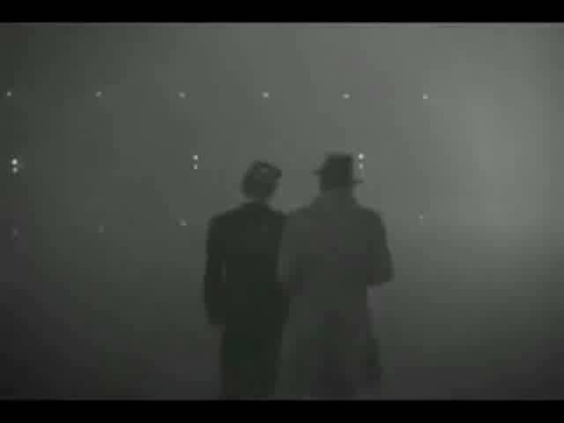

Slide 11
Break…
American Bar Association
Forum on the Construction Industry
2012 Fall Meeting

