Slide 1


Staying On An Even Keel:
Avoiding Problems On Green Projects
American Bar Association
Forum on the Construction Industry
Fall Meeting – 2012
Plenary 4
Moderator:
Joseph L. Seibold
ARCADIS
Steven M. Charney
Peckar & Abramson
Edward B. Gentilcore
Sherrard, German & Kelly, P.C.

Slide 2
AKA: THROUGH THE GREEN LOOKING GLASS
OBJECTIVE:
Discussing Strategies to Pursue Green/Sustainable Construction Without Falling Into the Rabbit Hole
Addressing Both Owner and Contractor Perspectives
Focusing on Key Case/Statute/Document Developments on Our Journey

Slide 3
WHERE DO WE BEGIN?
IS THERE ANYTHING ELSE TO SAY ABOUT GREEN?
Everybody is Doing It!
Green … Is Good
Green is New Wine in Old Bottles
Green is Full of Risk/Added Cost

Slide 4
BUT WHAT IF…?
…You No Longer Have a Choice to Go Green?
…Laws/Codes Now Specify Green?
…What Products You Specify or Use are Not Tested/Proven?
…Contracts Create Issues?
…Insurance and Surety Options Not Fully Defined?

Slide 5
How Did We Get to This Point?
USGBC’s LEED Program Has Defined the Dialog for Nearly Twenty Years
  Began as Voluntary Program
Growth/Proliferation Exploded
  Tax Incentives, Accelerated Permitting, Etc.
Hugely Successful Marketing Strategy
  Focusing on Key Elements, Including Reduced Impact of Buildings and Increased Energy Efficiency

Slide 6
What Can Be Bad About Green/LEED?
Required a new Contractual Paradigm to Accommodate Key Collaborative Elements
Saying to Comply with LEED or Achieve a Silver Rating Left Parties Adrift
Roles of Owner, Designer, Contractor Not as Well Defined as on Traditional Projects

Slide 7
What Can Be Bad About Green/LEED? (cont.)
New Technologies Mean New Uncertainty
  Chesapeake Bay Fdtn., Inc., et al. v. Weyerhaeuser Co. (MD 2010) (allegations Parallams/environmentally neutral coatings did not prevent water infiltration/damage)
  Dismissed on … statute of limitation defense
  Still intriguing due to representation angle
Consequences of Non-Compliance
  Often still beyond contract/parties’ control

Slide 8
The Industry Responds
American Institute of Architects (AIA) Develops the B214-2007
  One of First Form Documents to Address Anything Regarding LEED
  Longer on Protocol/Shorter on Responsibility for Consequences
ConsensusDOCS Launches the 310 Green Building Addendum in 2010
  Embraces/Defines the Collaborative Model

Slide 9
So Everything Is Good Now…?
Not Quite
  Note Timeline of Contract Development v. How Long LEED Has Been Around
  What Liabilities Are Still Lingering Out There/ What Can We Learn From Green Pioneers?
  Buildings Are Now Expected to be “Super Buildings”
  Environment Is Shifting Again…Dramatically

Slide 10
Watch Your Reps!
Representations Remain a Key Concern
  Objective of the Project?
  Have We Learned Our Shaw Lesson?
  Are We Tying Obligations to Actual/Objective Project-Based Performance Criteria?
  Are We Equilibrating Our Performance Obligations to Suppliers’/Manufacturers’
  Have the Parties Embraced Truly Collaborative Model and Avoided Quick Fix?

Slide 11
Watch Your Reps! (cont.)
Is anyone truly immune?
Gifford, et al. v. USGBC, et al.
  Originally began as a class action against USGBC and high ranking officials in October 2010
  Allegations of misrepresentation, false advertising, monopolization and conspiracy

Slide 12
Watch Your Reps! (cont.)
Gifford’s First Amended Complaint (FAC)
  No longer class action
  Only involves USGBC as Defendant, but more Plaintiffs
  Counts for False Advertising (Lanham Act § 43(a) and NY Consumer Protection Act violations, and common law claims for false advertising, and unfair competition and business practices

Slide 13
Watch Your Reps! (cont.)
Core allegations:
  LEED buildings not more energy efficient
  LEED does not verify that buildings designed/built to LEED actually lead to energy savings
USGBC Files Motion to Dismiss
  Gifford is a “gadfly”/“critic,” not a competitor
  lacks standing to sue USGBC
  emphasizes LEED is “purely voluntary”

Slide 14
Watch Your Reps! (cont.)
Other Arguments of Note:
  Says LEED is “aimed at improving environmental performance” and “does not assess actual…performance”
  LEED AP’s “offer expertise that the FAC does not allege the plaintiffs possess or market”
  LEED does not verify building performance just that they are “designed and built using strategies aimed at improving” performance

Slide 15
RESULT: CASE DISMISSED
Lack of Standing Over Federal Claims and Lack of Jurisdiction Over Remaining State Claims
So why do you still care about Gifford?
  USGBC already has been forced to state what LEED is/is not and purpose (e.g., “LEED is a voluntary nongovernmental rating system”)
  Speaks to broader concern of representing LEED as something it isn’t

Slide 16
Is THAT Enough? NO. Why?
Green is NOW Required
No Longer a Purely Voluntary Realm
If You Don’t Go Green, You Violate Laws
  New York City Local Law 86 of 2005
  New Mexico Executive Order 2006-0001
  Illinois Green Building Act/Green Guidelines for State Construction
  And, of course, CalGreen (Eff. 1/1/11)
    California Green Building Standards Code

Slide 17
Enter the IgCC (2012)
International Green Construction Code
Developed by the International Code Committee
  In Close Cooperation with ASTM, ASHRAE, AIA, the Green Building Initiative (read Green Globes) and … the USGBC
Applicable to Both New Construction and Alteration-Additions
Mandatory Minimums/Voluntary Options

Slide 18
IgCC In Profile
Regulatory Framework Establishing Minimum Green Requirements with Customizable Baselines
Overlay to Existing Codes, E.g., Int’l Energy Conserv Code and Nat’l Green Bldg Stndrd
ASHRAE 189.1 is Alt. Compliance Path
  Developed with ANSI and IES (USGBC too!)
  Performance based requirements/protocols

Slide 19
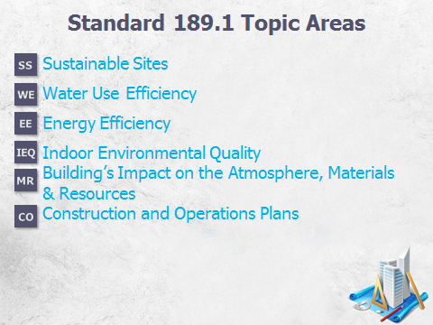
In ASHRAE’s Own Words

Slide 20
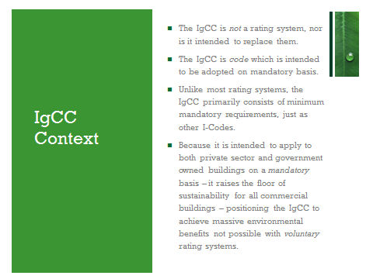
In IgCC’s Own Words

Slide 21
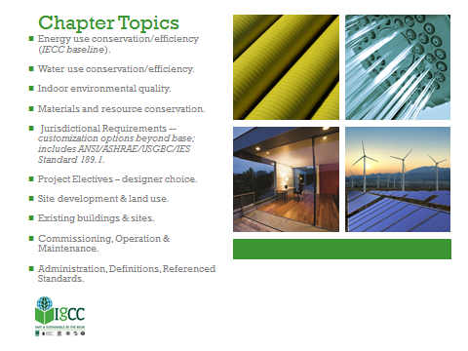
In IgCC’s Own Words

Slide 22
IgCC: Coming Soon to a Jurisdiction Near You . . .
However, already “adopted”
  in Rhode Island – Jan. 2011 (as alternative requirement for new public buildings)
  in Kayenta Township, Ariz. (first tribal community enactment as an optional requirement with mandatory applications still under consideration)
  in Richland, Washington (optional code)

Slide 23
IgCC: Coming Soon to a Jurisdiction Near You . . . (cont.)
in Maryland (Adopting MD. H.B. 972)
  Signed into law on 5/10/11/Effective Mar. 2012
  Optional requirement for new construction involving commercial buildings and residential buildings more than 3 stories http://www.iccsafe.org/newsroom/News%20Releases/NR-05102011-MdAdoptsIGCC.pdf
in AZ -- Phoenix Green Construction Code

Slide 24
Why Do You Care?
Must be aware of potentially mandatory codification of aspirational/consensus standards in play for your planned project
Certain contracts obligating Owner to identify laws and codes impacting project construction takes on significantly new meaning
  Q: Is the Owner best equipped party in this new paradigm to bear this responsibility?

Slide 25
Why Do You Care? (cont.)
Satisfying building code inspector now not only requirement for compliance (e.g., does green failure translate to no occupancy?)
  Q: What is the consequence in traditional project completion terms?
Changing codes (LEED beyond v2.2 / v3 / v4) vs. static laws
  Q: Can statutes/regulations keep pace?

Slide 26
What Do We Do?
Make sure Project’s goals/objectives clearly defined:
  Leafy-plaque/actual building performance/both
  LEED without the label (e.g., several communities in Minn. opting for this approach to save LEED costs
      Does it conflict with 2009 LEED Online (LOL3) ?
Confirm what legal/code requirements for green building exist in jurisdiction
  Assess req’d, not just incentive elements
ConsensusDOCS’ GBA supports approach

Slide 27
Speaking of Contracts…
ConsensusDOCS 310
  Created for instances where (most likely) separate underlying agreement is in place with entity who will become the GBF
  If no separate agreement, commercial terms must be addressed in separate agreement
  GBA accommodates attachment to separate underlying agreement forms in place

Slide 28
ConsensusDOCS 310
Adapts itself to multiple applications: GBF in hands of A/E, Contractor, CM or even third party consultant (hired by owner)
Adaptable to projects seeking LEED rating or other ratings such as Green Globes, Energy Star, and other high performance building goals
GBA designed for application in design/bid/build delivery model

Slide 29
ConsensusDOCS 310 (cont.)
Key feature of GBA is creation of Green Building Facilitator (GBF)
Emphasis on coordination, cooperation, collaboration and documentation required for/by various project participants
Intent is all primary project design/construction participants will have knowledge of roles/responsibilities of each as well as the GBF under the GBA

Slide 30
ConsensusDOCS 310 (cont.)
Emphasizes facilitative role of GBF
  Project participants encouraged to communicate terms of GBA to specialty contractors, subcontractors, material suppliers or others who may be assisting achievement of green building goals
Desired goal is all project participants are aware of each other’s roles and responsibilities as relate to achievement of green building objectives

Slide 31
ConsensusDOCS 310 (cont.)
Key Concepts Addressed:
  Who bears responsibility for various elements of green performance?
  Can it be answered by imposing responsibility in one place?
  Owner, Architect, Contractor, Etc.
  What are the consequences – who becomes liable for what?

Slide 32
ConsensusDOCS 310 (cont.)
1. General
2. Definitions
3. Green Reqmts/Procedures
4. Green Building Facilitator
5. Green Status
6. Green Measures
7. Plans And Specifications
8. Risk Allocation

Slide 33
ConsensusDOCS 310 (cont.)
In Plain Terms, the GBA:
  Guides the Green Process
  Commits to Key Definitions in Green Terms
  Sets Forth How Green Objective Selected
  Defines How Green Performance Measured
  Identifies Who Does What for Everyone to See
  Has Procedures Where Architect and Contractor Can Raise Concerns

Slide 34
ConsensusDOCS 310 (cont.)
In Plain Terms, the GBA:
  Provides Parameters of Collaborative GBF Role
  Allows for Changes on the Project Consistent with Specified Green Goals/Objectives
  Provides for Risk Allocation, But Only on Well-Defined Roles/Responsibilities
  Commits to Green-Based Liabilities Being Consequential Damages…
  But Allows Those to Be Adjusted/Disclaimed

Slide 35
What About the AIA?
The First Steps – B214-2007 Standard Form of Architect’s Services: LEED Certification
  To be used with existing Architect Agreement
  Specifically tied to LEED Certification Process
  Focus on process and procedures, but not in collaborative sense of ConsensusDOCS GBA
  No specific elaboration on requirements to include in construction documentation
  Does not set forth consequences for failure to achieve LEED Certification

Slide 36
What About the AIA? (cont.)
The Next Generation – B214-2012
  Requires Owner active performance of certain functions, e.g., to advise Architect of proposed changes to project impacting LEED Certification Plan
  Qualifies that LEED beyond Architect’s control
  Broad waiver of consequential damages
  Modifies Architect’s Instruments of Service control to allow for submission to GBCI
  Owner bears most responsibility for failure

Slide 37
What About the AIA? (cont.)
Does AIA Have an Agenda?
  B101 – Basic design agreement makes Architect an advocate for green
  Architect “shall” discuss with Owner whether feasible to incorporate sustainable elements
  Does this raise the standard of care?
  AIA recognizes standard of care issue, but considers it an “evolving concept” as sustainable design practices become more “accepted baseline standard”

Slide 38
What About the AIA? (cont.)
D503-2011, Guide for Sustainable Projects, including Agreement Amendments and Supplementary Conditions (May 2011)
  Provides issues to consider/suggested language to modify existing AIA documents
  Focuses on “sustainability” as the key term
  Appears to embrace rated/non-rated approaches
  Says no specific certification program endorsed

Slide 39
What About the AIA? (cont.)
D503-2011, Guide for Sustainable Projects, including Agreement Amendments and Supplementary Conditions (cont.)
  Recognizes possible impact of codification of sustainable requirements
  Acknowledges/allows for Architect to limit liability for failure of product performance
  Provides warnings on LOL3 conditions of registration

Slide 40
What About the AIA? (cont.)
D503-2011 notes LOL3 issues not covered by current AIA Family of Documents
  Project Registration Agreement, GBCI limits its monetary exposure and excludes simple negligence and breach of contract liabilities
  LEED Project Certification Agreement contains similar limitations on liability, plus indemnity
  Confirmation of Agent’s Authority places great deal of responsibility on Owner and makes Owner answerable for Agent’s actions

Slide 41
What About the AIA? (cont.)
A101-2007 SP Standard Form of Agreement Between Owner and Contractor for use on a Sustainable Project Where the Basis Of Payment Is a Stipulated Sum
B101-2007 SP Standard Form of Agreement Between Owner and Architect for use on a Sustainable Project
A201-2007 SP General Conditions of Contract For Construction for use on a Sustainable Project

Slide 42
What About the AIA? (cont.)
C401-2007 SP Standard Form of Agreement Between Architect and Consultant for use on a Sustainable Project
A401-2007 SP Standard Form of Agreement Between Contractor and Subcontractor for use on a Sustainable Project
Not to be Used with the D503-2011 Guide
Commits to Sustainable Measures and Sustainable Objectives Definitions

Slide 43
DBIA Presents a Design-Build Approach to Green
Sustainable Project Goals Exhibit
  Use with 525 (Lump Sum 2009 Ed.) or 530 (Cost Plus/With GMP Option 2009 Ed.)
  LEED - centric with credits to be identified in Basis of Design Docs.
  Does have “Legal Requirements” section
  Places burden on Owner to identify sustainable laws, codes, rules or standards
  “Remedies” section addresses consequences (e.g., waiver of claims, LD’s, cure … to a point)

Slide 44
Special Insurance Considerations
Be aware of possible limits of traditional coverages
May not reach warranties and guaranties
Some carriers are reacting with green-related policies
  Some include apparent coverage for LEED certification guarantees
  Another designed to handle reputational crisis
    Not clear whether failure to achieve certifications covered

Slide 45
Special Bonding Considerations
NASBP suggests full disclaimer
Alternative approach: only bond objective and verifiable performance requirements set forth in contract documents and not ratings or consensus standards
Revisit surety bonds regarding coverage for failure to achieve “green” objectives required by law/code
Be cautious in statutory bond scenarios

Slide 46
Concluding Thoughts
Green Still in Evolutionary Motion
Latest Trends Point in Mandatory Direction
Documents are Starting to Catch Up
Increased Risk/Liability Still Inevitable?
Is the Standard of Care Changing?
What Are You Actually Representing?
Most Trends Point to Owner Responsibility
Will the Pendulum Swing Back? And When?

Slide 47
Thank You For Attending!
Look to Your Written Materials for Articles Discussing These Points in Greater Detail
Also, You Will Find a Copy of This PowerPoint Presentation

Slide 48
Break…
American Bar Association
Forum on the Construction Industry
Fall Meeting – 2012

