Slide 1


Looking Towards the Horizon: Where Tomorrow’s Construction Dollars are Heading
American Bar Association
Forum on the Construction Industry
2012 Fall Meeting
Ken Simonson, Chief Economist
AGC of America
Kermit Baker, Chief Economist
The American Institute of Architects

Slide 2
Construction Recovery Has Taken an Unusually Long Time to Unfold
Access to credit still a big problem for construction industry;
Weak job growth, uncertain economic and political climate have made businesses nervous about capital expansions;
Energy costs – and other construction commodity prices – are unusually volatile given relatively weak economy;
European problems threaten financial system and limit U.S. exports;

Slide 3
However, Signs of Optimism Are Beginning to Emerge
Corporate profits past two years at pre-recessionary levels, giving companies potential for capital investment;
Manufacturing sector of the economy surprisingly strong; beginning to bring some production back to U.S. soil;
Construction market fundamentals (office vacancy rates, retail rents, hotel revenue per available room) are generally improving;
Housing market finally seems to be recovering;

Slide 4
Housing Market Issues
1. Housing recovery finally seems to be getting underway, but the magnitude of the upturn is still somewhat disappointing.
2. Falling house prices, a large inventory of distressed homes, and low mobility holding back stronger recovery.
3. Outlook is for continued gains over coming years, but still several years away from reaching long-term trend.
Notes:
Let’s start with what’s going on in the homebuilding market;
After an extremely steep downturn, we seem finally to have hit bottom, and are seeing the early signs of a recovery, but given how far we fell, this recovery continues to be an extremely disappointing recovery;
The problem is that we’re still dealing with some significant headwinds: namely weak house prices in many markets across the country; a large number of foreclosed homes; and low levels of mobility caused in larger part by households who are underwater with their mortgages;
The recovery that is getting underway is stronger in some parts of the country, but still looking for traction in others;

Slide 5
Almost Four Years Into Presumed Housing Recovery, Market Conditions Finally Beginning to Turn Up
Index: 1st quarter 2009 = 100
Sources: U.S. Department of Commerce; National Association of Realtors
Notes:
The principal housing indicators are pointing to an extremely tortured recovery; Given other things that were going on in the economy, we would have expected to see housing turn up beginning in early 2009; And in fact we did see a few quarters of relatively healthy growth beginning in the 1st quarter of 2009;
Historically, we have seen housing rebound 20% to 30% in the first year of a recovery, but this time the results were much more modest; And then, beginning around mid-year 2010 with the expiration of the first-time homebuyer tax credit, the major indicators began to turn down in the second half of 2010; 2011 also began on a weak note, and it hasn’t been until the past few months that we’ve signs of better progress;
Currently, new home sales are down 10% from where they were at the beginning of 2009 when we thought that we were at bottom; new homes are often competing with foreclosed existing homes which are typically deeply discounted; Existing home sales are up over 15% from what we thought was their low point; and seem to be on a healthy growth pace; housing starts are up over 30%, and seem to have benefitted from unusually warm weather in recent months in many parts of the country;

Slide 6
House Prices are Trending Up, But Haven't Shown Much Recovery Since Their Steep Decline…
Single-family house price index (Jan. 2000=100)
Source: CoreLogic National House Price Index (HPI), Single family combined, June 2012.

Slide 7
…Held Back in Large Part By Sales of Distressed Properties
Index Value (Jan. 2000=100)
Source: CoreLogic National House Price Index (HPI), Single family combined, June 2012. Distressed sales defined as REO and short sales.

Slide 8
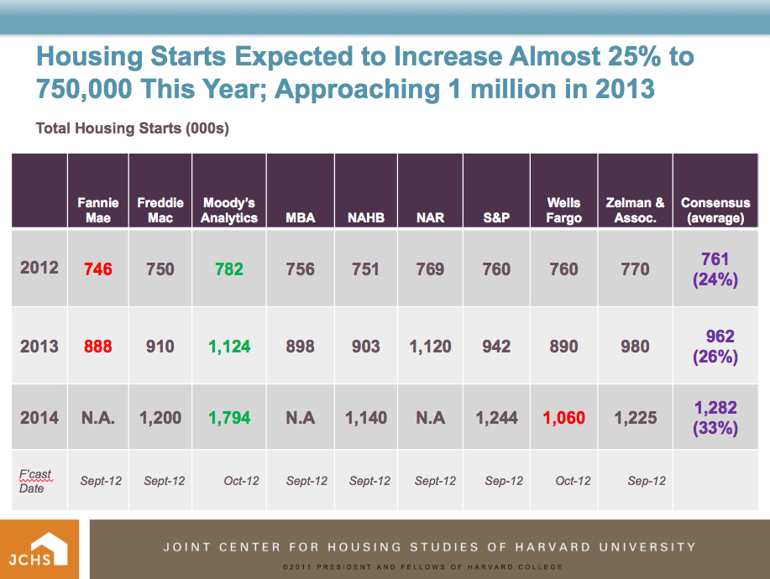

Slide 9
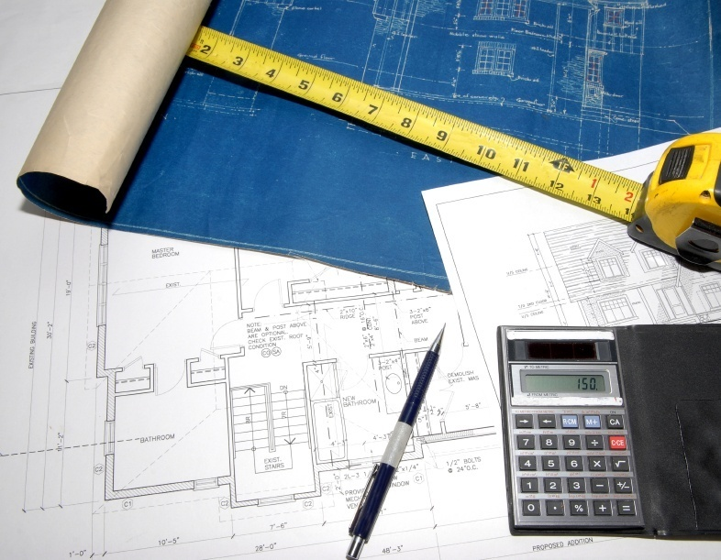
Business Conditions at Architecture Firms: The Outlook for Nonresidential Construction
Notes:
9
Let’s move on to recent trends in our ABI

Slide 10
Nonresidential Construction Issues
1. Nonresidential building downturn began later than housing bust, but decline in construction levels and prices has been nearly as dramatic.
2. However, with less overbuilding on the nonresidential side, downturn less likely to drag on.
3. Billings at architecture firms, a leading indicator of construction activity, have been sending mixed signals in recent months.
4. Expectations are for modest construction gains in 2012, and potential further improvement next year.

Slide 11
Since 1980, U.S. Nonresidential Building Construction Has Averaged 1.3 Billion Square Feet Per Year
Nonresidential building construction, billions of square feet
Source: McGraw-Hill Construction
Notes:
11

Slide 12
Downturn Has Been Extremely Severe for New Construction and Additions, But Not Alterations
Nonresidential building construction starts, billions $
Source: McGraw-Hill Construction.

Slide 13
As a Result, Alterations Share Typically Rises During Downturns
Construction starts, billions $
Source: McGraw-Hill Construction.

Slide 14
Commercial Property Values Fell Further Than House Prices, But a Recovery Appears to be Underway
Index Value (Dec. 2000=100)
Month
Notes: Data are normalized to 100 in December, 2000.
Source: CoreLogic National House Price Index (HPI), Single family combined, monthly data through July 2012; Moody’s/RCA Commercial Property Price Index–Core Commercial from Moody’s Investors Service and Real Capital Analytics (RCA) measures price changes in the retail, industrial and office market segments, through July 2012.

Slide 15
Architecture Billings Saw a Steep Decline During This Past Recession, But Have Begun to Recover in Recent Months
Billings scores since 1995; index: 50 = no change from previous month
Source: AIA Architecture Billings Index

Slide 16
Recent Downturn Has Pulled Down Commercial/Industrial Building Construction Sector
Billings scores since 2007; index: 50 = no change from previous month
Source: AIA Architecture Billings Index

Slide 17
Difficulty With Financing Rated as Most Serious Problem in Client’s Decision to Proceed on Project
Percent of firms rating as “very serious”
Source: The American Institute of Architects, September 2012.

Slide 18
Some Construction Sectors Recovering This Year; Overall Recovery Strengthens in 2013
billions $ of construction spending
annual % change
Source: AIA Consensus Construction Forecast Panel, June, 2012
Notes:
18

Slide 19
Population Growth Last Decade Was Dominated by College Age Population and Pre-Retirees
Population Growth, 2000 to 2010 (Millions)
Population growth 2000 to 2010 = 26.6 million
Source: US Census Bureau. 2000 and 2010 Decennial Censuses.

Slide 20
This Coming Decade, School Populations, Young Workers, and Active Retirees Dominate Growth
Population Growth (Millions)
Sources: US Census Bureau. 2000 and 2010 Decennial Censuses, and Projections of the Population by Selected Age Groups and Sex for the US: 2010 to 2050, Low Net International Migration Series, December, 2009.

Slide 21
Summing Up
1. Homebuilding finally recovering from historic lows – working through large inventory of distressed properties, and beginning to see prices edge up – but still well below long-term potential.
2. Nonresidential construction downturn has been most severe of several generations, and is currently running at half of its 3-decade average.
3. Nonresidential construction recovery appears to be on the horizon, but continues to be uneven and uncertain; commercial sectors expected to turn up before institutional.
4. Over the coming decade, growth heavily concentrated in seniors’ and young workers’ age ranges; construction activity focused on emerging demand of these populations.

Slide 22
Construction & Materials Outlook
October 12, 2012
Ken Simonson, Chief Economist
AGC of America
simonsonk@agc.org

Slide 23
Current economy; construction outlook
GDP, personal income, jobs: growing, but slowly
Office, retail up due to remodeling, not starts
Power, mfg., warehouse/distribution, lodging will grow
‘Shale gale,’ Panama Canal expansion driving new activity
Apartments should boom; single-family still a mystery
Federal, state, local construction cuts will continue
Unemployment dropping but only because workers leave
Materials costs not extreme but will outpace CPI
Source: AGC
23

Slide 24
One (or many) bright spot(s): the shale ‘gale’
Cody
Bakken
Gammon
Natural gas production
Trillion cubic feet (TCF)
862 TCF shale
2,543TCF total
67% increase in shale production 2007-10
Mowry
Antrim
Baxter-Mancos
Marcellus/
Devonian/Utica
Niobrara
Mancos
Lewis
Pierre
Mulky
New Albany
Woodford
Fayetteville
Barnett-
Woodford
Floyd-Neal
Barnett
Haynesville
Eagle Ford
Source: EIA Annual Energy Outlook, 2008 to 2011

Slide 25
Shale’s direct and indirect impacts on construction
Onsite: Each well requires access road, site prep, pad, storage pond, support structures, pipes
Nearby: Products, water require trucking, rail, pipeline, processing
Local spending by drilling firms, workers, royalty holders
Orders for fracking sand, drills, compressors, pumps, pipe, tanks, trucks, rail equipment, processing facilities
Downstream: Petrochemical, power, steel plants; LNG export terminals, fueling stations; LNG-powered vehicles
Losers: coal; maybe wind, solar, nuclear & suppliers
Source: AGC
25

Slide 26
U.S. Post-Panamax Ready Ports
Seattle & Tacoma
Columbia River at Mouth, OR & WA
New York-New Jersey
Oakland
Baltimore
Norfolk
Los Angeles/ Long Beach
San Diego (with tide)
Charleston (with tide)
Savannah
Jacksonville
Mobile
Miami
Source: U.S. Army Corps of Engineers
26

Slide 27
Panama Canal expansion’s impacts on construction
Ports: investing in dredging, piers, cranes, land access
Nearby: Storage, warehouse, trucking, rail facilities
Possible bridge, tunnel, highway improvements
Possible changes in inland distribution, manufacturing
Source: AGC
27

Slide 28
Construction spending (seasonally adjusted annual rate—SAAR )
Total construction, 1/08-8/12 (billion $)
Public, private nonres & private res, 1/08-8/12
Latest 1-month change: -0.6%
(-1.7%) (-0.8%) (0.9%)
12-month % change, 1/11-8/12
12-month % change, 1/11-8/12
Latest 12-month change: 6.5%
(7.2%) (-3.5%) (17.8%)
Source: Census Bureau construction spending reports

Slide 29
Nonres totals (billion $, SAAR), share & 12-month change
 | 8/12 Total |  | Share |  | 8/11-8/12
Nonresidential (priv.+federal+state/local) | $557 | billion | 100 | % |  | 2 | %
Power (incl. oil & gas struc., pipelines) | 85 |  | 15 |  |  | 12
Educational | 85 |  | 15 |  |  |  | -2
Highway and street | 81 |  | 15 |  |  | 4
Manufacturing | 48 |  | 9 |  |  | 6
Commercial (retail, warehouse, farm) | 46 |  | 8 |  |  |  | -2
Health care | 41 |  | 7 |  |  | 3
Transportation | 37 |  | 7 |  |  | 4
Office | 36 |  | 6 |  |  | 3
Sewage and waste disposal | 22 |  | 4 |  |  | 1
Communication | 17 |  | 3 |  |  |  | -4
Amusement and recreation | 15 |  | 3 |  |  |  | -4
Other (water, lodging; public safety; conservation; religious): 8% of total |  |  |  |  |  |  | -5
Source: Census Bureau construction spending report
29

Slide 30
Construction spending: public works (billion $, SAAR)
Latest 1-mo. change: -0.7%, 12-mo.: 4%
Latest 1-mo. change: 2.4%, 12-mo.: 1%
Amusement & recreation (57% public)
Latest 1-mo. change: -2.0%, 12-mo.: -4%
Latest 1-mo. change: -0.1%, 12-mo.: -13%
Source: Census Bureau construction spending reports

Slide 31
Construction spending: industrial, heavy (billion $, SAAR)
Latest 1-mo. change: -3.0%, 12-mo.: 12%
Latest 1-mo. change: -0.6%, 12-mo.: 6%
Public transportation facilities
Latest 1-mo. change: 0.2%, 12-mo.: 15%
Latest 1-mo. change: -1.6%, 12-mo.: 0%
Source: Census Bureau construction spending reports

Slide 32
Construction spending: institutional (private + state/local)
Latest 1-mo. change: -1.4%, 12-mo.: 31%
Latest 1-mo. change: -1.4%, 12-mo.: -9%
Latest 1-mo. change: -0.7%, 12-mo.: 3%
Latest 1-mo. change: -4.9%, 12-mo.: -6%
Source: Census Bureau construction spending reports

Slide 33
Construction spending: developer-financed (billion $, SAAR)
Latest 1-mo. change: -0.3%, 12-mo.: 4%
Latest 1-mo. change: -0.5%, 12-mo.: 10%
Latest 1-mo. change: -2.1%, 12-mo.: -7%
Latest 1-mo. change: -0.1%, 12-mo.: 34%
Source: Census Bureau construction spending reports

Slide 34
Priv. residential spending, permits, starts: single- & multi-family, 2008-12
Single-family & improvements spending
Latest 1-mo. change: 3.7%, 12-mo.: 45%
▬SF: 1-mo 2.8%, 12-mo 21% ▬ Imp:1-mo -1.7%, 12-mo 11%
Multi-family permits & starts
Single-family permits & starts
▬ Permits (1-mo -3.0%, 12-mo 35%)
▬ Starts (1-mo -4.9%, 12-mo 35%)
▬ Permits (1-mo 0.2%, 12-mo 19%)
▬ Starts (1-mo 5.5%, 12-mo 27%)
Source: Census Bureau construction spending, housing starts reports

Slide 35
Housing outlook
SF: improvement so far but distressed and ‘shadow’ inventory will depress prices, limit new construction
MF: Upturn should last throughout 2012 and 2013
  Vacancy rate is now at 10-year low; rents are up
  Rental demand should rise as more people get jobs
  But condo market continues to have large overhang
  And government-subsidized market likely to worsen
The big mystery: Have preferences changed to favor renting, close-in locations (=> more MF, less SF)?
Source: Author
35

Slide 36
Construction vs. overall (un)employment, 9/10-9/12
Private sector added jobs since 2010, construction only since 1/11
Unemployment fell but construction added few jobs in 2 years
Thus, workers are leaving for other sectors, school, retiring
Construction vs. private employment, 9/10-9/12
(seasonally adjusted, cumulative % change since 9/10)
Unemployment rates
(September 2010-September 2012)
Private
3.6%
3,881,000
Construction
0.6%,
31,000
Source: BLS employment, unemployment reports

Slide 37
State construction employment change (U.S.: 0.4%)
8/11 to 8/12 (seasonally adjusted): 20 + DC up, 30 down
-10% or worse
-5.0% to -9.9%
-0.1% to -4.9%
0% to 4.9%
5.0% to 9.9%
10% or better
2%
0.3%
4%
-7%
NH
1%
2%
12%
2%
-5%
-5%
-3%
VT
-1%
-1%
-7%
6%
-10%
-0.2%
-4%
MA
-5%
1%
11%
-6%
3%
5%
9%
9%
-1%
-7%
-2%
CT
-6%
RI
8%
-5%
7%
-8%
-5%
DE
-5%
NJ
-6%
2%
6%
7%
-5%
-1%
-8%
-4%
-7%
MD
-0.4%
DC
15%
-14%
-0.2%
-3%
HI
3%
Source: BLS state and regional employment report
37

Slide 38
Material & labor costs vs. office & highway bid prices, 3/09-9/12
PPI for materials
ECI
PPI for offices
NHCCI
Source: Author, based on Bureau of Labor Statistics for Producer Price Indexes (PPIs) and Employment Cost Index (ECI); Federal Highway Administration for National Highway Construction Cost Index (NHCCI)

Slide 39
PPIs for inputs vs. bid prices, 1/11-9/12 (January 2011=100)
PPI for inputs to commercial structures
PPI for new offices
PPI for inputs for other nonres (highway, heavy)
Natl. Highway Construction Cost Index (NHCCI)
Source: Author, based on BLS reports (PPI), Federal Highway Administration reports (NHCCI)

Slide 40
Producer price indexes for key inputs, 1/11-9/12 (January 2011=100)
Steel mill products
Copper & brass mill shapes
Gypsum products
Lumber & plywood
Source: Author, based on BLS producer price index reports

Slide 41
Producer price indexes for key inputs, 1/11-9/12 (January 2011=100)
No. 2 diesel fuel
Concrete products
Asphalt paving mixtures & blocks
Prepared asphalt & tar roofing & siding materials
Source: Author, based on BLS producer price index reports

Slide 42
Outlook for materials
Industry depends on specific materials that:
  are in demand worldwide
  have erratic supply growth
  are heavy, bulky or hard to transport
Construction requires physical delivery
Thus, industry is subject to price spurts, transport bottlenecks, fuel price swings
Expect 2-4% Dec-Dec PPI increase but volatility still a risk
Source: Author
42

Slide 43
Summary for 2012
Private nonres spending: +10 to +15% (more power, pipelines, mfg., warehouse, hospitals, maybe higher ed)
Public: -2 to -5% (highways, educational 0%, other transp. -5%; continued weak state-local spending)
Res: +10% to +15% (SF and imp. up a bit, MF very strong)
Total construction spending: +5 to +9%
Materials costs: +2 to +4% Dec.-Dec.
Labor costs: +1.5% to +2.5%
Source: Author
43

Slide 44
Trends: 2013-2017
Total construction spending: +6% to +10% per year
- less housing, retail; declining public spending
- new drivers: shale-based gas & oil; Panama Canal widening; more elderly & kids, fewer young adults
Materials costs: +3% to +8% (vs. 2% to 3% for CPI)
Labor costs: +2% to + 4%
Bid prices: +2% to +5%
Source: Author
44

Slide 45
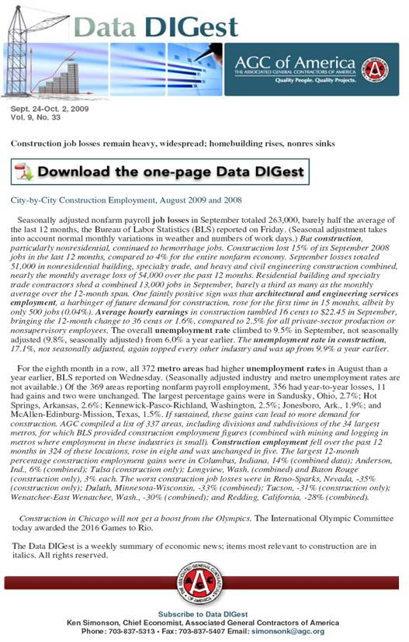
AGC economic resources
(email simonsonk@agc.org)
The Data DIGest: weekly 1-page email (subscribe at: www.agc.org/datadigest)
5 monthly press releases: national, state, metro employment; spending; PPI
State and metro data, fact sheets
Webinars
Website: http://www.agc.org/Economics
45

Slide 46
