Slide 1


Workshop B
American Bar Association
Forum on the Construction Industry
Fall Meeting 2012
Straying Off Course:
What You Don’t Know Can Hurt You When Working Across State Lines
Daniel J. Goldberg
Ruberto, Israel & Weiner
J. Andrew Howard
Alston & Bird LLP

Slide 2
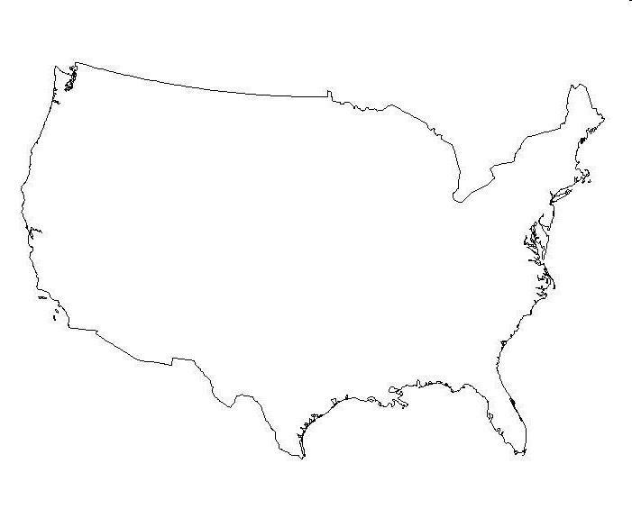
The Forum, Boston, 2012

Slide 3


Slide 4
workshop www.dictionary.com
work·shop
[wurk-shop]
noun
a seminar, discussion group, or the like, that emphasizes exchange of ideas and the demonstration and application of techniques, skills, etc.:
For example, a theater workshop; opera workshop or a Construction Forum workshop presented by Andy Howard and Dan Goldberg

Slide 5
Coordinating & Local Counsel
Coordinating Counsel
  Counsel engaged to oversee multi-state transactions and/or multi-jurisdictional disputes for a common client
  E.g. mass tort class action
Local Counsel
  Counsel engaged for a single transaction and/or single dispute, usually confined to a single jurisdiction

Slide 6
Why coordinating & local counsel?
Why coordinating counsel?
  Develop better understanding of business goals and objectives
  Develop (consistent) “global” strategies and procedures
  Knowledge management
  Identify, retain and supervise local counsel

Slide 7
Why coordinating & local counsel?
Why local counsel?
  Different states, different laws; different courts, different procedures
  “I may not know the law, but I know what’s right.”
  Political solutions unavailable to inside or national coordinating counsel

Slide 8
How do you best engage local counsel?
Public credentials vs. Word of Mouth
  Find someone who actually knows the attorney
Full service vs. specialized
Cost conscious

Slide 9
How do you best engage local counsel?
Dependable, frank
Deadlines have meaning
Advise of delays, unusual circumstances
Are you a team and does the GC want
to be involved?

Slide 10
Billing Practices
How are bills presented?
Detail, certain level of information (e.g. no block billing; task codes?)
Need to be billed to individual projects?
Do you want your coordinating counsel reviewing local counsel bills?
Do you want your coordinating counsel to pay your local counsel bills and then bill you?

Slide 11
State Differences that Matter: Liens, Bonds
PRIVATE PUBLIC
Bonds Possible Bonds Required
Deadlines, Notices
Liens Permitted Liens Prohibited
Deadline, Notices
Balance of Contract or Full Value
Liens on Funds

Slide 12
State Differences that Matter: Contract Laws, Issues Unique to the Specific State
Consistency of contracts in different states
Same party, different contracts with different GC’s- what happens if you take position in one state that is opposite to a position you are taking in another state?

Slide 13
State Differences that Matter
Contractual Indemnity
  Nearly every state has laws that restrict contractual indemnity clauses
  Indemnity for indemnified’s sole negligence, willful misconduct and/or intentional act or omission near universally void
  Handful of states prohibit indemnity where indemnified is cause in any degree

Slide 14
State Differences that Matter
Insured Contracts Exception
  Workaround to contractual indemnity laws
  Exception to contractual liability exclusion
  Provides insurance coverage for all losses resulting from personal injury or property damage, regardless of cause
  More and more states have passed limitations

Slide 15
State Differences that Matter
Contractor licensing issues
  State and/or local licenses required?
  Typical licensure requirements.
  Penalties for lack of licensure.
  Licensing consultants?

Slide 16
State Differences that Matter
Prevailing Wage Issues
  Subject to prevailing wages?
  Subject to living wages?
  Penalties for failure to pay proper wages.
  Recordkeeping requirements and best practices.

Slide 17
State Differences that Matter
Unauthorized Practice of Law
  What is the Unauthorized Practice of Law and when do you need local counsel?
  Can you sign the Lien?
  Can you sign the Notice?
  What can you say?
  Counterclaims (Resolved on the next job, and the “silo” effect)

Slide 18
Confidentiality
E-mails as Evidence
Who is cc’d on the e-mail?
Do you need “reply to all”?
Delete Chains
Are e-mails confidential?
Settlement

Slide 20
Confidentiality
Cell Phones
Develop and implement a mobile device policy
Determine the extent of access provided to employees
Should e-mail have enhanced protections?
Applications?

Slide 21
Communication: Expectations
Establish response expectations
Establish periodic update protocols
Updates for General Counsel?
Updates for Board?
No surprises!

Slide 22
Lunch….
American Bar Association
Forum on the Construction Industry
Fall Meeting 2012

