Slide 1

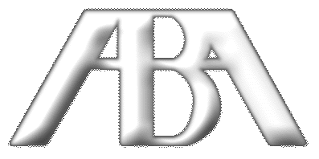

Workshop F
American Bar Association
Forum on the Construction Industry
Fall Meeting 2012
Who Is Allowed On The Dock?
What Construction Counsel Need To Know About E-Verify and Immigration Enforcement
Erin L. Ebeler
Woods & Aitken, LLP
Andrea G. Woods
Nabholz Construction Services

Slide 2
Workshop F: Who is Allowed on the Dock?
Part 1:
Why the I-9?: Completing, Retaining and Auditing the I-9 Employment Eligibility Form
Part 2:
E-Verify: What Is It, Why Do You Care, and
When Can You Be Required To Use It?

Slide 3
Why it Matters
The Immigration Reform and Control Act (“IRCA”) of 1986 prohibits employers from knowingly hiring illegal workers.

Slide 4
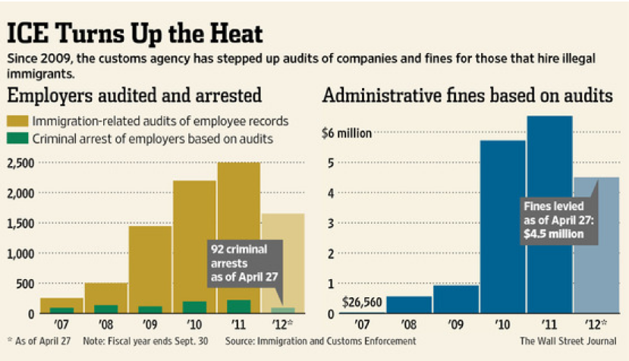
Why it Matters

Slide 5
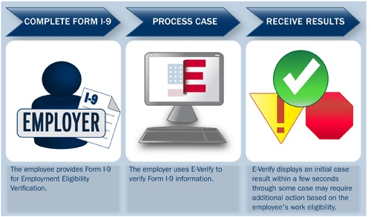
E-Verify & Form I-9s: Two Sides of the Same Coin

Slide 6
E-Verify & Form I-9s: Two Sides of the Same Coin
Form I-9
    All Employers MUST complete this form!
    This is the document the USCIS is auditing
E-Verify
    Supplements completion of Form I-9
    Internet-based system to verify employees

Slide 7

E-Verify & Form I-9s:
The Clock is Ticking
Form I-9 / E-Verify
    Must complete within 3 business days of employee’s first day of work for pay.
Only Acceptable Excuses for
E-Verify:
    Technical Outage
    Employee had applied for but did not yet have a social security number

Slide 8
E-Verify & Form I-9s:
The Clock is Ticking
 | Complete Form I-9 | Create E-Verify Case
The earliest you may: | The employee has accepted an offer of employment | The employee has accepted an offer of employment; and Form I-9 is complete
The latest you may: | The 3rd business day after the employee started work for pay | The 3rd business day after the employee started work for pay; and Form I-9 is complete
USCIS, What’s the Hire Date for E-Verify?
www.uscis.gov/e-verify

Slide 9
Form I-9
Why the I-9?: Completing, Retaining and
Auditing the I-9 Employment Eligibility Form

Slide 10
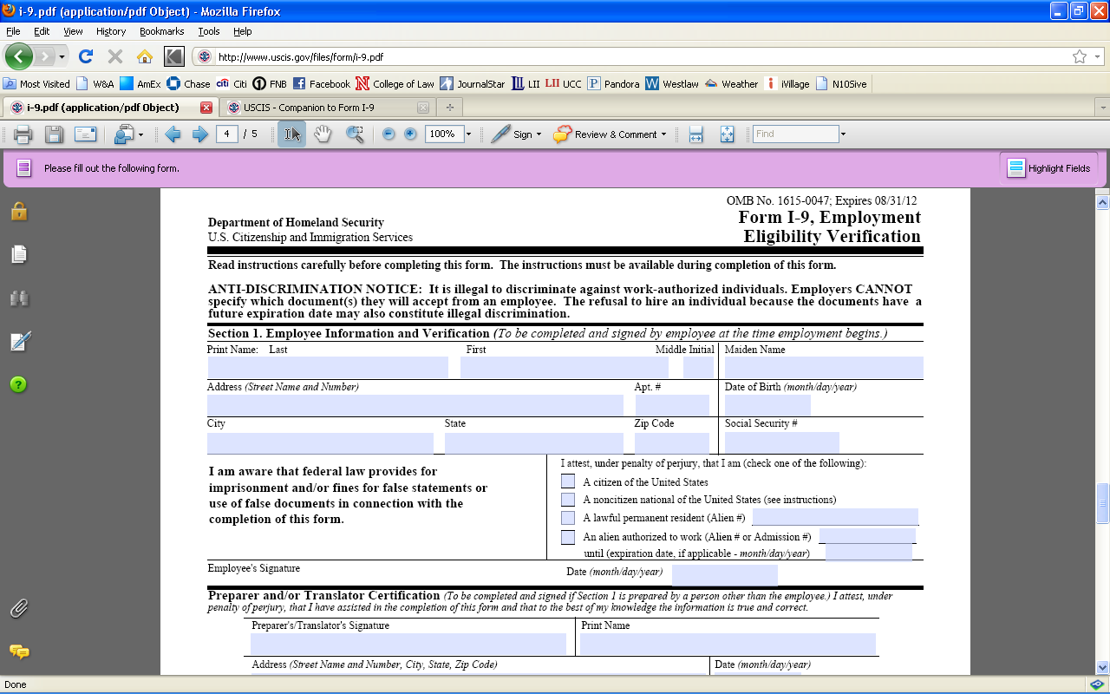
Form I-9

Slide 11
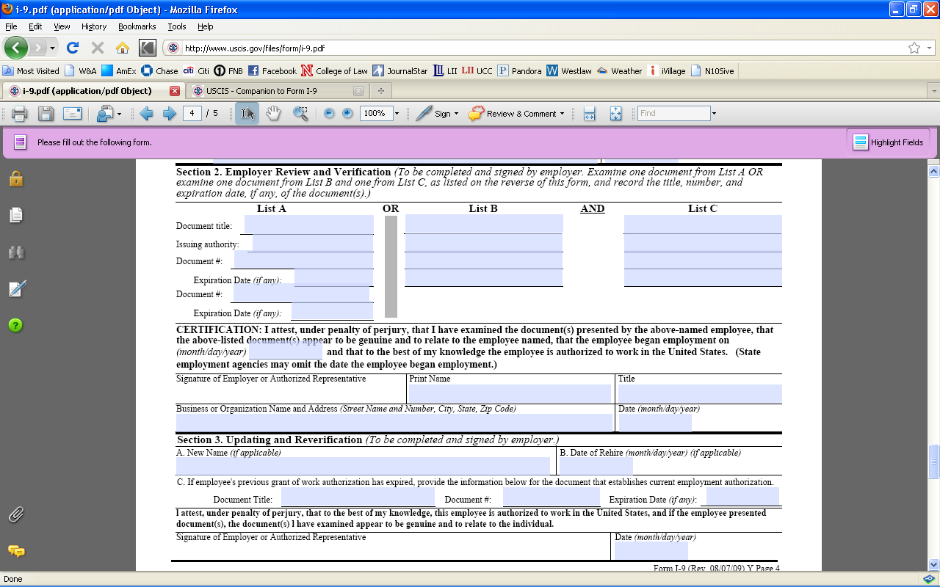
Form I-9

Slide 12
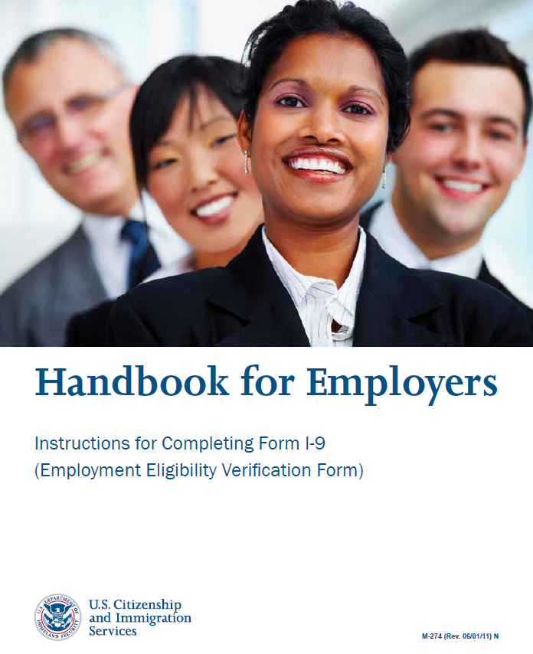
Form I-9: The Importance of Internal Audits
Train Your Employees to Fill Out the I-9 Properly the First Time.
    Handbook for Employers: Instructions for Completing Form I-9 (Employment Eligibility Verification Form)
    http://www.uscis.gov/files/form/m-274.pdf

Slide 13
Form I-9: The Importance of Internal Audits
Considerations in Conducting an Audit
  Have a schedule for completing Form I-9 audits. Avoid being accused of conducting targeted audits or of conducting an audit because you learned of an impending audit.
  Be consistent in the evaluation of the Forms I-9 and the treatment of employees to avoid claims of discrimination.

Slide 14
Form I-9: The Importance of Internal Audits
Considerations in Conducting an Audit
  Who: According to the Immigration and Customs Enforcement (“ICE”), audits should be conducted either by an external auditor or a trained employee who is not otherwise involved in the Form I-9 process.
  http://www.ice.gov/image/best-practice.htm

Slide 15
Form I-9: The Importance of Internal Audits
Considerations in Conducting an Audit
  When: ICE states that the audits should be done on an annual basis; however, ICE also recommends that there be a secondary review of each Form I-9 completed.
  http://www.ice.gov/image/best-practice.htm

Slide 16
Form I-9: The Importance of Internal Audits
What to Look For…
    Review which I-9s are in Your Files: Retain completed Forms I-9 for all employees for three years after the date that they hire an employee or one year after the date employment is terminated, whichever is later.
    Tips
      Consider separate files for current/former employees so that Form I-9s can be more easily purged at the earliest possible point.
      Keep an index with dates when each I-9 can be purged.

Slide 17
Form I-9: The Importance of Internal Audits
Index 1: Former Employees (Alphabetical)
Employee | Hire Date | Termination Date | 3 Years Past Hire Date | 1 Year Past Termination Date | Purge Date of Form I-9
Adam | 01/01/2000 | 12/31/2000 | 01/01/2003 | 12/31/2001 | 01/01/2003
Barb | 01/01/2000 | 02/01/2000 | 01/01/2003 | 02/01/2001 | 01/01/2003
Conner | 01/01/2000 | 12/31/2005 | 01/01/2003 | 12/31/2006 | 12/31/2006
Diane | 01/01/2000 | 12/31/2002 | 01/01/2003 | 12/31/2003 | 12/31/2003

Slide 18
Form I-9: The Importance of Internal Audits
Index 2: Former Employees (Purge Date)
Employee | Hire Date | Termination Date | 3 Years Past Hire Date | 1 Year Past Termination Date | Purge Date of Form I-9
Adam | 01/01/2000 | 12/31/2000 | 01/01/2003 | 12/31/2001 | 01/01/2003
Barb | 01/01/2000 | 02/01/2000 | 01/01/2003 | 02/01/2001 | 01/01/2003
Diane | 01/01/2000 | 12/31/2002 | 01/01/2003 | 12/31/2003 | 12/31/2003
Conner | 01/01/2000 | 12/31/2005 | 01/01/2003 | 12/31/2006 | 12/31/2006

Slide 19
Form I-9: The Importance of Internal Audits
What to Look For…
    Review each section of the Form I-9 to determine if properly completed.
      Any change should be initialed, dated, and identified as part of a self-audit.
      Ensure original information is still legible.
    Tips
      Keep an index of changes so that you can more easily demonstrate good faith compliance.
      Purge the index when you purge old Form I-9s.

Slide 20
Form I-9: The Importance of Internal Audits
Date of Audit: March 31, 2012
Employee | Issue Description | Suggested Resolution | Identity of Person Making Correction | Date of Correction
Calvin | Calvin forgot to check the appropriate box re: his citizenship / work auth. status. | Call Calvin and have him stop by to check the appropriate box | Calvin | 3/2/2012

Slide 21
Form I-9: The Importance of Internal Audits
Date of Audit: March 31, 2012
Employee | Issue Description | Suggested Resolution | Identity of Person Making Correction | Date of Correction
Hobbes | The number written on the Form I-9 for Hobbes’ passport doesn’t match the number on the copy of the passport retained with the I-9. | Date/Initial change made on the I-9 | H.R. Person | 3/20/2012

Slide 22
Form I-9: The Importance of Internal Audits
Date of Audit: March 31, 2012
Employee | Issue Description | Suggested Resolution | Identity of Person Making Correction | Date of Correction
Miss Wormwood | Miss Wormwood provided 2 List B items only. | Miss Wormwood died a 1 ½ years ago. Nothing can be done about this error at this time. | N/A | N/A

Slide 23
Form I-9: The Importance of Internal Audits
What to Look For…
    Are there persistent trends that indicate a need for re-training?
    Are new procedures necessary to ensure that Form I-9s are completed properly?

Slide 24
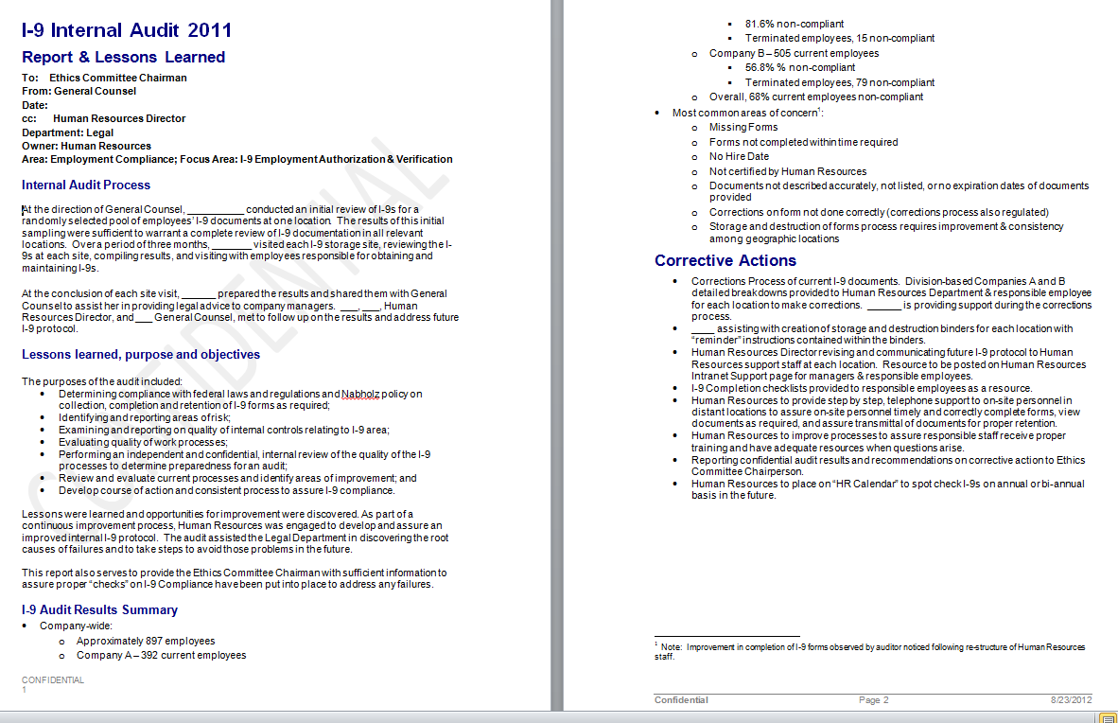
Form I-9: The Importance of Internal Audits

Slide 25
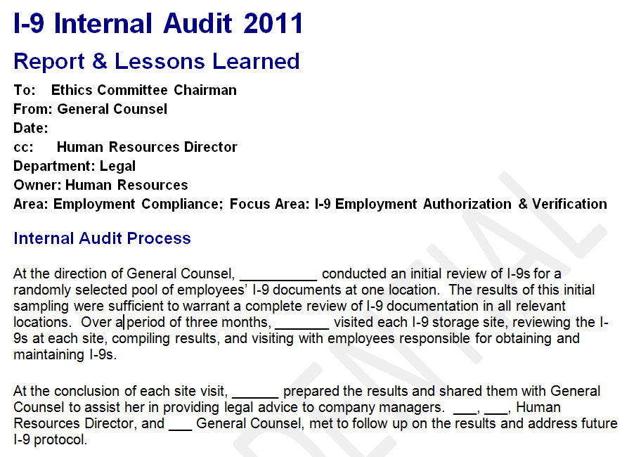
Form I-9: The Importance of Internal Audits

Slide 26
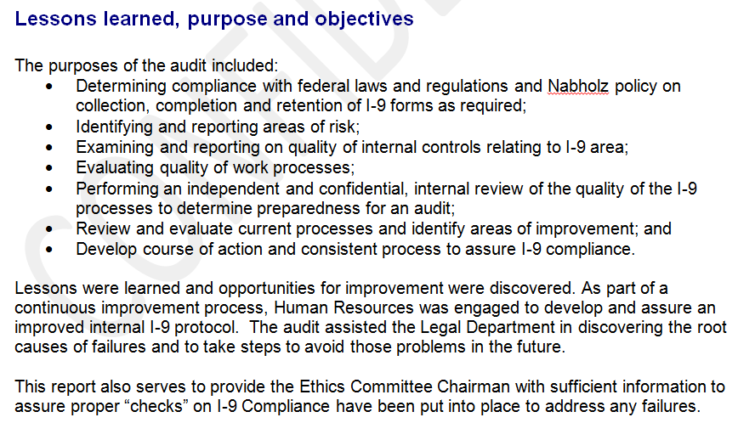
Form I-9: The Importance of Internal Audits

Slide 27
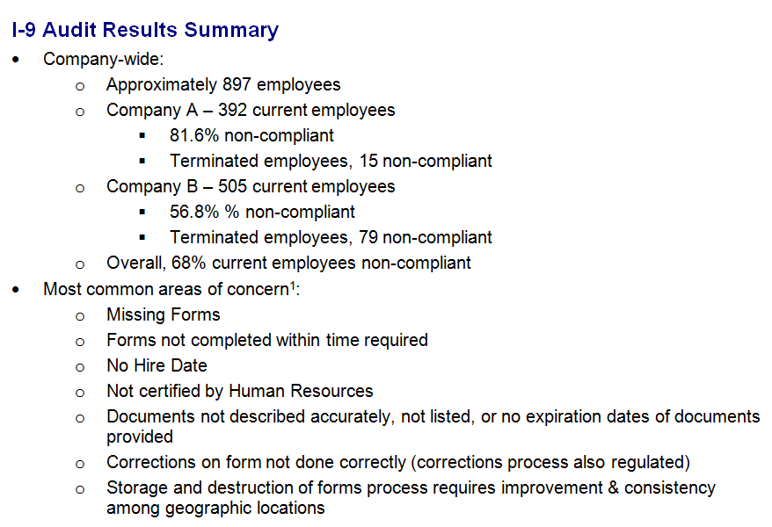
Form I-9: The Importance of Internal Audits

Slide 28
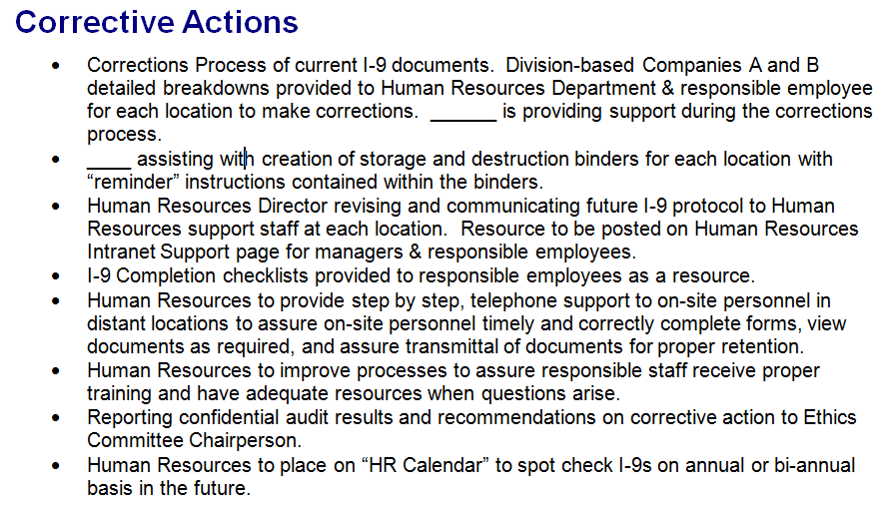
Form I-9: The Importance of Internal Audits

Slide 29
Form I-9: The Importance of Internal Audits
Penalties for Knowing Hire / Continuing to Employ Fine Schedule (for violations occurring on or after 03/27/2008)
 | Standard Fine Amount
Knowing Hire and Continuing to Employ Violations | First Tier $375 – $3,200 | Second Tier $3,200 – $6,500 | Third Tier $4,300 – $16,000
0% – 9% | $375 | $3,200 | $4,300
10% – 19% | $845 | $3,750 | $6,250
20% – 29% | $1,315 | $4,300 | $8,200
30% – 39% | $1,785 | $4,850 | $10,150
40% – 49% | $2,255 | $5,400 | $12,100
50% or more | $2,725 | $5,950 | $14,050

Slide 30
Form I-9: The Importance of Internal Audits
Substantive / Uncorrected Technical Violation Fine Schedule
 | Standard Fine Amount
Substantive Verification Violations | 1st Offense $110 – $1100 | 2nd Offense $110 – $1100 | 3rd Offense + $110 – $1100
0% – 9% | $110 | $550 | $1,100
10% – 19% | $275 | $650 | $1,100
20% – 29% | $440 | $750 | $1,100
30% – 39% | $605 | $850 | $1,100
40% – 49% | $770 | $950 | $1,100
50% or more | $935 | $1,100 | $1,100

Slide 31
E-Verify
What is it, why do you care, and when can you be required to use it?

Slide 32
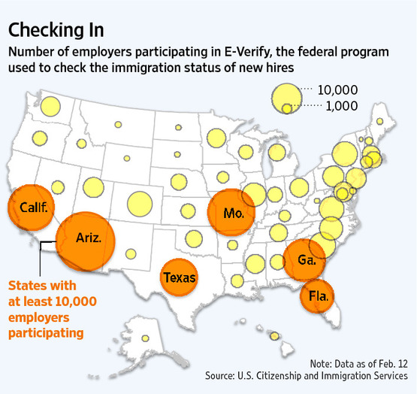
E-Verify
"With 26 million Americans unemployed or underemployed, expanding E-Verify would help open up jobs that they need," Rep. Lamar Smith (R., Texas).

Slide 33
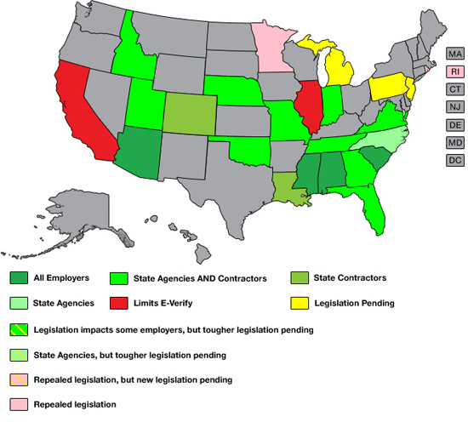
E-Verify
“E-Verify is a no-brainer for employers. For employers attempting to build immigration compliance, it's a fundamental component. For employers who continue to hire illegals, it provides some protection against adverse government action.”
--Mark Reed, former immigration agent
Notes:
California
AB 1236 - In October, 2011, Gov. Jerry Brown signed AB1236 into law. The law prohibits state municipalities from passing mandatoy E-Verify ordinances.
Georgia
SB 529 - Passed in 2006, SB 529 requires public employers, contractors and subcontractors with 500 or more employees to participate in E-Verify for all new employees, effective July 1, 2007. Public employers, contractors and subcontractors with more than 100 employees (but less than 500) must use E-Verify on or before July 1, 2008 and public employers, contractors and subcontractors with fewer than 100 employees must use E-Verify on or before July 1, 2009.
HB 87 - Passed in 2011, HB 87 requires all private businesses with more than 10 employees to use E-Verify. The phase-in began on July 1, 2011 and runs through July 1, 2013.
Illinois
HB 1774 - HB 1744 bars Illinois companies from enrolling in any Employment Eligibility Verification System until accuracy and timeliness issues are resolved. Illinois also enacted HB 1743, which creates privacy and antidiscrimination protections for workers if employers participating in E-Verify don’t follow the program’s procedures. On August 24, 2009, Illinois enacted S1133 prohibiting the state or localities from requiring employers to use an employment eligibility verification system.
Indiana
SB 590 - Passed in 2011, SB 590 requires state and local agencies and state and local contractors to use E-Verify. The bill also require private employers to use E-Verify in order to qualify for certain tax credits on their state income taxes.
Minnesota
Executive Order - In January 2008, Governor Tim Pawlenty issued an executive order effective, January 29, 2008, stating that all hiring authorities within the executive branch of state government as well as any employer seeking to enter into a state contract worth in excess of $50,000 must participate in the E-Verify program. The executive order expired 90 days after Pawlenty left office.
Emmer Amendment - In February, 2009, Rep. Tom Emmer offered and the State House approved an amendment requiring the mandatory use of E-Verify for anyone receiving funds from a $1 billion stimulus bill.
Rhode Island
Executive Order - In March 2008, Governor Carcieri issued an executive order requiring executive agencies to use E-Verify; and for all persons and businesses, including grantees, contractors and their subcontractors and vendors to use E-Verify. Shortly after taking office in 2011, Gov. Lincoln Chafee rescinded Gov. Carcieri's executive order.

Slide 34
E-Verify: Generally
Electronically checks Form I-9 information against records contained in Homeland Security and Social Security Administration databases.
Voluntary
Can only be used on NEW employees and must be used on ALL of them.
May NOT be used to screen applicants.

Slide 35
E-Verify: Generally
Must carefully follow the terms of the MOU or risk charges of discrimination and/or exclusion from E-Verify privileges.
Tentative Non-Confirmations are not sufficient grounds to terminate! You must follow the process!
    (When you don’t, you get to have lots of conversations with Department of Justice attorneys regarding document abuse and discrimination.)

Slide 36
E-Verify: Generally
Options when E-Verify Process is Performed:
    Employment Authorized
    SSA Tentative Non-Confirmation
    DHS Verification in Process
    (Typical: 24 hour response stating employment is authorized or giving a tentative non-confirmation)

Slide 37
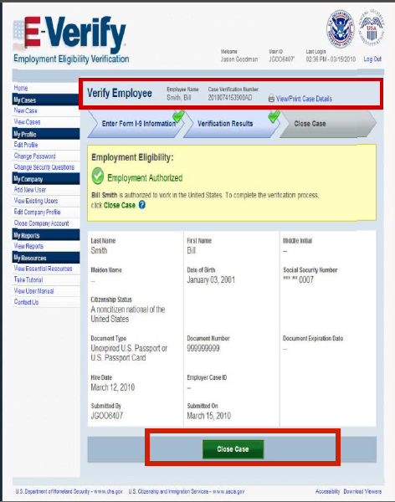

Slide 38
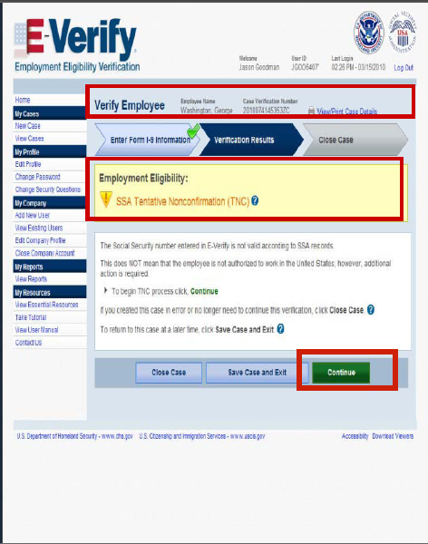

Slide 39
E-Verify: Federal Contractor Rule
Requires federal contractors to agree to use E-Verify to confirm the employment eligibility of all persons hired during a contract term, and to confirm the employment eligibility of federal contractors’ current employees who perform contract services for the federal government within the United States.

Slide 40
E-Verify: Federal Contractor Rule
Prime Contracts Covered: Those with a period of performance longer than 120 days and a value above $100,000.
Subcontracts Covered: The rule may apply to subcontractors if the prime contract includes the clause. For these subcontracts, covered subcontracts include those for services or for construction with a value over $3,000.

Slide 41
E-Verify: Federal Contractor Rule
Special Privilege…
Federal contractors may choose to verify their entire workforce, including current employees, regardless of whether those employees are assigned to a Federal contract.
Exceptions: Employees who were previously E-Verified or hired on or before November 6, 1986, cannot be verified in E-Verify.

Slide 42
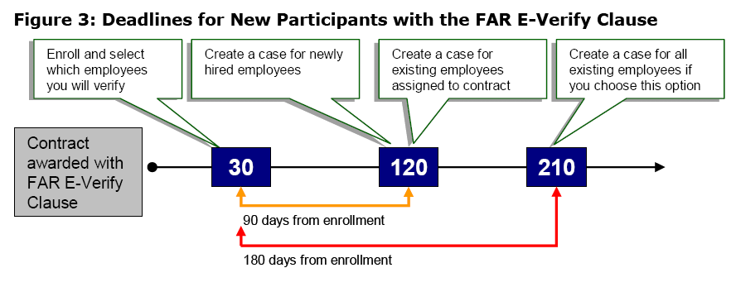
E-Verify: Federal Contractor Rule
Supplemental Guide for Federal Contractors (May 2011)
www.uscis.gov/e-verify

Slide 43
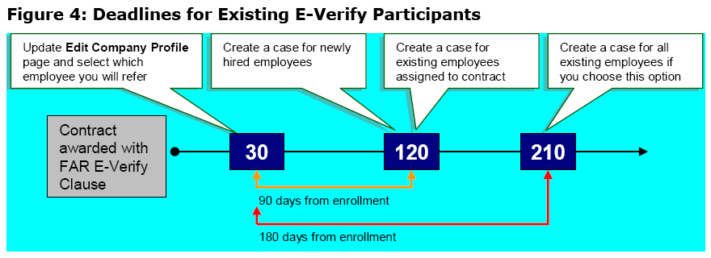
E-Verify: Federal Contractor Rule
Supplemental Guide for Federal Contractors (May 2011)
www.uscis.gov/e-verify

Slide 44
E-Verify: Federal Contractor Rule
WARNING!!!
Federal contractors may NOT use E-Verify to verify current employees until they are awarded a contract that includes the FAR E-Verify Clause.

Slide 45
E-Verify: Federal Contractor Rule
What to Do with Your Subcontractors…
  The prime contractor may be subject to fines and penalties if it knowingly continues to work with a subcontractor who is in violation of the E-Verify requirement.
  Subcontractor should provide the prime contractor a copy of its Edit Company Profile page in E-Verify, which can be printed directly from E-Verify.

Slide 46
E-Verify: State Laws
Illinois
  2007: Passed a statute prohibiting employers from participating in E-verify until the program met certain speed and accuracy requirements.
  September 2007: DHS sued Illinois in order to invalidate the statute.
  March 2009: Illinois Federal District Court invalidated the statute based on the supremacy clause

Slide 47
E-Verify: State Laws
Illinois
    2010: Illinois passed a less restrictive statute
      Before Enrolling Voluntarily: Encourages employers:
        To consult the Illinois DOL’s website for current information regarding accuracy of E-Verify.
        To review and understand legal responsibilities.
      Generally restates current E-Verity requirements
      Allows Illinois DOL to investigate and inspect

Slide 48
E-Verify: State Laws
Nebraska
  April 2009: Passed by Unicameral and signed by the Governor
  Vote: Nearly 90% of senators voted in favor of LB 403
    In favor: 44
    Against: 0
    Present, not voting: 3
    Excused, not voting: 2

Slide 49
E-Verify: State Laws
Nebraska
  As originally introduced, Nebraska LB 403 would have required all businesses to verify legal status of new hires. Those employers who would have knowingly hired undocumented workers would have been subject to sanctions.
  This is not what happened…but it might still.

Slide 50
E-Verify: State Laws
Nebraska
  Applies to:
    Employees of a state agency or political subdivision
    Anyone who has applied for “public benefits” administered by an agency or a political subdivision of the State.
  Public Benefits: Grants, contracts, loans, professional licenses, commercial licenses, welfare benefits, health payment or financial assistant benefits, disability benefits, and more!

Slide 51
E-Verify: State Laws
Nebraska
  Every public contractor must use the E-Verify program to determine the status of new employees physically performing services in Nebraska.
  Public contractor: Any contractor or his or her subcontractor who is awarded a contract by a public employer for the physical performance of services within the State of Nebraska

Slide 52
E-Verify: State Laws
Nebraska
  Contracts between public employers and public contractors MUST contain a provision requiring the public contractor to use E-Verify.
  Applies to contracts awarded October 1, 2009 and after.

Slide 53
E-Verify: State Laws
Nebraska Employee Classification Act
  It’s not just about independent contractors vs. employees
  Application is limited to those engaged in delivery services and construction.
  Only relates to contracts that are between the state or political subdivision and a contractor.

Slide 54
E-Verify: State Laws
Nebraska ECA
  Contractor must submit an affidavit stating that the contractor:
    Completed a Form I-9 and has it on file
    Complied with section 4-114 (requiring E-Verification of employees)
    Has no reasonable basis to believe that any individual is an undocumented worker

Slide 55
E-Verify: State Laws
Nebraska ECA
  Penalties
    First and Subsequent Violations: Knowingly providing a false affidavit shall be subject to the penalties for perjury.
    Second and Subsequent Violations: Contractor is barred from contracting with the State or any political subdivision for 3 years after the false affidavit is discovered.

Slide 56
E-Verify: State Laws
Georgia
  May 2011: E-Verify Required for All Employers with More Than Ten Employees
      Different effective dates depending on the number of employees you have working.
  Arizona-Style Component: Allows local law enforcement officers to question suspects about their immigration status.

Slide 57
E-Verify: State Laws
Indiana
  May 2011: SB 590 passed relating to E-Verify and numerous issues re: undocumented workers
  Obligated to use E-Verify
      State Agencies and Political Subdivisions
      Public Contractors and Subcontractors
      Certain Recipients of State Funds

Slide 58
E-Verify: State Laws
Indiana
  Reimbursement Obligations
    If the state pays unemployment benefits to an unauthorized alien who was knowingly employed, those benefits must be reimbursed by the employer.
    Law disallows certain state income tax deductions and credits that were taken by an employer, which are the result of employing an unauthorized alien.
  Safe Harbor: E-Verify

Slide 59
Division 6: Workforce Management and Human Resources
Monthly Calls:
Last Wednesday of Each Month
Dial In: 866-646-6488
Conference Code: 491-965-2344
12 Noon EST

Slide 60
American Bar Association
Forum on the Construction Industry
Fall Meeting 2012
Break….

