Slide 1


Plenary 2
American Bar Association
Forum on the Construction Industry
2013 Mid Winter Meeting
Contract Drafting To Reduce or Eliminate Damages
What Are The Limits?
Linda Dickhaus Agnant
The Agnant Law Firm
Jaimee L. Nardiello
Zetlin & De Chiara LLP
Buck S. Beltzer
Holland & Hart LLP
Joseph D. West
Gibson Dunn & Crutcher LLP

Slide 2




Fifty State Survey On Enforcement Of Limitation Of Liability Clauses
R. Thomas Dunn
Little Medeiros Kinder Bulman & Whitney, PC
Providence, RI
tdunn@lmkbw.com
401-272-8080
Kenneth H. Haney
Quarles & Brady LLP
Naples, FL
kenneth.haney@quarles.com
239-659-5050
Michael Kamprath
Thresher & Thresher P.A.
Tampa, FL
michael.kamprath@thresherpa.com
813-229-7744
Bruce W. Merwin
Haynes and Boone
Houston, TX
bruce.merwin@haynesboone.com
713-547-2116

Slide 3

SCENE 1
2006 Drafting Contract Documents for Trump’s New Naples Stadium

Slide 4

The Donald

Slide 5
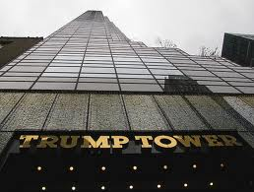

Slide 6
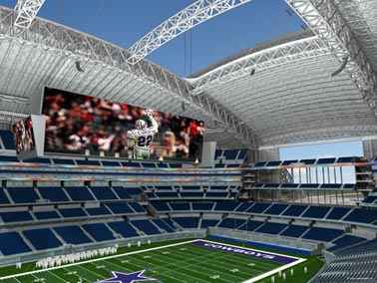
The Project

Slide 7

The Stadium

Slide 8


Slide 9
Limitations of Liability

Slide 10
Limitations of Liability
Three most recognized contractual provisions to limit liability:
(1) limit liability to certain claims;
(2) limit liability to fees paid; and/or
(3) limit liability to insurance recovery

Slide 11
Limitations of Liability
Limiting Liability to Certain Claims:
Statute of limitations
Differing site conditions

Slide 12
Limitations of Liability
Limiting Liability to Fees Paid
Dollar Cap
Don’t forget to include attorney’s fees!

Slide 13
Limitations of Liability
The liability of Consultant, and of Consultant’s employees and sub-consultants, to Client, including attorneys’ fees awarded under this Agreement, shall not exceed an aggregate limit of $50,000 or the amount of the fee, whichever is greater regardless of the legal theory under which such liability is imposed.

Slide 14
Limitations of Liability
Limitations to Insurance Recovery
“insurance coverage available at the time of settlement or judgment”

Slide 15
Limitations of Liability
Will your limitation of liability clause be enforceable?
Upheld in 36 states
Confirm the law governing your agreement permits a LOL clause
Be clear and unambiguous
Negotiate the terms
Don’t be overzealous
Confirm the contract provisions are not in conflict

Slide 16
Limitations of Liability
In a perfect world…
No monetary caps
All claims brought within one year
No added protections for differing site conditions

Slide 17
Waiver of Consequential Damages

Slide 18
Waiver of Consequential Damages
Make the party whole, by placing in the position that party would have been had the contract been performed
but must be reasonably foreseeable as a result of the breach
but not including remote losses

Slide 19
Waiver of Consequential Damages
Damages 101
“the basic purpose of contract damages is to make a party whole by putting it in as good a position as the party would have been had the contract been performed…a party is not entitled to recover damages not the proximate result of the breach of contract and those which are remote, contingent, and speculative in character.”
ABA Model Jury Instruction 10.02

Slide 20
Waiver of Consequential Damages
Consequential v. Direct
Direct damages flow naturally and necessarily from the breach and compensate for foreseeable or contemplated loss
Contract balance; cost to repair defective work
Consequential damages do not flow directly and immediately from the breach, but only from some of the consequences or results of the breach

Slide 21
Waiver of Consequential Damages
Examples - Contractor
Material Escalation
Inefficiency
Overtime/Cost of Acceleration
Extended jobsite overhead
Loss of early completion bonus
Lost Profits (this and other projects)
Home Office overhead
Loss of bonding capacity
Loss of reputation
Loss of financing

Slide 22
Waiver of Consequential Damages
Examples - Owner
Rental income
Diminution in value
Financing
Loss of use
Loss of income
Loss of profit
Loss of business reputation
Loss of management productivity
Insolvency

Slide 23
Waiver of Consequential Damages
Contract Drafting Tips
Generally enforceable if drafted correctly
Spell out definitions for “consequential damages”
One sided or neutral?

Slide 24
Waiver of Consequential Damages
In no event shall Owner be liable to Contractor for any indirect, special, incidental or consequential damage including, but not limited to, material escalation, inefficiency, overtime, cost of acceleration, extended jobsite overhead, lost profits, home office overhead, or loss of bonding capacity.

Slide 25
No Damages for Delay

Slide 26
No Damages for Delay
Basic Principal – Freedom of Contract
Generally Enforceable
Exception - Statutory
Exception - Traditional Contract Law

Slide 27
No Damages for Delay
Exception – Extraordinary Circumstances
fraud
willful or malicious or grossly negligent conduct
active interference
abandonment
uncontemplated delay

Slide 28
No Damages for Delay
Consider
Economic loss rule?
Liquidated damages or incentives?

Slide 29
No Damages for Delay
Owner shall not be liable to Contractor and/or any Subcontractor for any claims or damages caused by or arising out of delays. Contractor’s sole remedy against Owner for delays shall be an allowance of additional Contract Time.

Slide 30
Liquidated Damages

Slide 31
Liquidated Damages
Basic Principal
Compensation for Breach
Two Requirements
Actual damages are difficult to estimate
Liquidated amount must be reasonable estimate of damages
Key
Cannot be a penalty

Slide 32
Liquidated Damages
The contractor’s failure to achieve substantial completion by the contract completion date shall require the contractor to pay liquidated damages to the Owner in the amount of One Hundred Thousand Dollars ($100,000) for each day that substantial completion is delayed. …

Slide 33
Liquidated Damages
… Such liquidated damages are intended to represent estimated actual damages and are not intended as a penalty, and Contractor shall pay them to Owner without limiting Owner’s right to terminate this agreement for default as provided elsewhere herein.

Slide 34
Liquidated Damages
Substantial Completion Occurs When:
Stadium can be used for its intended purpose
City of Naples issues a Certificate of Occupancy
All systems are fully functional
All claims are resolved
All manuals and instructional materials have been delivered
All punch list items must be resolved

Slide 35
SCENE 2
2009 Construction is underway What does the contract actually say?

Slide 36
Limitations of Liability
The liability of Architect, and of Architect’s employees and sub-consultants, to Client, including attorneys’ fees awarded under this Agreement, shall not exceed an aggregate limit of $550,000 or the amount of the fee paid to Architect, whichever is greater regardless of the legal theory under which such liability is imposed.

Slide 37
Waiver of Consequential Damages
In no event shall Owner be liable to Contractor either party be liable to the other for any indirect, special, incidental or consequential damage including, but not limited to, material escalation, inefficiency, overtime, cost of acceleration, extended jobsite overhead, lost profits, home office overhead, or loss of bonding capacity, rental expenses, lost use, lost profit, lost financing, or lost profits.

Slide 38
No Damages for Delay
Owner shall not be liable to Contractor and/or any Subcontractor for any claims or damages caused by or arising out of delays, unless the delay is caused by acts of the Owner constituting active interference with the Contractor’s performance of the work. Contractor’s sole remedy against Owner for delays shall be an allowance of additional Contract Time.

Slide 39
Liquidated Damages
The contractor’s failure to achieve substantial completion by the contract completion date shall require the contractor to pay liquidated damages to the Owner in the amount of One Hundred Fifty Thousand Dollars ($100,000) ($50,000) for each day that substantial completion is delayed. …

Slide 40
Liquidated Damages
… Such liquidated damages are intended to represent estimated actual damages and are not intended as a penalty, and Contractor shall pay them to Owner without limiting Owner’s right to terminate this agreement for default as provided elsewhere herein.

Slide 41
Liquidated Damages
Substantial Completion Occurs When:
Stadium can be used for its intended purpose
City of Naples issues a Certificate of Occupancy
All systems are fully functional
All claims are resolved
All manuals and instructional materials have been delivered
All punch list items must be resolved

Slide 42
SCENE 3
2013 Things did not go well In the boardroom with Trump

Slide 43

Bruce Springsteen Concert
CANCELLED

Slide 44

Trump’s Finances

Slide 45
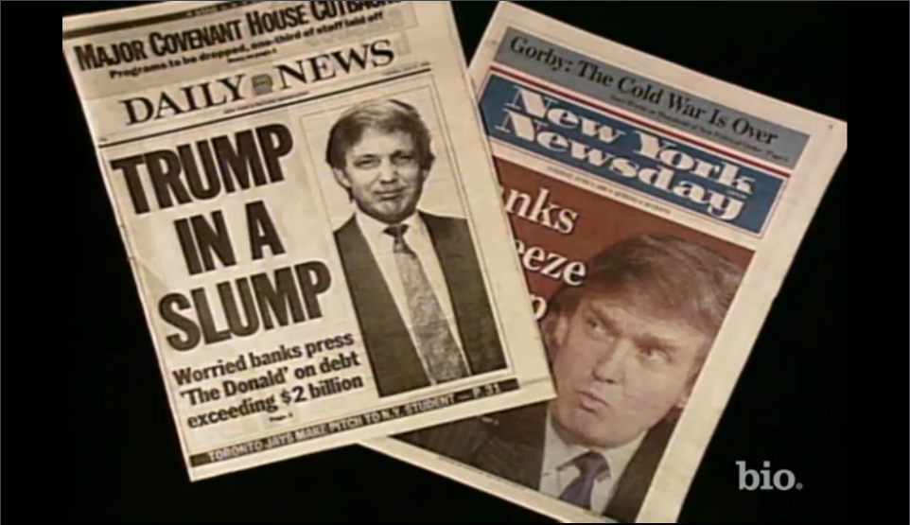
Trump’s Finances

Slide 46
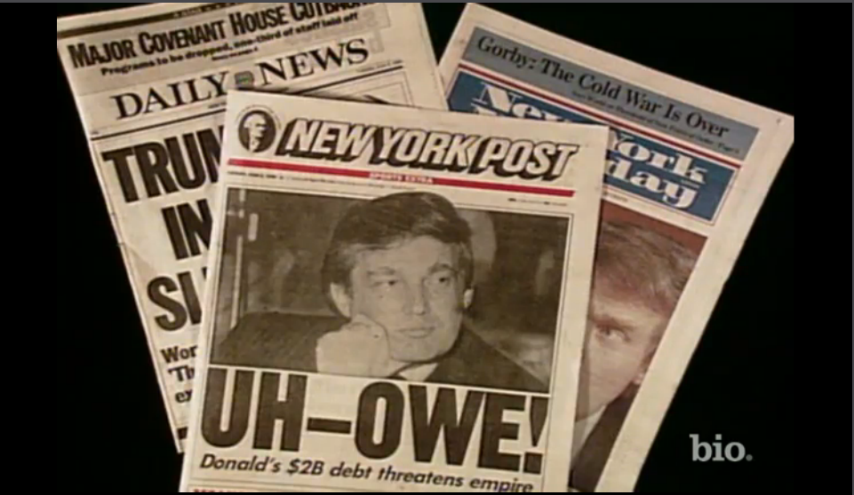
Trump’s Finances

Slide 47

The Inefficient Contractor

Slide 48

Gold Goal Posts
DELAYED

Slide 49
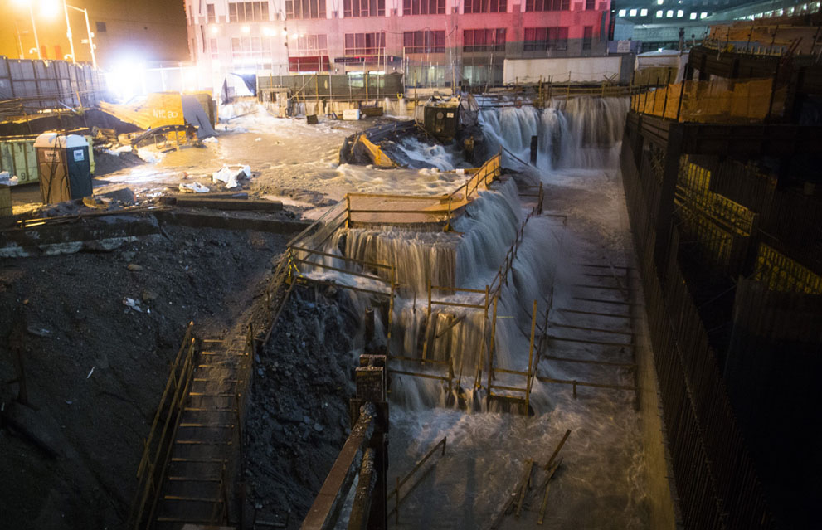
The Hurricane

Slide 50

The Missing Architect

Slide 51
Limitations of Liability
Professional Negligence
Ignored site administration responsibilities
Delayed approval of requisitions
Delayed responding to RFIs
Maximum liability is capped at his fee

Slide 52
Waiver of Consequential Damages
Owner and Contractor breached
Owner breaches: missing/inept architect; late gold goal posts
Contractor breaches: inefficiency, late completion of punch list
Acts of God: Hurricane
Both parties suffered both direct and consequential damages

Slide 53
Waiver of Consequential Damages
Mutual waiver means neither will recover their consequential losses from the other
Trump will not owe the Contractor for material escalation, inefficiency, etc.
But Trump will not recover the lost revenues associated with the Super Bowl relocation to New Orleans, or the cancelled Springsteen concert

Slide 54
No Damages for Delay
Uncontemplated Delay (the New York Approach)
Hurricane
OSHA Investigation for “Hair Hats”
Active Interference
Refusing to award change orders
Forbidding work without signed change orders

Slide 55
Liquidated Damages
Stadium was ready for use 210 days after completion date.
City issued C/O at that time
But
TV service to “Million Dollar” suites not operative for additional 200 days
Manuals for overhead doors on loading dock were delivered 250 days beyond the ready for use date
Punch list was not resolved until 300 days beyond the ready for use date
Therefore, LD’s = (210 + 300) x 50,000 = $25,500,000

Slide 56
Liquidated Damages
Many states are moving to a “Look Back” approach
Concept is to prevent windfalls
FORTUNATELY NEW YORK IS A SINGLE LOOK STATE

Slide 57


Slide 58

You’re All Fired

