Slide 1


“Graphics for Damages Presentations: Putting the Pow into Ow”
American Bar Association
Forum on the Construction Industry
2013 Mid Winter Meeting
PRESENTERS:
James D. O’Connor
Maslon Law Firm
Minneapolis, MN
Michael Boucher
Trial Consulting Services, LLC
Tampa, FL

Slide 2
Introduction
Computer generated evidence (“CGE”) is common today.
Animations and graphics are widely used in every forum (mediation, arbitration, trial).
CGE can be an effective and persuasive way to present what otherwise is simply a number crunching exercise: damages.

Slide 3
Presentation Techniques
Video camera overhead (Elmo).
Presentation Boards.
Interactive computer presentation; e.g. Trial Director.
Tablets; e.g. Ipad.

Slide 4
Legal Considerations
Demonstrative vs. Substantive.
Foundation.
Authentication.
Hearsay.
Scientific Evidence: Frye and/or Daubert.

Slide 5
Technical Considerations
Use the appropriate technique in the appropriate way.
Identify failure points.
Redundancy – Redundancy.
Support personnel (in-house v. outsource).
Coordinate with the court and opposing counsel.

Slide 6
Hypothetical
25-story commercial building.
16 month construction period.
GC encounters delay caused by concrete issues.
GC encounters delay caused by poorly coordinated design documents.
Project is delivered 60 days late.
Owner, GC, and Subs all claim economic damages.

Slide 7
Owner’s Damages
The owner is claiming damages for loss revenues, temporary housing on executed leases and additional financing charges.

Slide 8
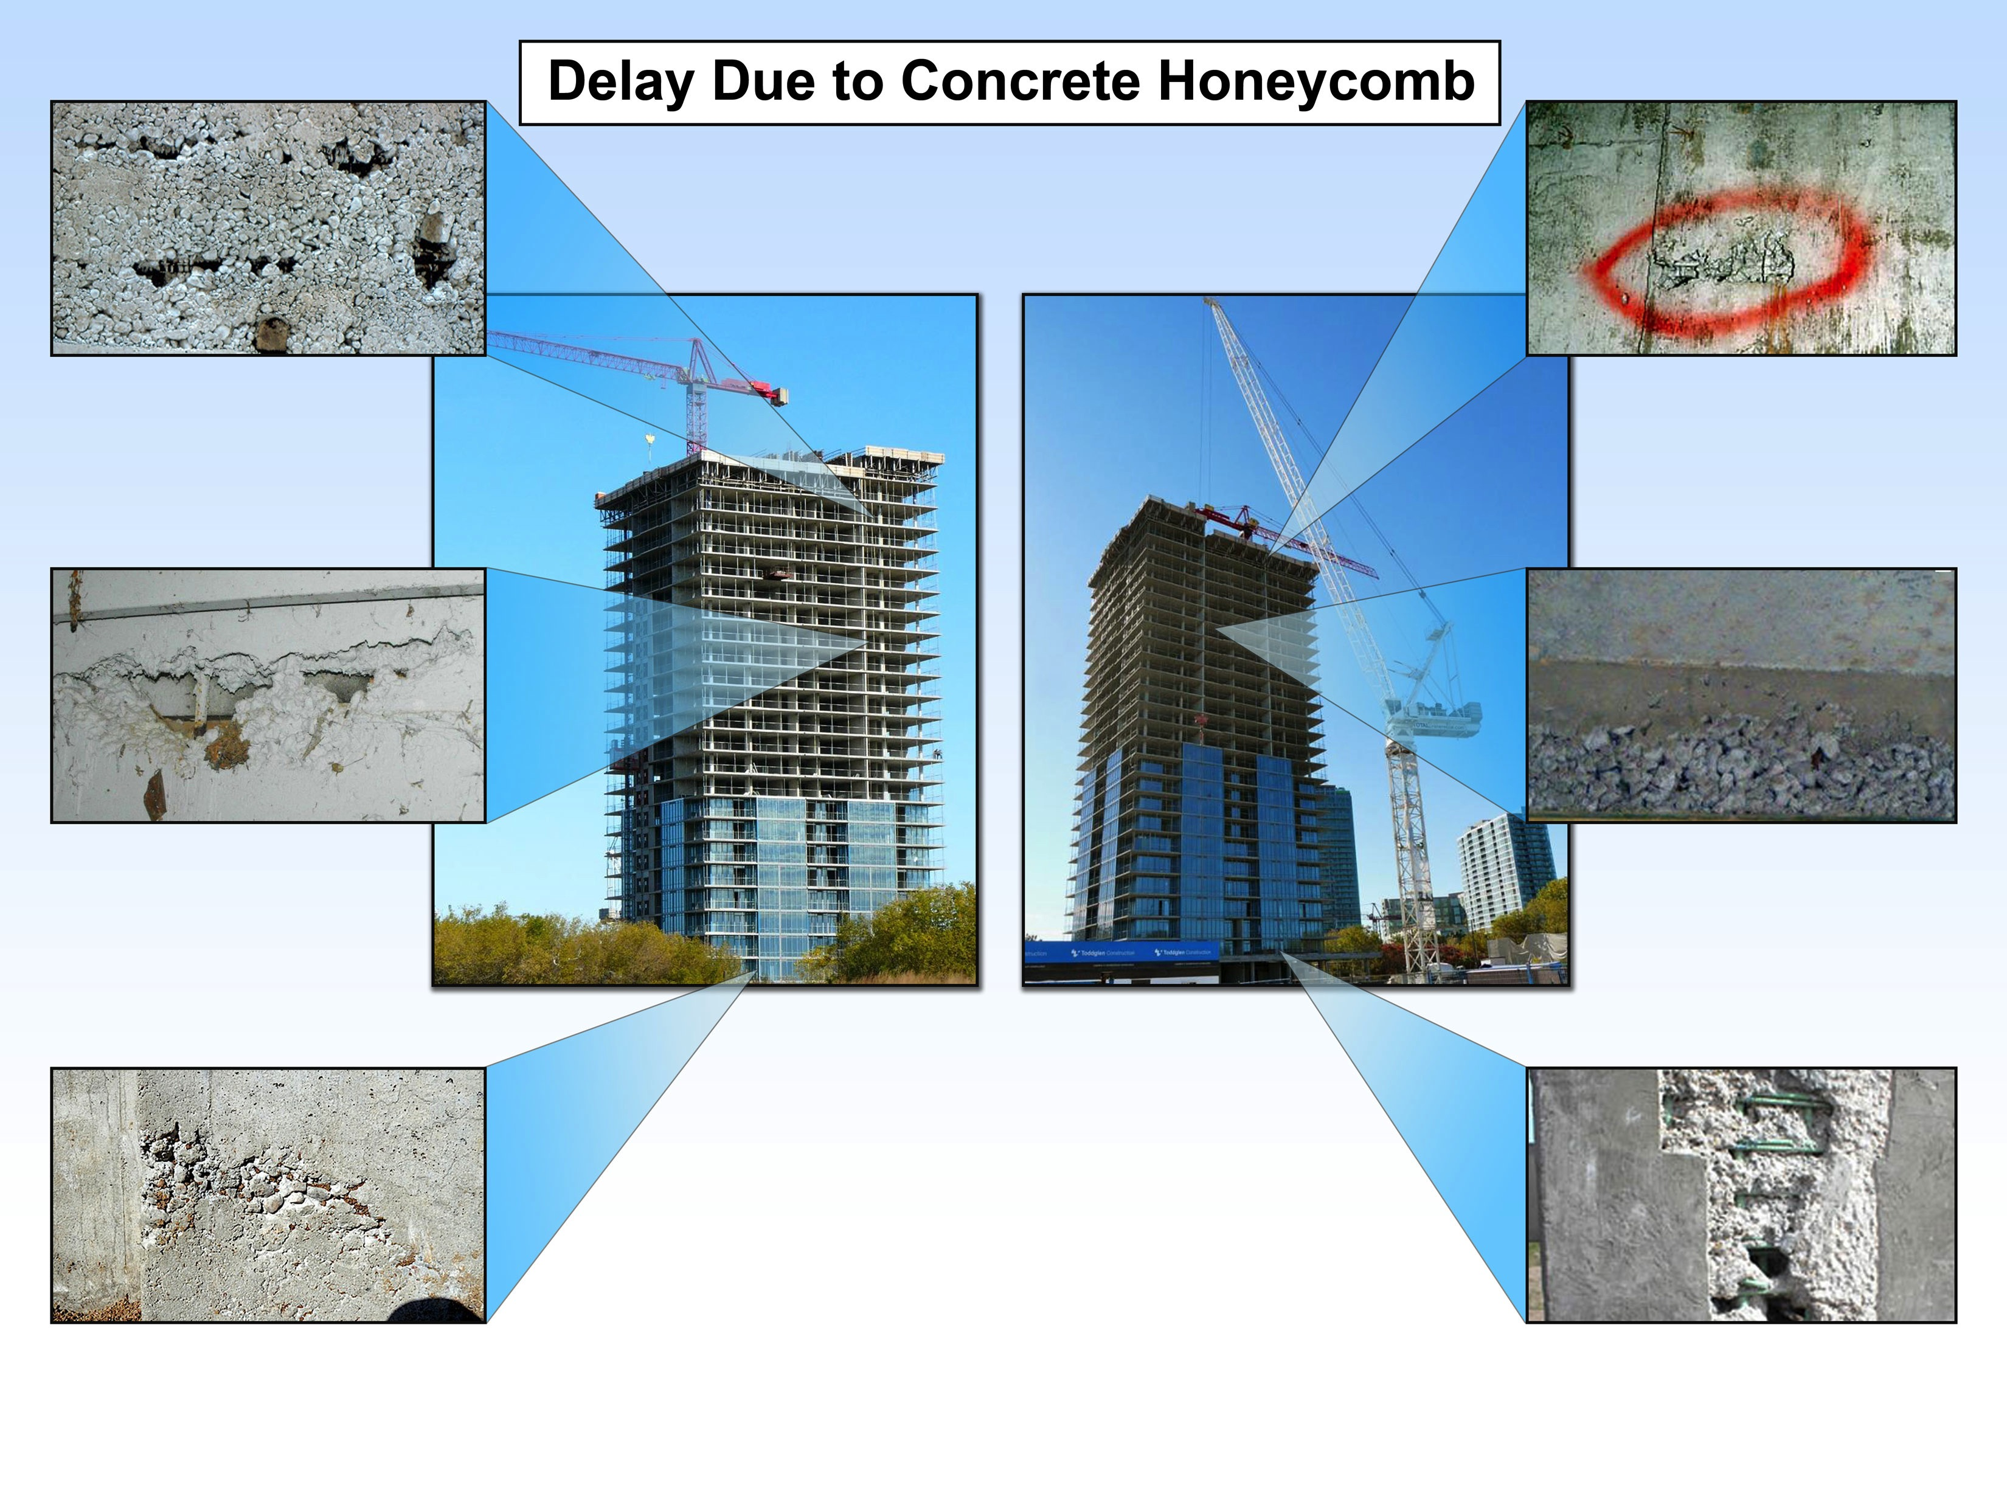
Owner’s Damages

Slide 9
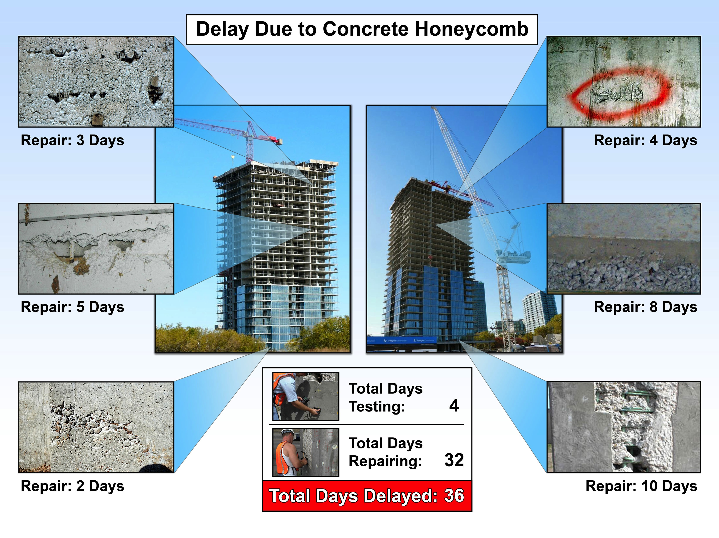
Owner’s Damages

Slide 10
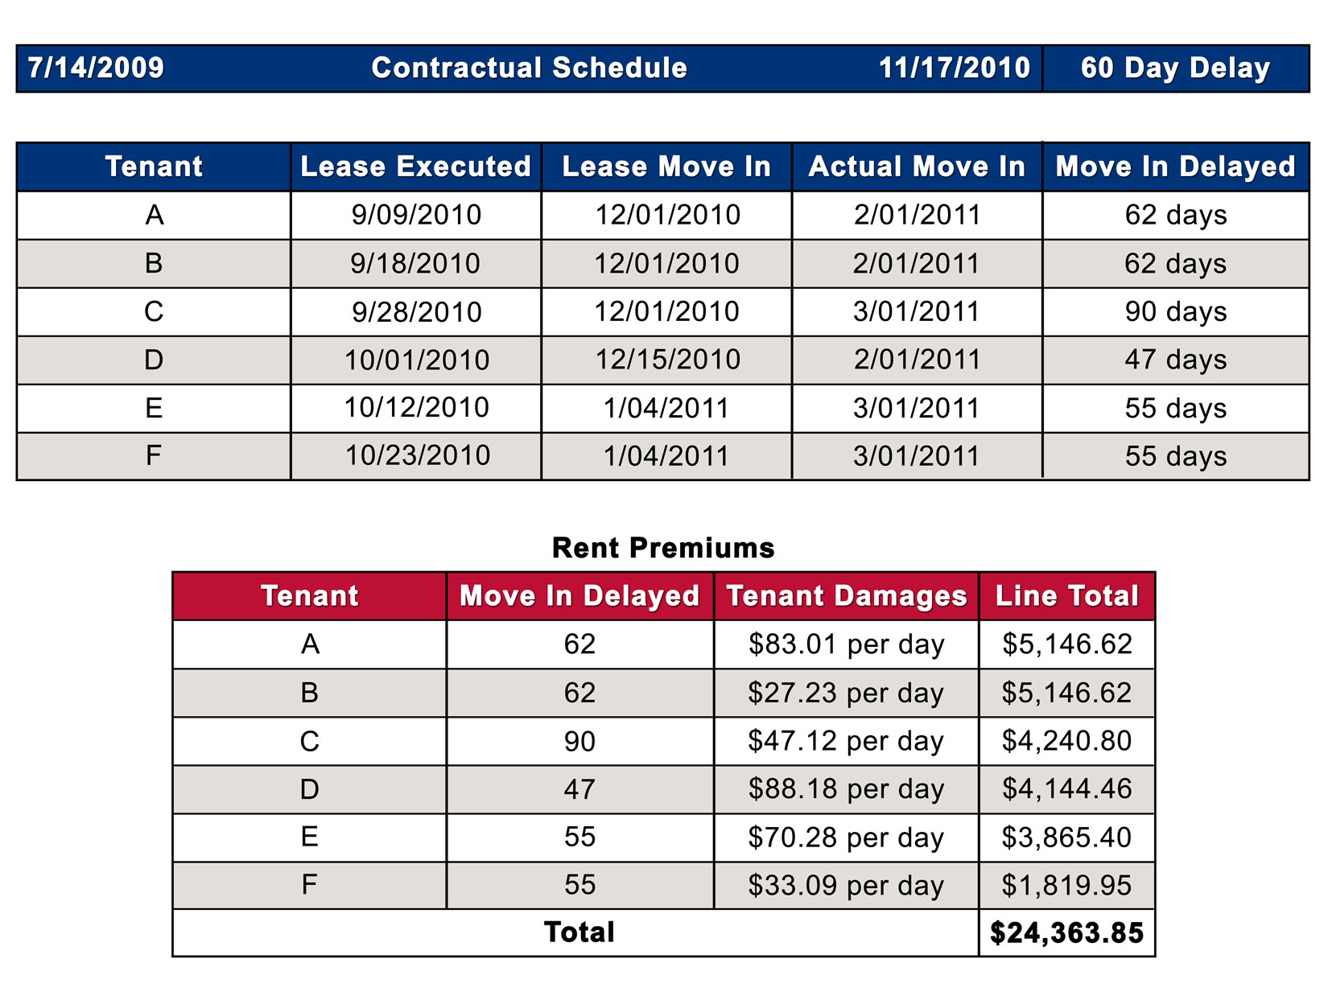
Owner’s Damages

Slide 11
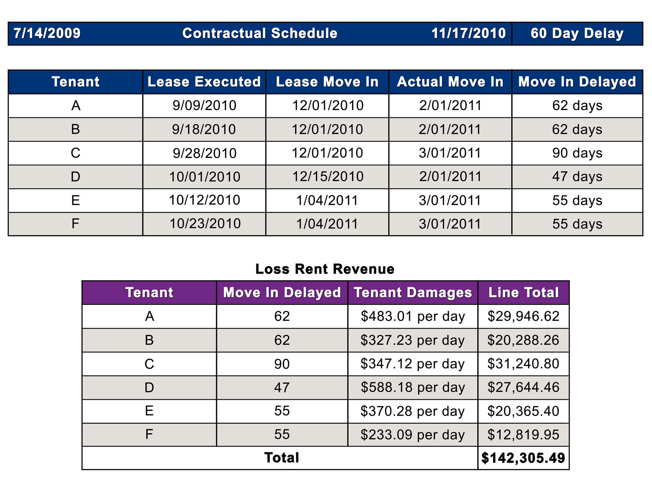
Owner’s Damages

Slide 12
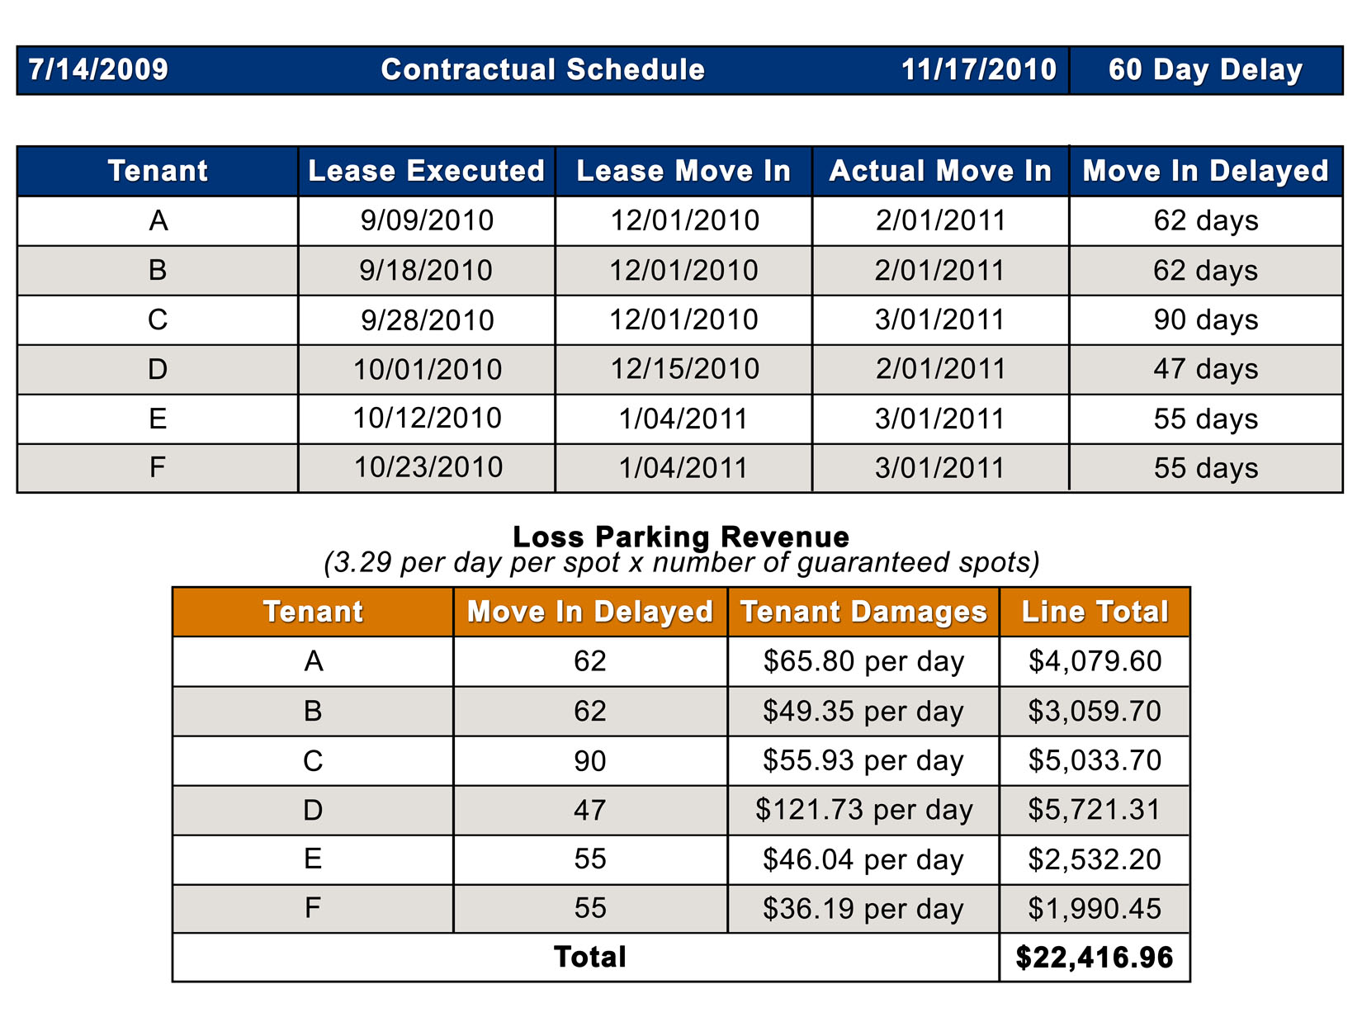
Owner’s Damages

Slide 13
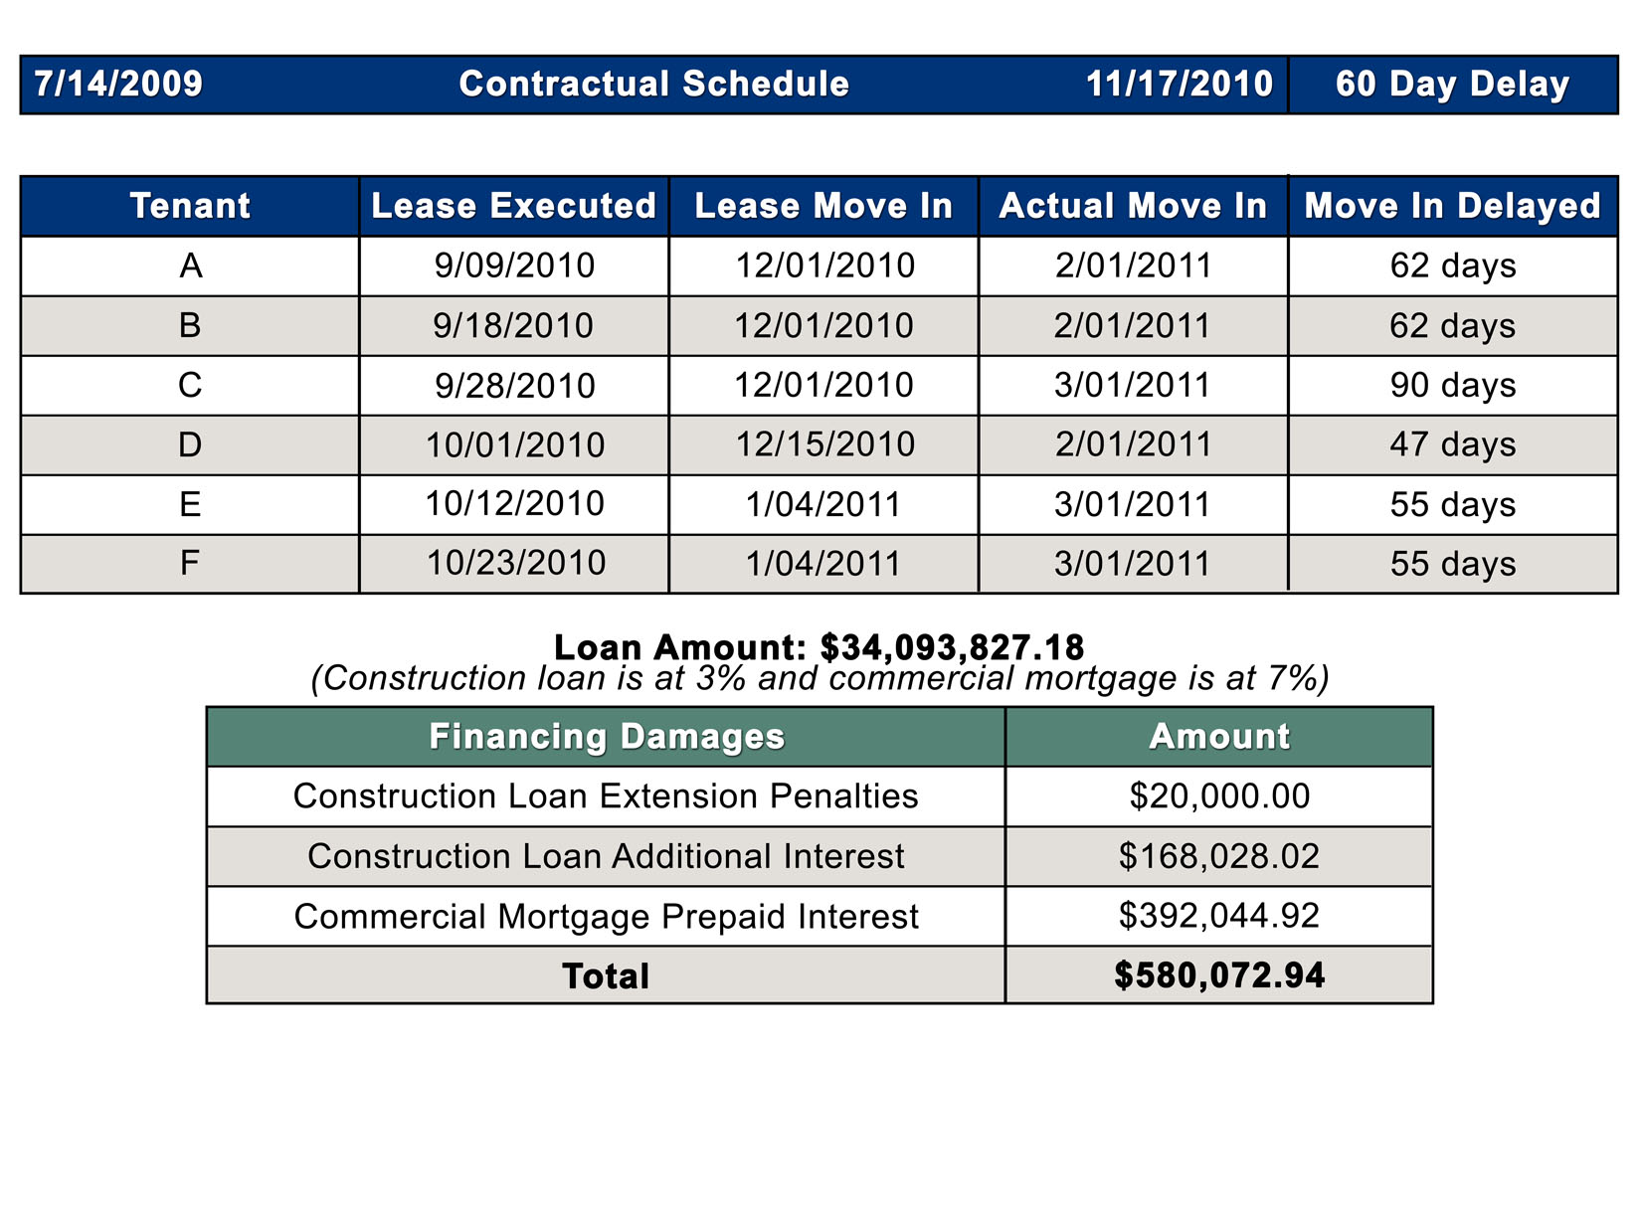
Owner’s Damages

Slide 14
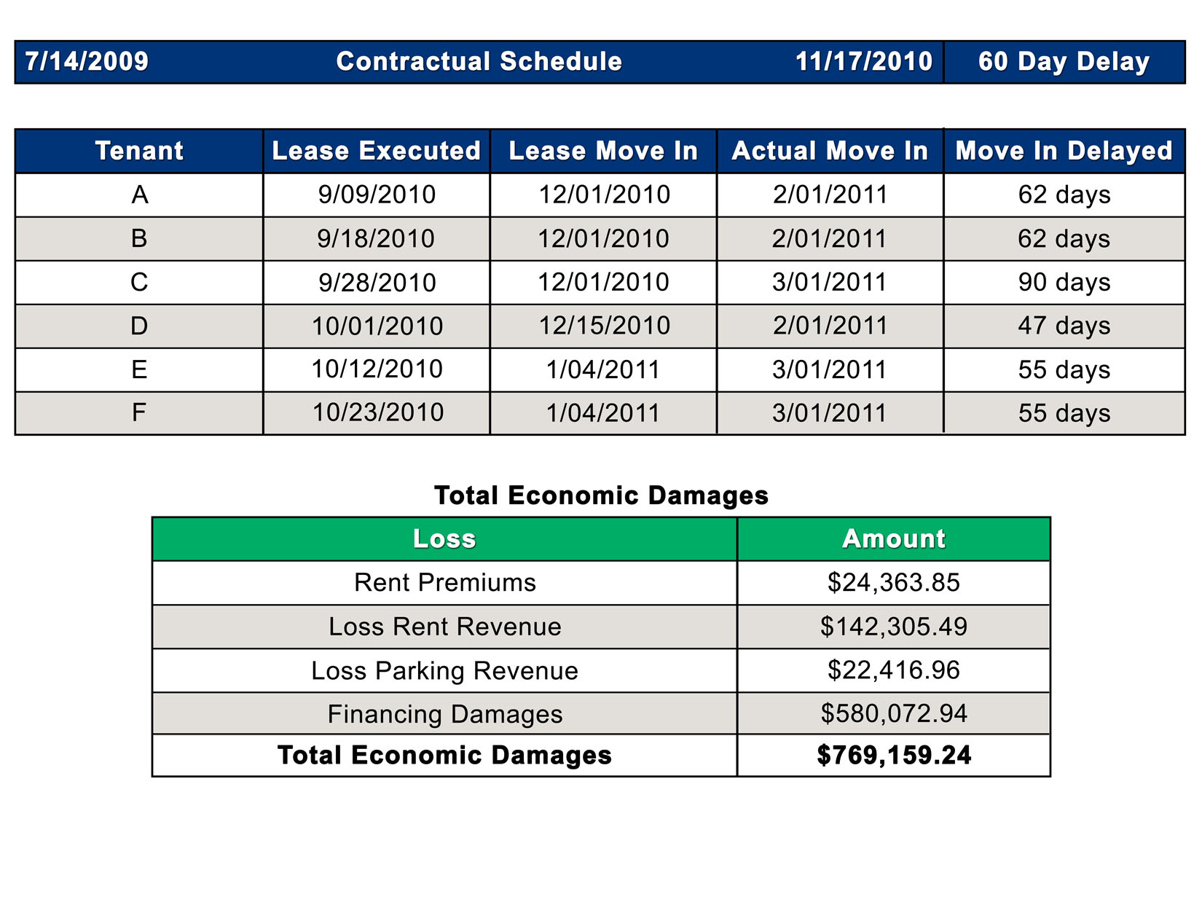
Owner’s Damages

Slide 15
General Contractor’s Damages
Contractor alleges that the delays are caused by poorly coordinated design documents.

Slide 16
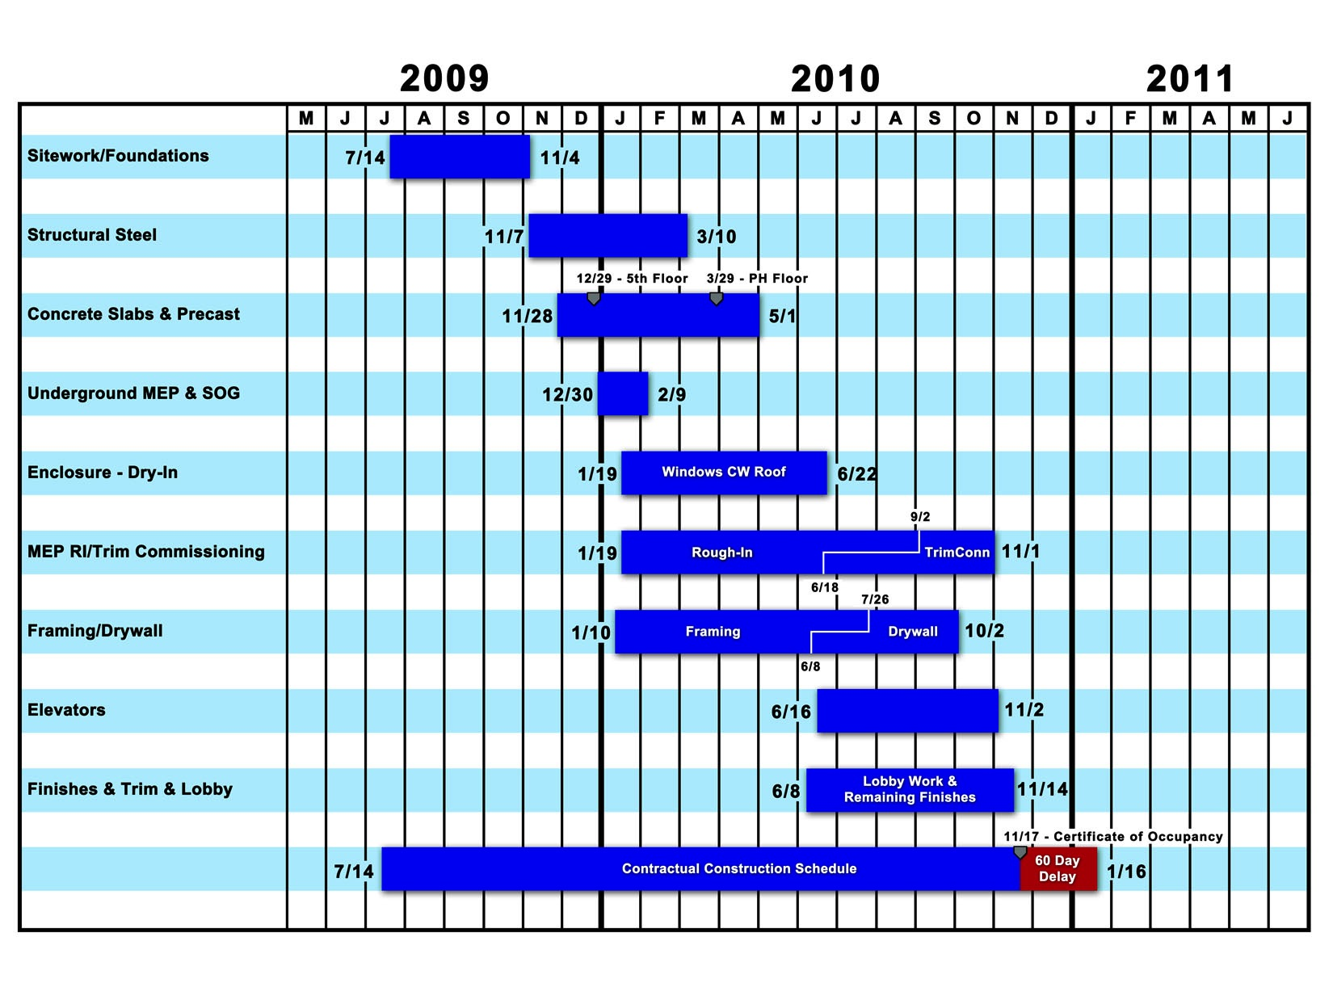
General Contractor’s Damages

Slide 17
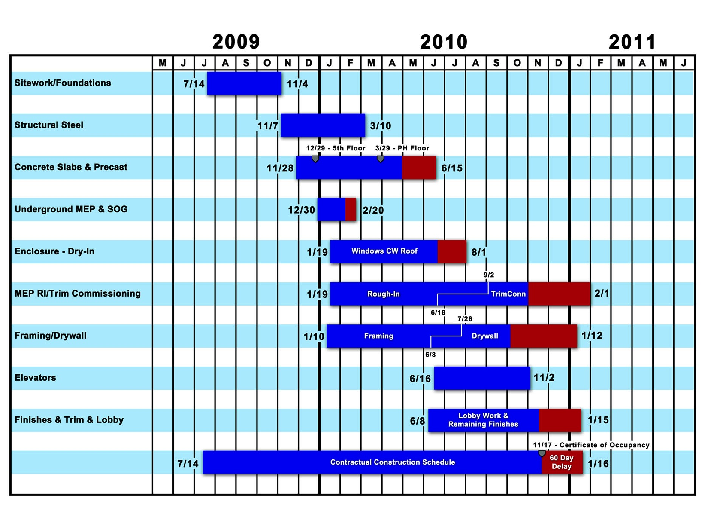
General Contractor’s Damages

Slide 18
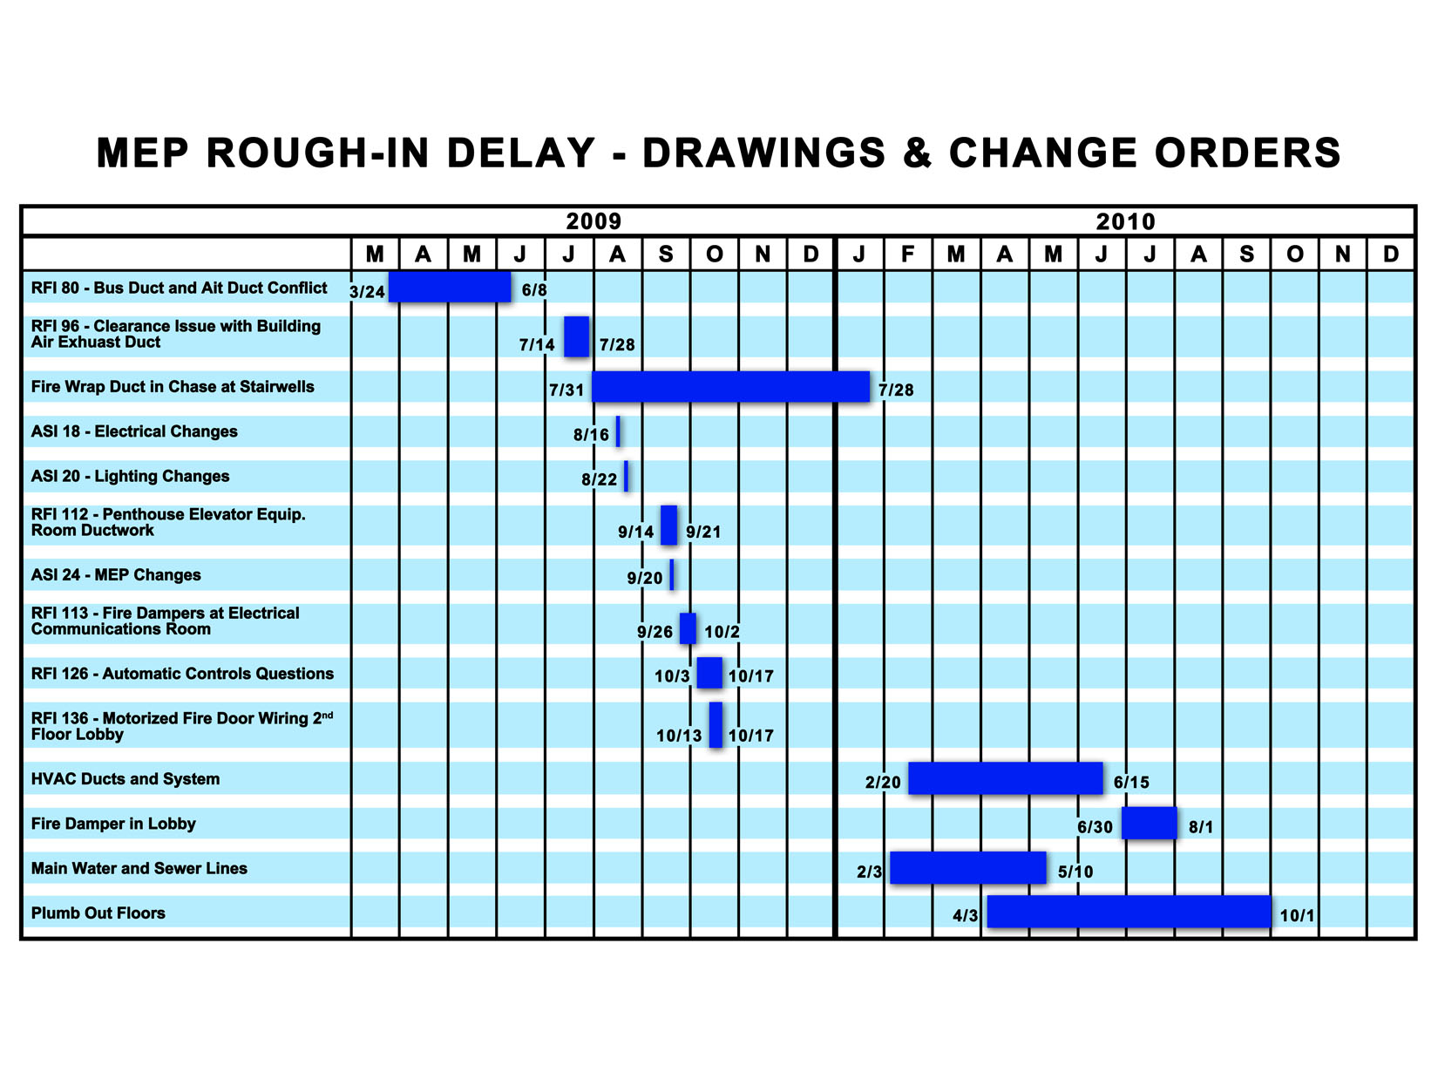
General Contractor’s Damages

Slide 19
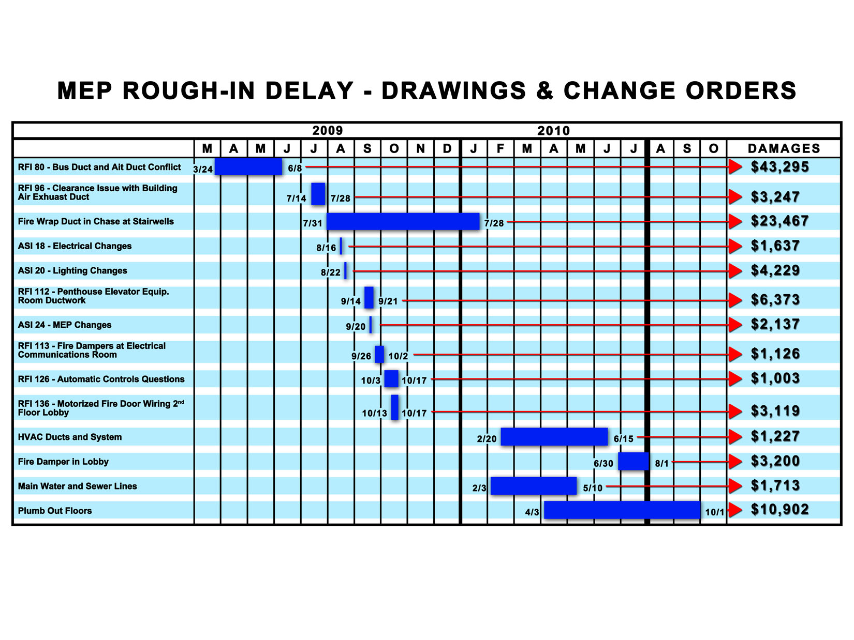
General Contractor’s Damages

Slide 20
Subcontractor’s Damages
HVAC subcontractor is claiming damages due to issues with drawings, inefficient stacking of trades and interrupted installation of system and duct work.

Slide 21
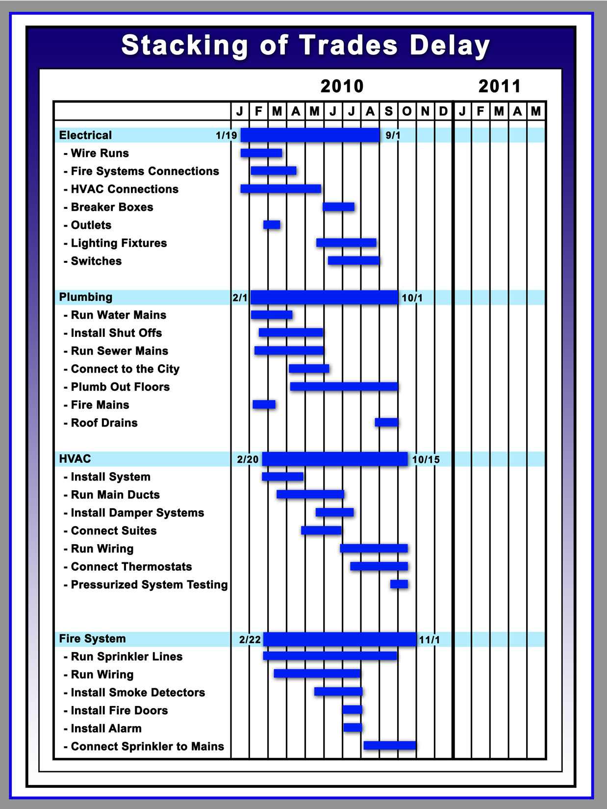
Subcontractor’s Damages

Slide 22
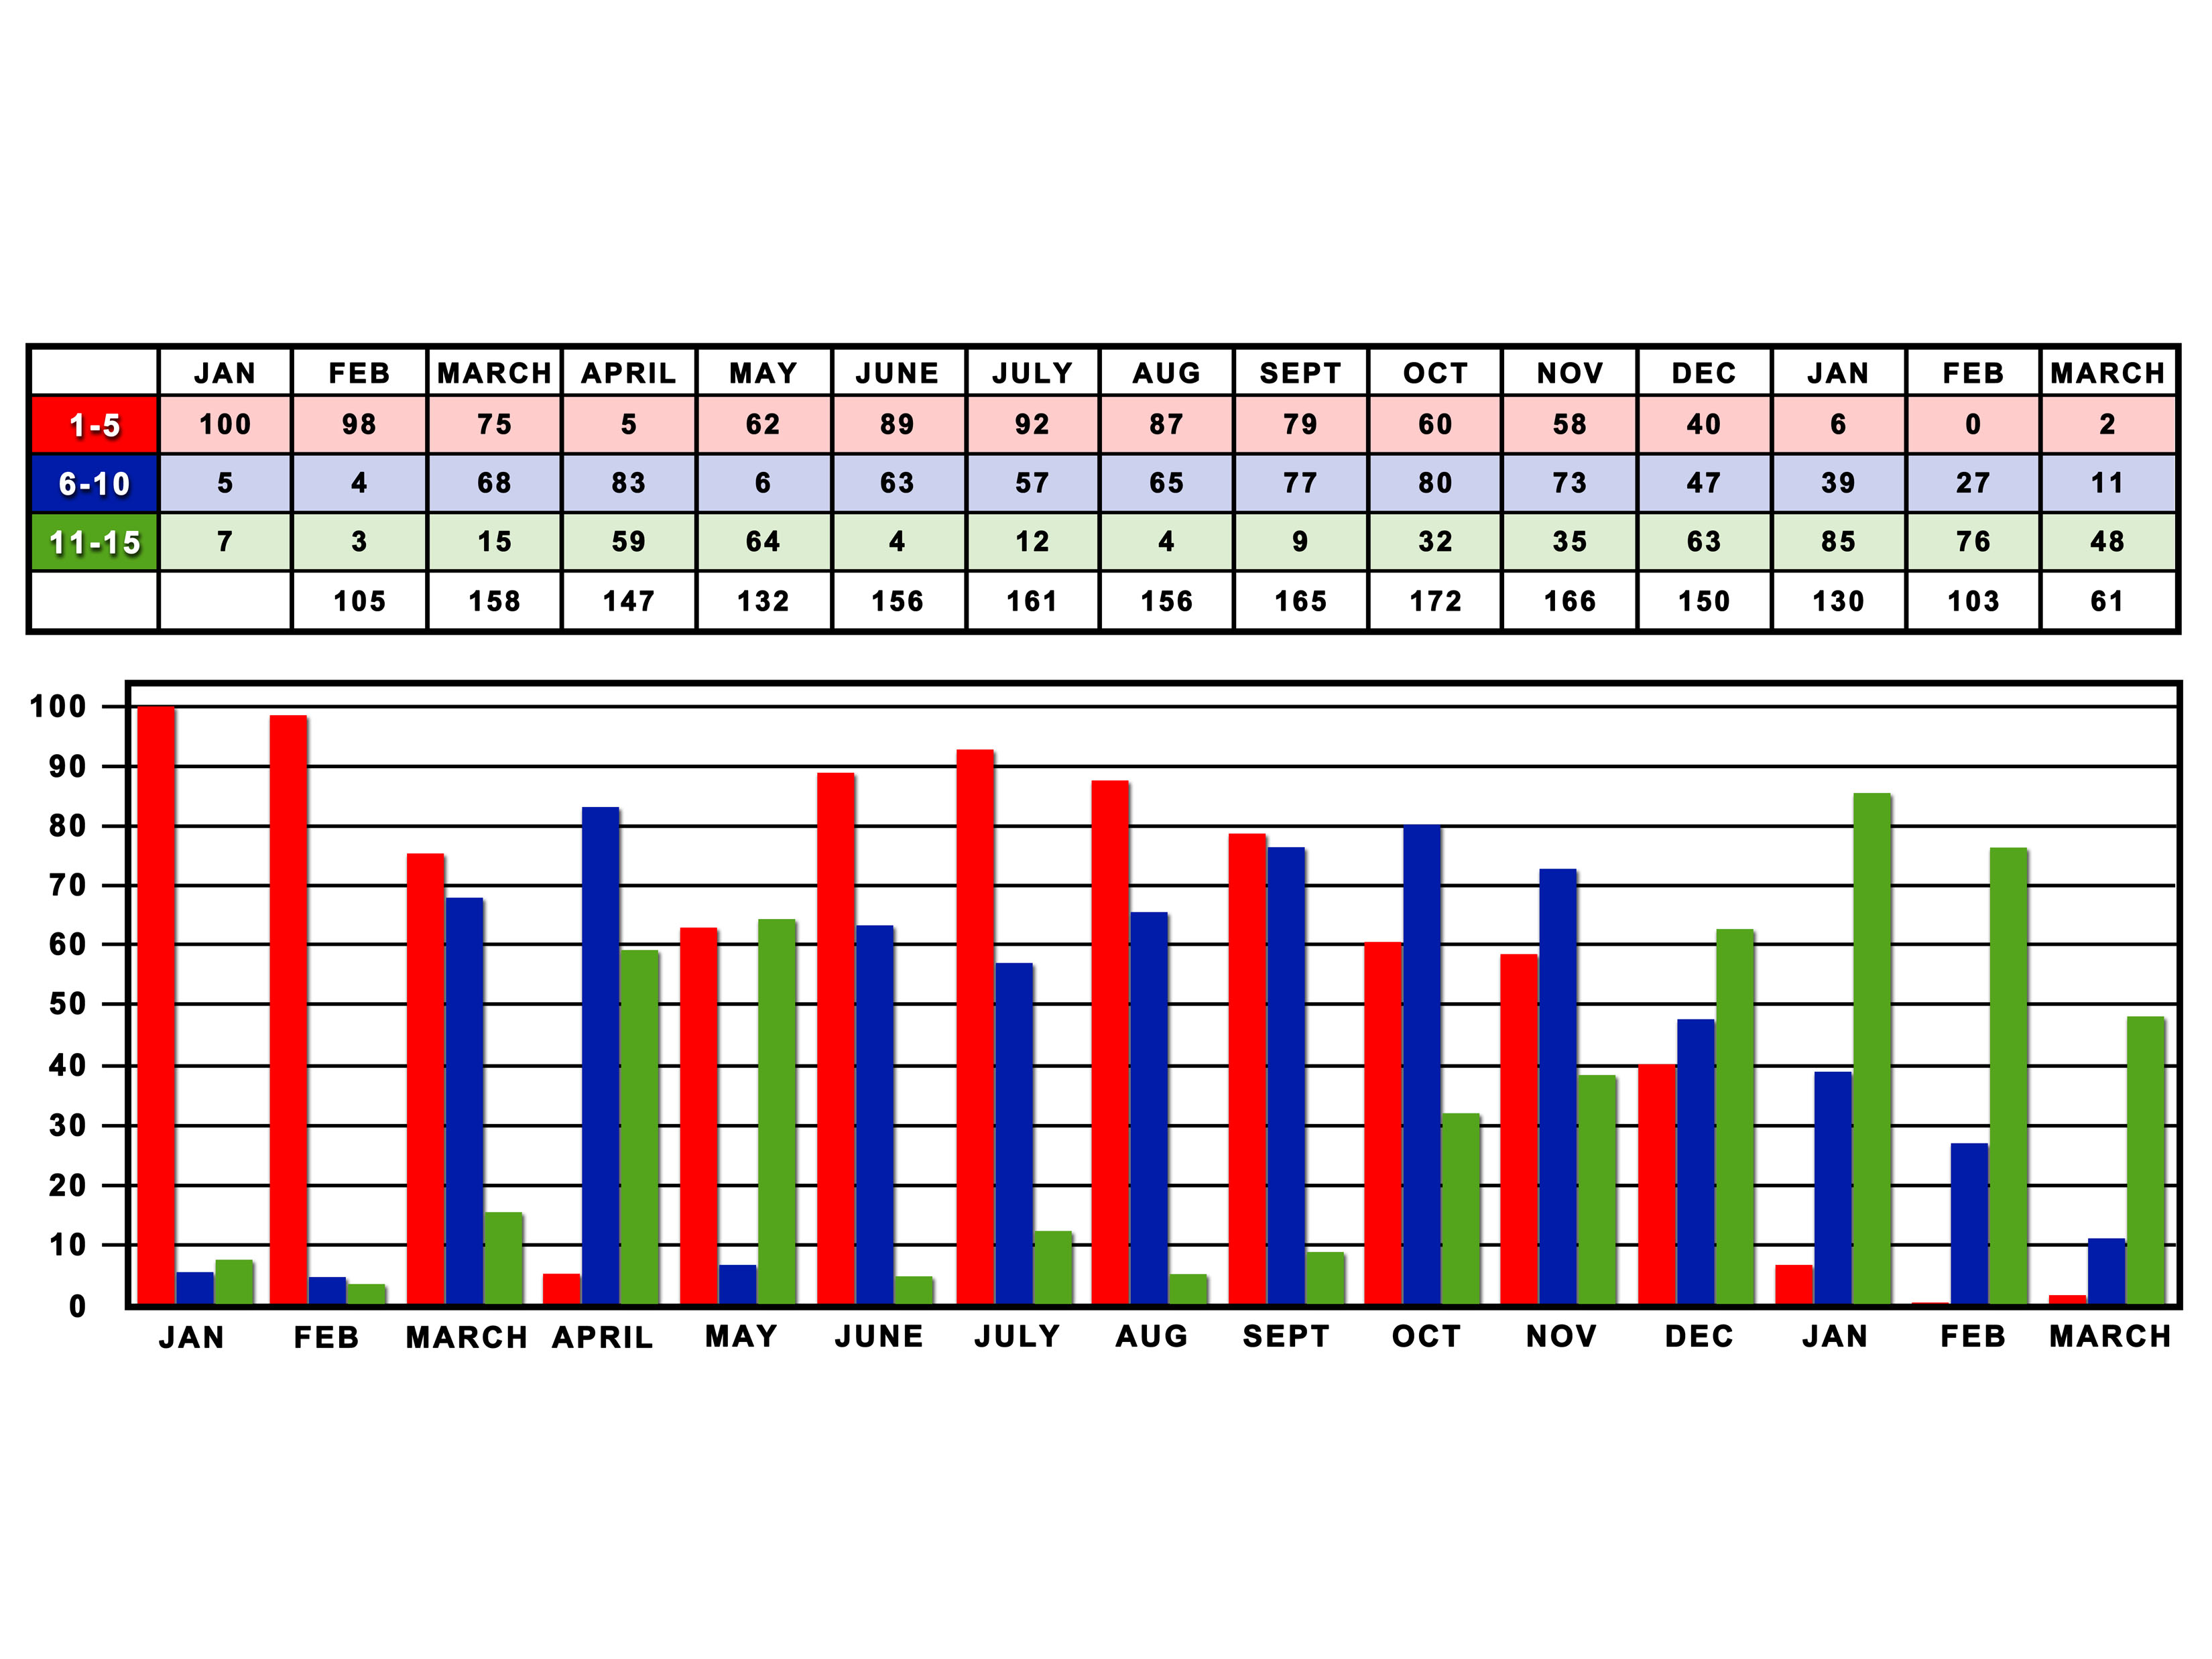
Subcontractor’s Damages

Slide 23
Subcontractor’s Damages (as drawn)

Slide 24
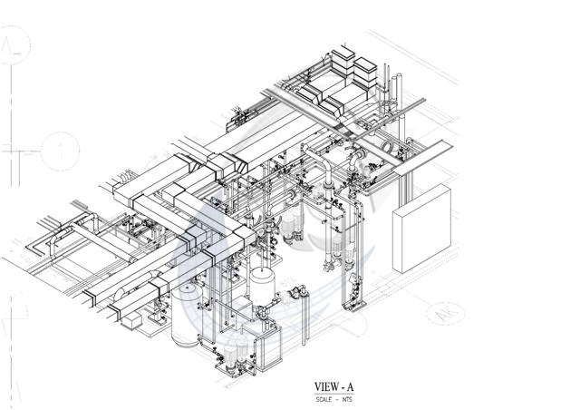
Subcontractor’s Damages (as built)

Slide 25
Subcontractor’s Damages
Additional Labor Hours – Regular | 427 | $28.57 | $12.199.39
Additional Labor Hours – Overtime (time and a half) | 279 | $42.86 | $11,956.55
Additional Materials (Ducts) | 350 | $12.25 | $4,287.50
Additional Materials (Wiring) | 950 | $2.85 | $2,707.50
Additional Materials (Insulation) | 57 | $44.00 | $2,508.00
Contractual Delay Penalty Per Month | 2 | $7,500.00 | $15,000.00

Slide 26
Challenging CGE
Plan for a hearing in advance of the offer
Know how the software works
Concentrate the challenge on as many foundation elements as possible
Hearsay
Prejudice
Frye/Daubert

Slide 27
Conclusion & Questions

