Slide 1
PSAV - Event Wireless
Login: 1657ABA
This session is participatory
Please Go To
http://ambar.org/plenarypoll

Slide 2


Mock Trial Direct and Cross Examination of the Damages Expert
Plenary 6
American Bar Association
Forum on the Construction Industry
2013 Mid Winter Meeting
Daniel D. McMillan
Jones Day
James Adrian
Adrian International
Paul Sandars
Lum, Drasco & Positan
Ann Greeley
Decision Quest
Richard H. Lowe
Duane Morris

Slide 3
The Case
Loss of Productivity – Expert Analysis
ACME Constructors v. American Power

Slide 4
INTRO: QUESTION 1:
Have you previously participated in a mock trial in any capacity?
Yes
No
VOTE NOW
Go To
http://ambar.org/plenarypoll

Slide 5
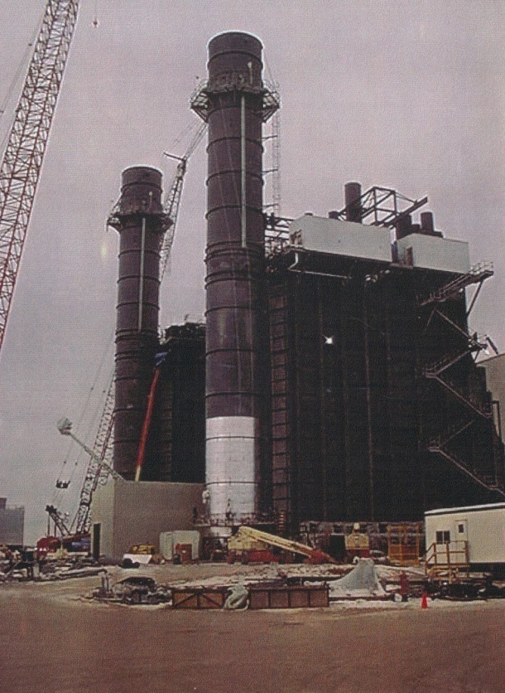
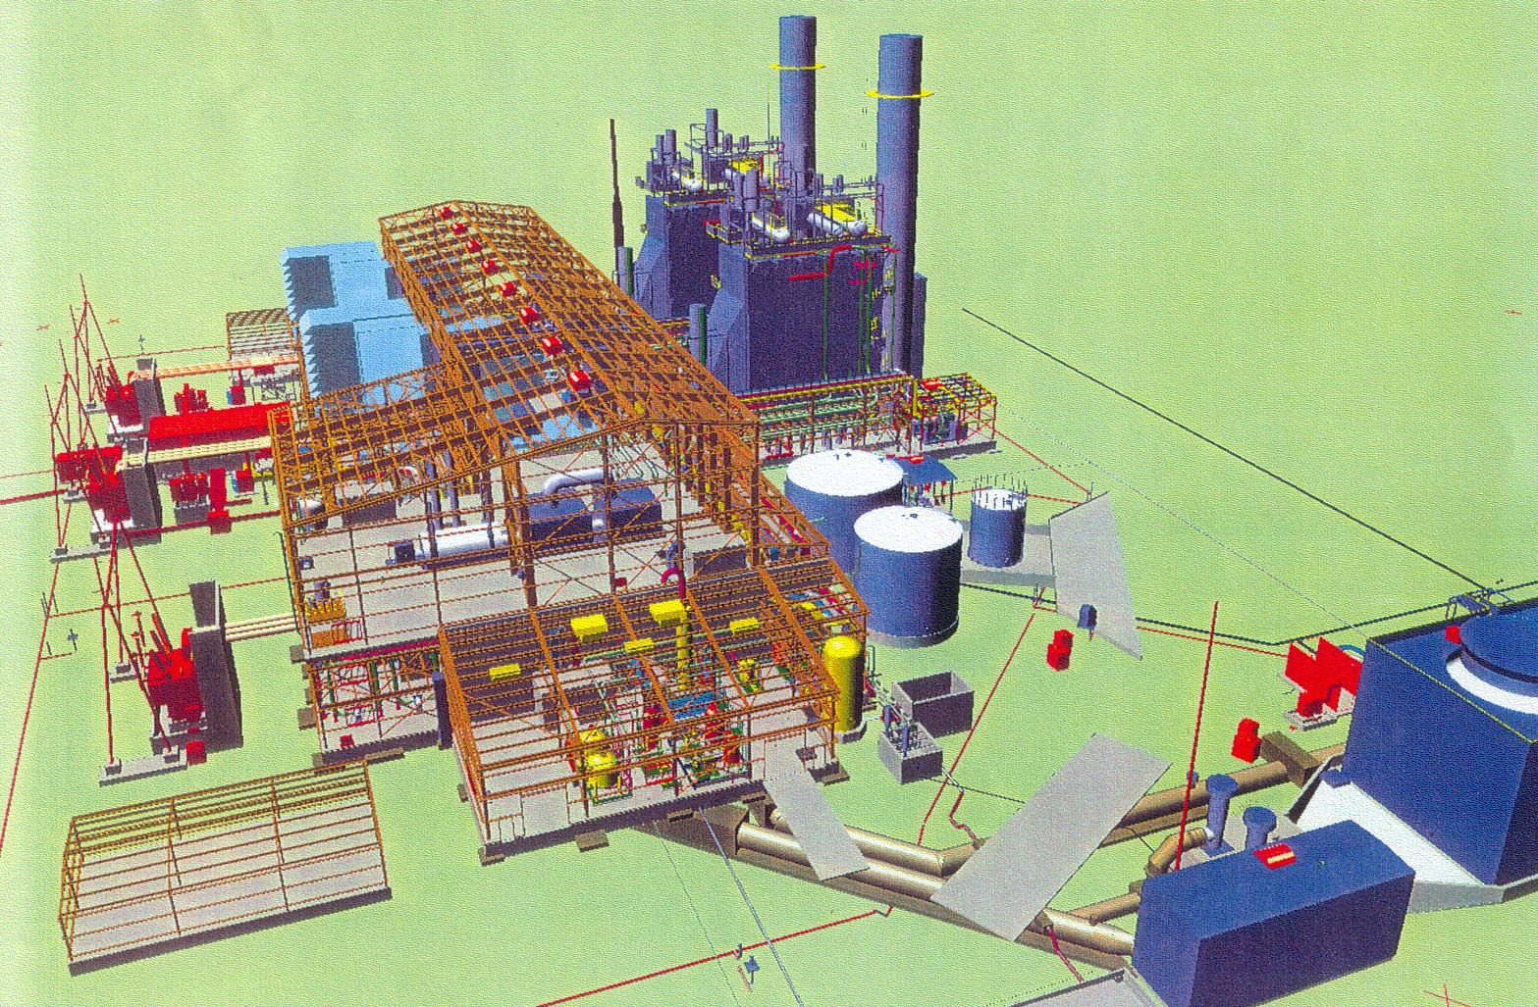
American Power Project in Peoria IL

Slide 6
DIRECT AND CROSS EXAMINATION OF THE DAMAGES EXPERT
James Adrian, Ph.D. (Expert) Adrian International, Peoria, IL
Ann T. Greeley, Ph.D (Trial Consultant) DecisionQuest, State College, PA
Richard H. Lowe, Esq. (Judge) Duane Morris, Philadelphia, PA
Daniel D. McMillan, Esq. (Cross-Examination) Jones Day, Los Angeles, CA
Paul Sandars, Esq. (Direct Examination) Lum, Drasco & Positan, Roseland, NJ

Slide 7
Direct Examination
WITNESS James Adrian
Adrian International, Peoria, IL
ATTORNEY Paul Sandars
Lum, Drasco & Positan, Roseland, NJ

Slide 8
Loss of Productivity – Expert Analysis
ACME Constructors v. American Power
James J. Adrian, Ph.D., PE, CPA
Professor, Bradley University
President, Adrian International LLC

Slide 9
Dr. Adrian Engagement
Quantify financial damages (lost productivity craft hours) for ACME owing to owner caused disruptions
Calculate lost labor hours caused by excessive overtime
Calculate lost labor hours caused by cold weather
Calculate lost labor hours caused by sequencing changes and disruption
Calculate lost labor hours caused by loss of learning
Compare my calculated lost craft hours to actual craft hour overrun

Slide 10
James J. Adrian, Ph.D., PE, CPA CONSTRUCTION PRODUCTIVITY EXPERT
Ph.D. University of Illinois-Urbana, Civil Engineering; Thesis: Measuring Construction Productivity
Author of Three Textbooks on Construction Productivity
Author of Associated General Contractors (AGC) National Construction Productivity Training Course/Manual
Consultant to Project Owners, Designers, and Construction Firms on Measuring and Improving Construction Productivity
Lecturer Worldwide on Measuring and Improving Construction Productivity

Slide 11
American Power Plant: Major Issues
Added work and constructability issues with Heat Recovery Steam Generator (HRSG’s)
Unanticipated modifications to combustion turbine issue
Turbine building size issues

Slide 12
EXPERT OPINION
“
It is my expert opinion that owing to project owner caused disruptions and delays during the construction of the American Power Plant, that ACME Constructors incurred a minimum loss of 136,730 craft hours.
”

Slide 13
Dr. Adrian’s Engagement
Project Documents Reviewed, Personnel Interviewed / Steps Performed
Reviewed project drawings
Reviewed accounting reports to include job cost reports and labor reports
Reviewed project estimate
Reviewed project correspondence
Reviewed schedule
Reviewed temperature, wind, and humidity weather data and expert reports
Interviewed job site personal
Inspected job site
Participated in job site tour
Conducted on site productivity analysis

Slide 14
Rule 703. Bases of an Expert’s Opinion Testimony
An expert may base an opinion on facts or data in the case that the expert has been made aware of or personally observed. If experts in the particular field would reasonably rely on those kinds of facts or data in forming an opinion on the subject, they need not be admissible for the opinion to be admitted. But if the facts or data would otherwise be inadmissible, the proponent of the opinion may disclose them to the jury only if their probative value in helping the jury evaluate the opinion substantially outweighs the prejudicial effect.

Slide 15
Conclusions
LOST PRODUCTIVITY DUE TO: | Calculated Lost Labor Hours
Excessive overtime (to speed up construction) | 50,323
Shift of HRSG work to winter 2010-2011 | 31,189
Change of sequencing that caused disruption and congestion | 46,668
Loss of learning (the need to accelerate required hiring more workers) | 8,550
TOTAL | 136,730 hrs

Slide 16
Conclusions
LOST PRODUCTIVITY DUE TO: | Calculated Lost Labor Hours
Excessive overtime (to speed up construction) | 50,323
Shift of HRSG work to winter 2010-2011 | 31,189
Change of sequencing that caused disruption and congestion | 46,668
Loss of learning (the need to accelerate required hiring more workers) | 8,550
TOTAL | 136,730 hrs
Lost Labor Dollars at $52.92 / hour
$2,663,040
$1,650,522
$2,469,671
$452,466
$7,235,699

Slide 17
Loss of Productivity Due to Unexpected and Excessive Overtime: Dr. Adrian Independent Analysis

Slide 18
Calculation of Lost Craft Hours Due to Unexpected Overtime on the PPC project
STEP 1: Each worker’s regular time, overtime, and double time determined for each work day and activity: 160,000 daily payroll records!
STEP 2: Based on selection of random labor crafts
STEP 3: Loss productivity factor determined for excessive overtime
STEP 4: Calculation: Lost productivity factor X Hours for each worker → Lost labor hours for any one worker on any one day

Slide 19
Conclusions
LOST PRODUCTIVITY DUE TO: | Calculated Lost Labor Hours
Excessive overtime (to speed up construction) | 50,323
Shift of HRSG work to winter 2010-2011 | 31,189
Change of sequencing that caused disruption and congestion | 46,668
Loss of learning (the need to accelerate required hiring more workers) | 8,550
TOTAL | 136,730 hrs

Slide 20
Shifting HRSG Work Into Winter 2010-2011
Impact on Construction Worker

Slide 21
Dr. Adrian Calculation of Lost Craft Hours Due to Shifting HRSG Work into the Winter
STEP 1: On site studies: loss of craft hours on cold weather days
STEP 2: Reviewed industry studies on cold weather construction
STEP 3: PPC payroll: each worker’s regular time, overtime, and double time determined for each work day and activity: 160,000 daily payroll records!
STEP 4: Worked with expert meteorologist to list weather data for each day
STEP 5: Weather data used to determine a productivity loss factor for each day for work tasks or cost codes.
STEP 6: Calculation: Lost productivity factor X Hours for each worker → Lost labor hours for any one worker on any one day
The lost hours were summed to yield the total lost hours

Slide 22
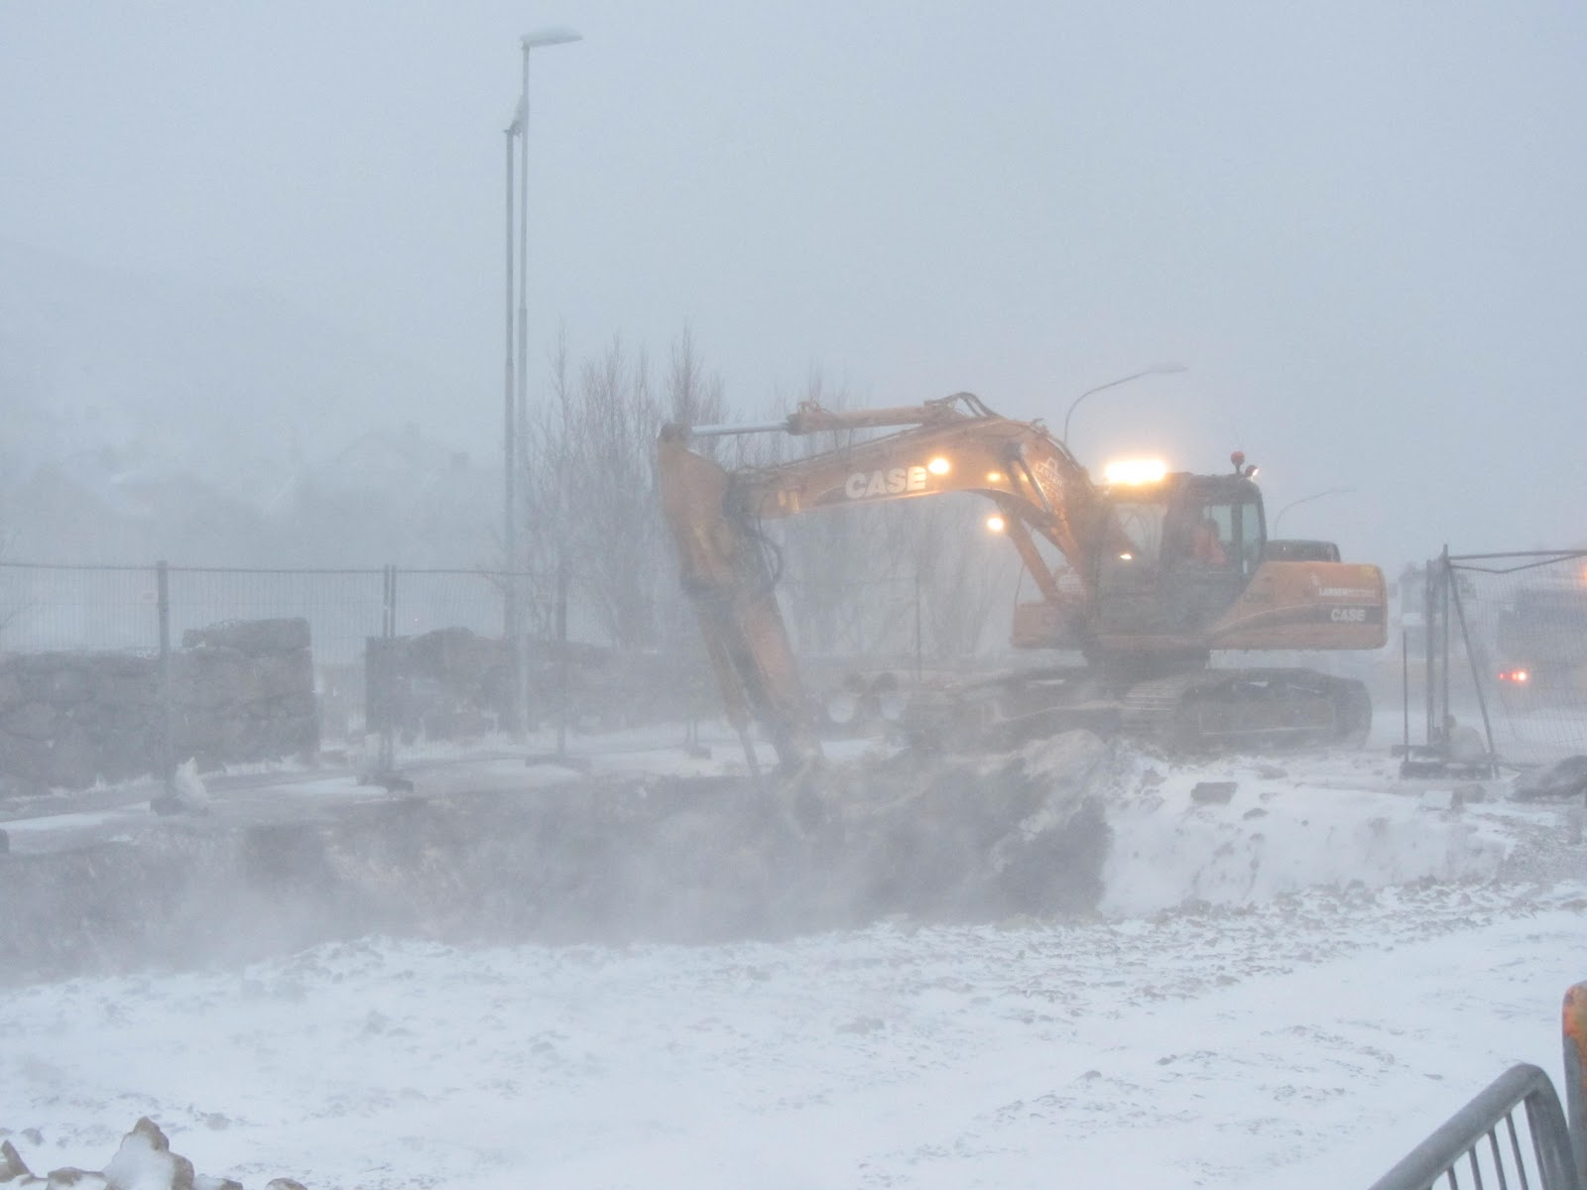
Impact of Cold Weather on Workers Doing HRSG Work
Added time to “warm up” to include walking to heated areas
Added restroom breaks (and walking several hundred feet to heated restrooms)
Lost hours looking for tools and materials in the snow
Time spent chipping ice and snow to be able to work
Time spent constructing insulation barriers
Extended break times to warm up
Added time putting on added clothing
Decrease in productivity from added clothing and gloves
General fatigue associated with working in colder temperatures

Slide 23
Conclusions: Dr. James Adrian
LOST PRODUCTIVITY DUE TO: | Calculated Lost Labor Hours
Excessive overtime (to speed up construction) | 50,323
Shift of HRSG work to winter 2010-2011 | 31,189
Change of sequencing that caused disruption and congestion | 46,668
Loss of learning (the need to accelerate required hiring more workers) | 8,550
TOTAL | 136,730 hrs

Slide 24
Loss of Productivity Due to Sequencing and Disruption:
Dr. Adrian
Independent Analysis

Slide 25
Conclusions: Dr. James Adrian
LOST PRODUCTIVITY DUE TO: | Calculated Lost Labor Hours
Excessive overtime (to speed up construction) | 50,323
Shift of HRSG work to winter 2010-2011 | 31,189
Change of sequencing that caused disruption and congestion | 46,668
Loss of learning (the need to accelerate required hiring more workers) | 8,550
TOTAL | 136,730 hrs

Slide 26
Loss of Productivity Owing to Loss of Learning Due to Need to Accelerate:
Dr. Adrian Analysis

Slide 27
Conclusions: Dr. James Adrian
LOST PRODUCTIVITY DUE TO: | Calculated Lost Labor Hours
Excessive overtime (to speed up construction) | 50,323
Shift of HRSG work to winter 2010-2011 | 31,189
Change of sequencing that caused disruption and congestion | 46,668
Loss of learning (the need to accelerate required hiring more workers) | 8,550
TOTAL | 136,730 hrs

Slide 28
Conclusions: Dr. James Adrian
LOST PRODUCTIVITY DUE TO: | Calculated Lost Labor Hours
Excessive overtime (to speed up construction) | 50,323
Shift of HRSG work to winter 2010-2011 | 31,189
Change of sequencing that caused disruption and congestion | 46,668
Loss of learning (the need to accelerate required hiring more workers) | 8,550
TOTAL | 136,730 hrs
Lost Labor Dollars at $52.92 / hour
$2,663,040
$1,650,522
$2,469,671
$452,466
$7,235,699

Slide 29
ACME Labor Hours on Project
Description | Craft hours
Actual Craft Hours | 926,000
– Estimated Craft Hours | 580,000
– Approved Change Hours | 148,000 | # of changes = 120
– Unapproved Change Hours | 56,000 | # of changes = 101
= Additional Lost Hours (Total Cost Claim) | 142,000 | Changes, sequencing, weather, added workers, 1820 RFIs, overtime

Slide 30
DIRECT: QUESTION 1:
Based on what I have heard, the direct helped me to:
A) Strongly favor the plaintiff
B) Slightly favor the plaintiff
C) Slightly favor the defendant
D) Strongly favor the defendant
VOTE NOW
Go To: http://ambar.org/plenarypoll

Slide 31
DIRECT: QUESTION 2:
The level of testimony was:
A) Too hard to understand
B) Just right
C) Too simplified
VOTE NOW
Go To: http://ambar.org/plenarypoll

Slide 32
DIRECT: QUESTION 3:
Which of the following is more true of the PowerPoint that was used?
A) It helped to focus my attention
B) It didn’t make a difference
C) It was distracting
VOTE NOW
VOTE NOW
Go To: http://ambar.org/plenarypoll

Slide 33
Cross Examination
WITNESS James Adrian
Adrian International, Peoria, IL
ATTORNEY Daniel D. McMillan
Jones Day, Los Angeles, CA

Slide 34
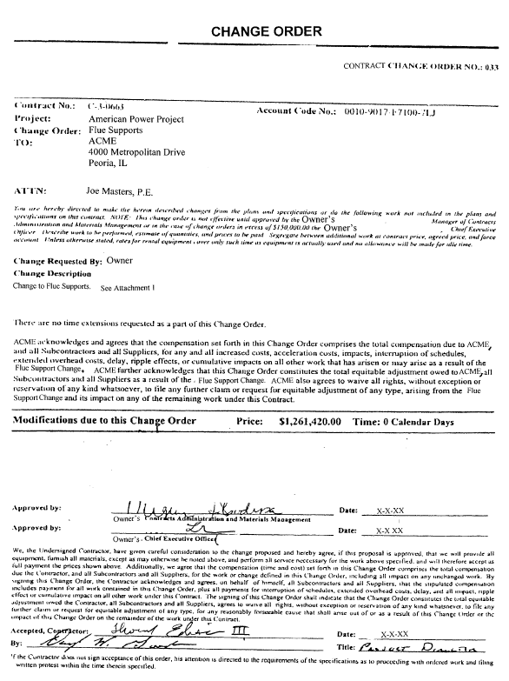
Trial Exhibit 20 Change Order 33: Flue Supports

Slide 35
Trial Exhibit 20 Change Order 33: Flue Supports
Change Description
Change to Flue Supports.

Slide 36
Trial Exhibit 20 Change Order 33: Flue Supports
ACME acknowledges and agrees that the compensation set forth in this Change Order comprises the total compensation due to ACME, and all Subcontractors and all Suppliers, for any and all increased costs, acceleration costs, impacts, interruption of schedules, extended overhead costs, delay, ripple effects, or cumulative impacts on all other work that has arisen or may arise as a result of the Flue Support Change.
ACME also agrees to waive all rights, without exception or reservation of any kind whatsoever, to file any further claim or request for equitable adjustment of any type, arising from the Flue Support Change and its impact on any of the remaining work under this Contract.

Slide 37
Trial Exhibit 20 Change Order 33: Flue Supports
Additionally, we agree that the compensation (time and cost) set forth in this Change Order comprises the total compensation due the Contractor, and all Subcontractors and all Suppliers, for the work or change defined in this Change Order, including all impact on any unchanged work.
The signing of this Change Order shall indicate that the Change constitutes the total equitable adjustment owed the Contractor, all Subcontractors and all Suppliers, [and Contractor] agrees to waive all rights, without exception or reservation of any kind whatsoever, to file any further claim or request for equitable adjustment of any type, for any reasonably foreseeable, cause that shall arise out of or as a result of this Change Order or the impact of this Change Order on the remainder of the work under this Contract.

Slide 38
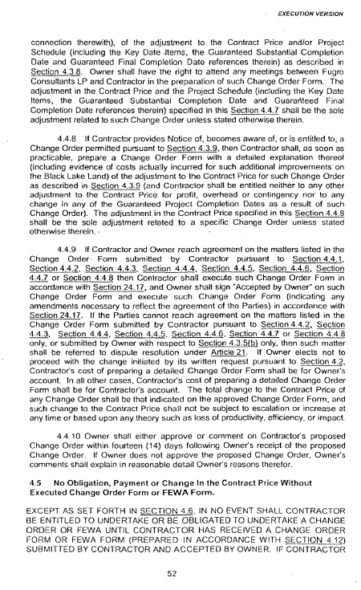
Trial Exhibit 1 Construction Contract

Slide 39
Trial Exhibit 1 Construction Contract
The total change to the Contract Price of any Change Order shall be that indicated on the approved Change Order Form, and such change to the Contract Price shall not be subject to escalation or increase at any time or based upon any theory such as loss of productivity, efficiency, or impact.

Slide 40
Conclusions: Dr. James Adrian
LOST PRODUCTIVITY DUE TO: | Calculated Lost Labor Hours
Excessive overtime (to speed up construction) | 50,323
Shift of HRSG work to winter 2010-2011 | 31,189
Change of sequencing that caused disruption and congestion | 46,668
Loss of learning (the need to accelerate required hiring more workers) | 8,550
TOTAL | 136,730 hrs
Lost Labor Dollars at $52.92 / hour
$2,663,040
$1,650,522
$2,469,671
$452,466
$7,235,699

Slide 41
CROSS: QUESTION 1:
Based on what I have heard, the cross helped me to:
A) Strongly favor the plaintiff
B) Slightly favor the plaintiff
C) Slightly favor the defendant
D) Strongly favor the defendant
VOTE NOW
Go To: http://ambar.org/plenarypoll

Slide 42
CROSS: QUESTION 2:
The Cross:
A) Made me think that the plaintiff is really stretching to get his number
B) Raised some questions in my mind about plaintiff’s number
C) Left me feeling confused
D) Reinforced my sense that plaintiff is
deserving of damages requested
VOTE NOW
VOTE NOW
Go To: http://ambar.org/plenarypoll

Slide 43
CROSS: QUESTION 3:
The cross-examiner asked the Q’s:
A) Too aggressively
B) Just right
C) Too weakly – I wanted fireworks!
VOTE NOW
Go To: http://ambar.org/plenarypoll

Slide 44
IN SUMMARY
PANELIST POINTERS

Slide 45
Welcome Reception
6:00 – 8:00 PM

