Slide 1


THE REALITY BEHIND THE THEORY OF LOSS OF LABOR PRODUCTIVITY
American Bar Association
Forum on the Construction Industry
2013 Mid Winter Meeting
Presenters:
William Ibbs
W. Alexander Moseley
Lee Schumacher
Paul Stynchcomb

Slide 2
ELEMENTS OF PROOF
Liability – a remedy exists in the contract, or for breach of contract
Causation – owner’s conduct made contractor’s labor inefficient
Quantum – amount by which labor expense was increased by the owner’s conduct

Slide 3
AACE Recommended Practice No. 25R-03
Identified 20 quantitative methods to estimate value of loss labor productivity
Based on a survey of the literature at that time
Peer-reviewed and published in 2004
AACE in process of updating RP at this time

Slide 4
reality or theory?
Are results consistent with project facts and cost records?
Are impacts of both owner and contractor considered?
Is the method used to quantify damages most reliable given circumstances?
Sometimes a combination of methods yields the most precise overall estimate

Slide 5
AACE RP No. 25R-03 Ranking of Methods
Project Specific Studies
Measured Mile
Earned Value Analysis
Project Comparison Studies
Based on comparable project work
Based on comparable work on other projects

Slide 6
AACE RP NO. 25R-03 RANKING OF METHODS (cont’d)
Subject Specific Studies
Overtime
Impact of change orders
Many more of various specific factors
General Industry Studies – MCAA, NECA and others

Slide 7
AACE RP NO. 25R-03 RANKING OF METHODS (cont’d)
Cost-Based Methods
Total Cost
Entire project
Specific units of work
Modified Total Cost
Entire project
Specific units of work

Slide 8
Choosing a Method Practical CONSIDERATIONS
Amount and quality of available information
Nature of the productivity impacts
Anticipated level of required certainty
Evaluation time and cost
Prospective estimates versus after-the-fact determinations

Slide 9
industry studies
Can be useful:
When there is a lack of labor and production data
When there is no “non-impacted” period
The issue specific study matches project issue
To collaborate results of other methods
Best used when industry guide relates to affected trade
Have been accepted if done properly

Slide 10
Utilizing Industry Studies in Preparing and
Presenting Loss of Labor Productivity Claims
Professor William Ibbs, PhD
Department of Civil and Environmental Engineering
University of California – Berkeley
The Ibbs Consulting Group, Inc.
and
Paul Stynchcomb, PSP, CFCC
Senior Managing Director, FTI Consulting, Inc.

Slide 11
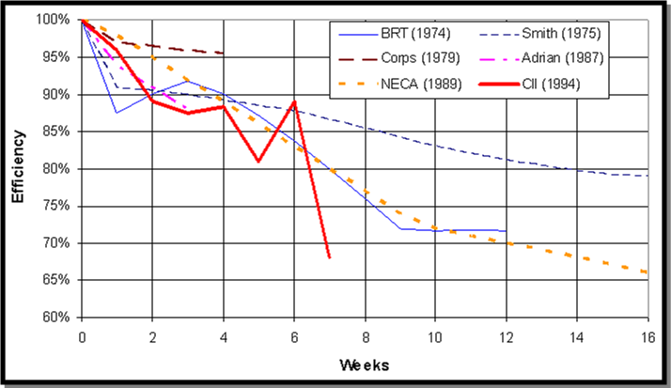
Utilizing Industry Studies in Preparing and
Presenting Loss of Labor Productivity Claims
Overtime Inefficiency Study Comparisons

Slide 12
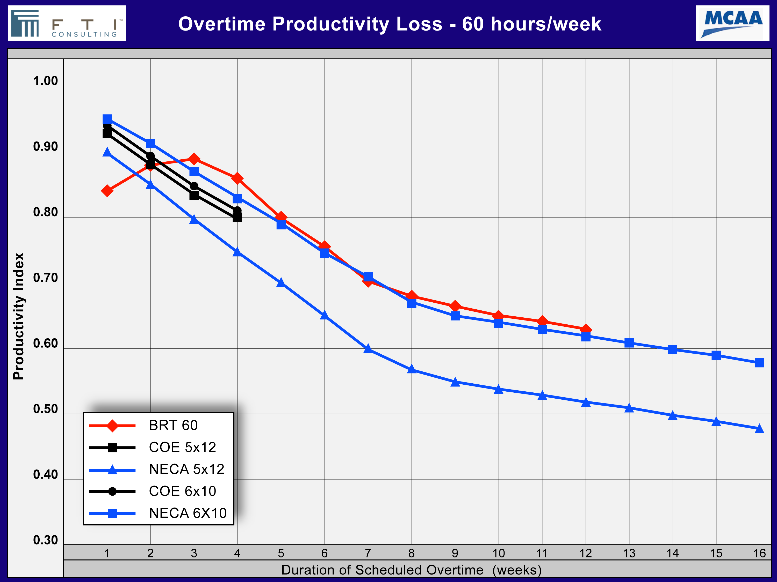
Utilizing Industry Studies in Preparing and
Presenting Loss of Labor Productivity Claims
MCAA’s 2011Publication Comparing Overtime Studies

Slide 13
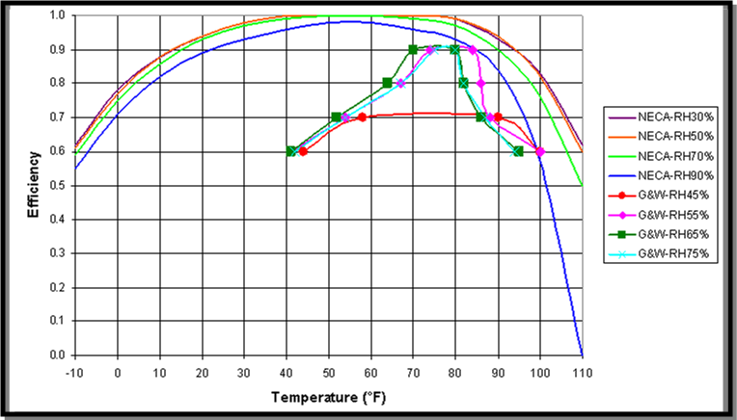
Utilizing Industry Studies in Preparing and
Presenting Loss of Labor Productivity Claims
Temperature Productivity Impact Curves

Slide 14
Utilizing Industry Studies in Preparing and
Presenting Loss of Labor Productivity Claims
The 16 MCAA Labor Inefficiency “Factors”

Slide 15
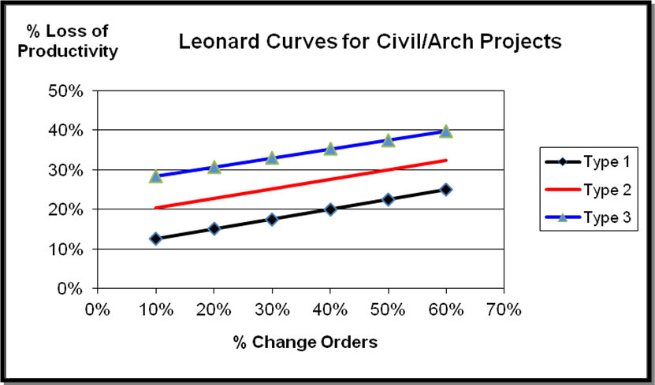
Utilizing Industry Studies in Preparing and
Presenting Loss of Labor Productivity Claims
The “Leonard” Curves

Slide 16
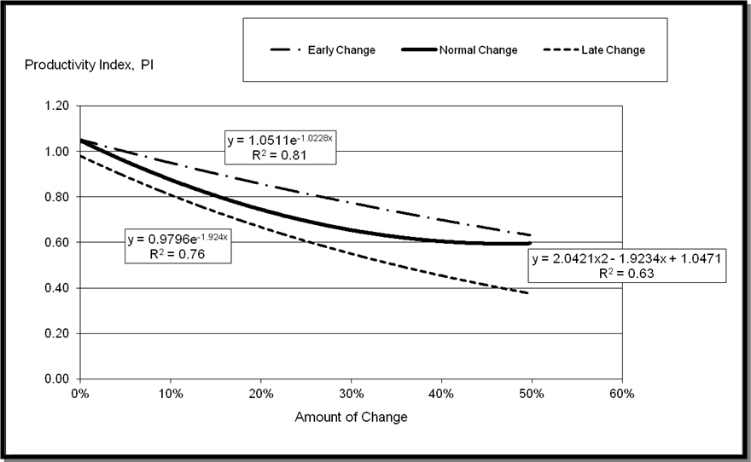
Utilizing Industry Studies in Preparing and
Presenting Loss of Labor Productivity Claims
The “Ibbs” Curves

Slide 17
Selecting a Measurement Method

Slide 18
Utilizing Industry Studies in Preparing and
Presenting Loss of Labor Productivity Claims
Questions to Consider When Selecting a Methodology
Data Processing
Were the data processing methods such as data screening, data categorization, and manipulation (summing, adding, etc.) fully disclosed?
If so, was the process reasonable?
If not disclosed, can the process be presumed to be reasonable? Any flaws?
Data Source
From what project(s) and what trades are the data?
Are the data republished from previous studies?
Does the study use data from other studies with manipulation?
How old are the data (compatible with current construction industry)?
Is there biased or unrelated data due to unique environment?
Is the source known?
Has this study been accepted by other courts or boards?
Analysis Procedures
If any further analyses were performed to develop some kinds of predicting models, were the procedures disclosed?
Were they reasonable and logical? Any flaws?
Project Types and Scope
Does the study fairly represent the ordinary, common situations of the type of projects in question?
Does the project scope match?
Are there unique conditions, environments, or biases in the source projects?
Data Size
Are the data from a single or multiple projects?
Is the sample size (data points) big enough?
Data Collection Method
Were data obtained through direct observations, surveys, interviews, or past records and documents?
Was the collection method reasonable and fair (no potential for a bias)?
Type of Trades
Do the types of trades studied match or include the trades in question?
Is the study too general and covers too many trades?

Slide 19
WHAT IS THIS LOSS OF PRODUCTIVITY OF WHICH YOU SPEAK?
In layman’s (or lawyer’s) terms, con-sumption of more labor than should be required to perform some element of the work
Usual causes -- “waiting or idle, traveling, working slowly, doing ineffective work, and doing rework”

Slide 20
PROVING QUANTUM OF PRODUCTIVITY LOSS
Preferred technique – actual records of labor productivity rates – rarely available
If possible – comparison of actual impaired vs. unimpaired productivity as by “Measured Mile”
Comparison of contractor’s labor productivity to results of industry studies
If all else fails, total cost (or total labor cost) type of claim

Slide 21
PROBLEM WITH INDUSTRY STUDIES?
Sample opinion – My client, a general building contractor, had a lot of change orders. MCAA, and Leonard, and CII say that its labor costs therefore increased by 30%, and the owner owes me for that increase
Problem: None of those studies related to the conditions this contractor claimed to face, or purported to justify such a simple and conclusive analysis.

Slide 22
WHAT’S A LAWYER TO DO WITH SUCH AN OPINION?
Move to disqualify witness for lack of testimonial credentials?
Move to exclude the opinion under Frye for lack of general acceptance of the method used to reach it?
Move to exclude opinion under Daubert/Kumho Tire?
Very unlikely to succeed with any of these approaches

Slide 23
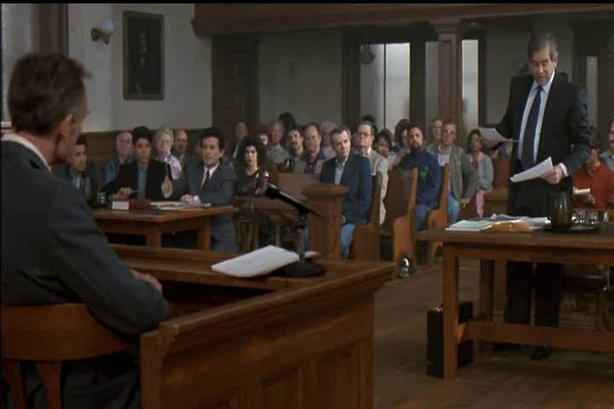

Slide 24
BETTER APPROACH
Disparage the Industry Study – either the quality of the study or the objectivity of its author
Distinguish the Industry Study as inapt (e.g., MCAA factors used by grading contractor)
Show that the expert is misinterpreting or misusing the study
For sure, and as usual, hire a better expert, and use a better technique, so your proof is more convincing, and opponent’s is rejected

Slide 25
THE REALITY BEHIND THE THEORY OF LOSS OF LABOR PRODUCTIVITY
American Bar Association
Forum on the Construction Industry
2013 Mid Winter Meeting
Presenters:
William Ibbs
W. Alexander Moseley
Lee Schumacher
Paul Stynchcomb

