Slide 1


Slide 2


American Bar Association
Forum on the Construction Industry
2013 Mid Winter Meeting
When Damages Aren’t Enough
Alternative Remedies in Construction Cases
William G. Geisen
Stites & Harbison, PLLC
Denise Morris Hammond
Wright, Fulford, Moorhead & Brown, P.A.
Michael S. McNamara
Pillsbury Winthrop Shaw Pittman, LLP

Slide 3
Scenario #1

Slide 4


Slide 5


Slide 6
. . . and the guilty

Slide 7
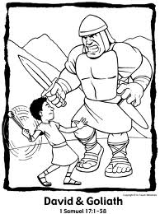

Slide 8
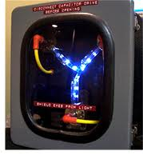

Slide 9
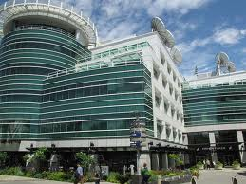

Slide 10
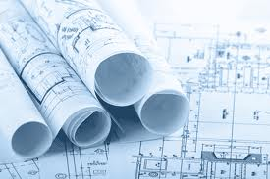

Slide 11

David makes a deal with Goliath.

Slide 12


Slide 13
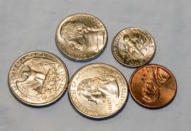

Slide 14


Slide 15
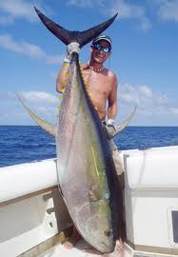

Slide 16


Slide 18


Slide 19


Slide 20


Slide 21
Teaming Agreement The bad news
“This Agreement does not create a partnership, joint venture or similar relationship between the parties.”
“[Goliath] may terminate this Agreement in whole or in part for its convenience with 90 days notice.”
“This Agreement is non-exclusive, and [Goliath] does not make any commitment for or guarantee any minimum or maximum amount of Purchase by [Goliath].”

Slide 22
Teaming Agreement More bad news – maybe
“. . . neither party is liable to the other for (1) consequential, incidental, indirect, punitive or special damages, including commercial loss and lost profits . . .”
Neither party is liable to the other for direct damages in excess of $1 million.

Slide 23
Teaming Agreement More bad news – but look again
Except for each party’s breach of any requirements regarding Confidential Information . . . neither party is liable to the other for consequential, incidental, indirect, punitive or special damages . . .

Slide 24
Teaming Agreement The good news
“Confidential Information means all information shared by either party during the term of this Agreement.”
Each party will use Confidential Information only to exercise its rights and perform its obligations under this Agreement.
“[David] hereby grants [Goliath] a license to resell and distribute the Purchases”

Slide 25
Scenario #2

Slide 26
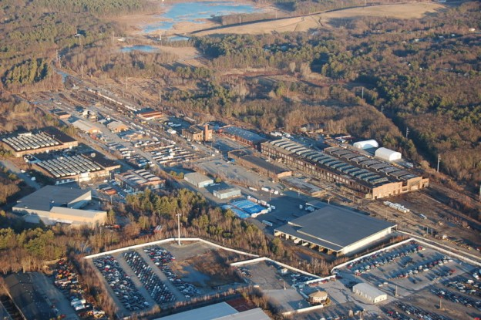
Superfund Site

Slide 27
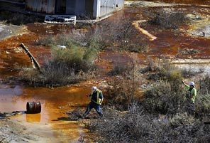
Pond Discharge

Slide 28
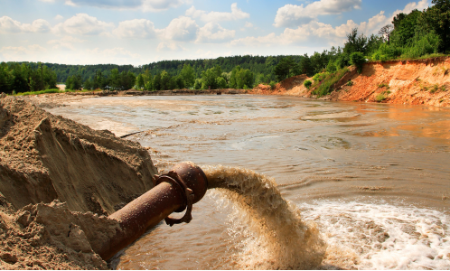
Pipe Discharge

Slide 29
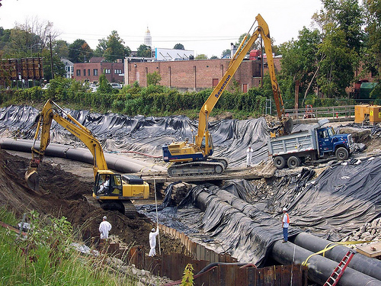
Soils Remediation

Slide 30
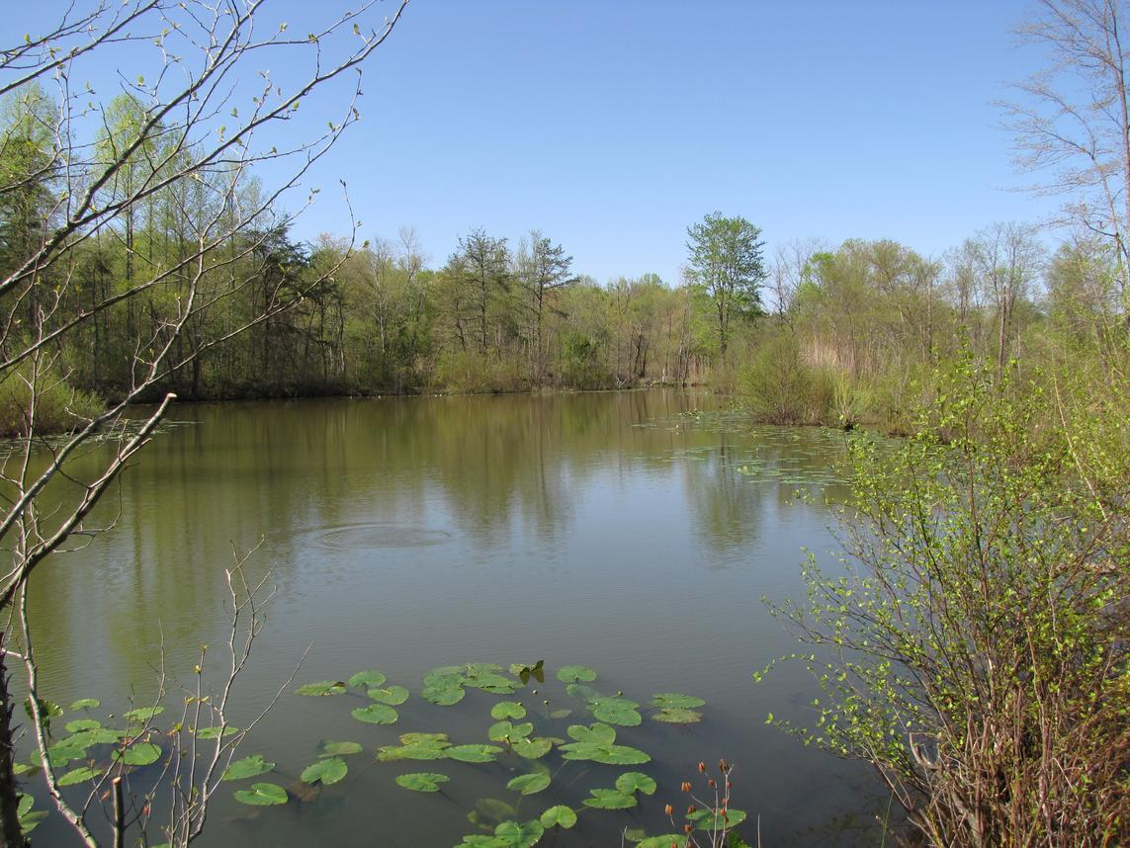
Clean(er) Pond

Slide 31
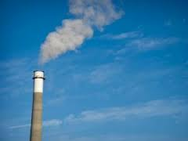
What now?

Slide 32
Superfund Project Timeline
1996- Industrial plant named Superfund Site.

Slide 33
Superfund Project Timeline
1996- Industrial plant named Superfund Site.
1998- Consent Decree.

Slide 34
Superfund Project Timeline
1996 - Industrial plant named Superfund Site.
1998 - Consent Decree.
1999 - Remediation Trust Fund Established.
2000 - Soils Remediation Completed.

Slide 35
Superfund Project Timeline
1996 - Industrial plant named Superfund Site.
1998 - Consent Decree.
1999 - Remediation Trust Fund Established.
2000 - Soils Remediation Completed.
2001- Superfund Site Leased to Third Party.

Slide 36
Superfund Project Timeline
2002- New Industrial Operator on Site.

Slide 37
Superfund Project Timeline
2002 - New Industrial Operator on Site.
2004 - Environmental Contractor hired to
remediate groundwater and surface water.

Slide 38
Superfund Project Timeline
2002 - New Industrial Operator on Site.
2004 - Environmental Contractor hired to remediate groundwater and surface water.
2006 - Additional contaminated discharges from site operations discovered.

Slide 39
Scenario #3

Slide 40
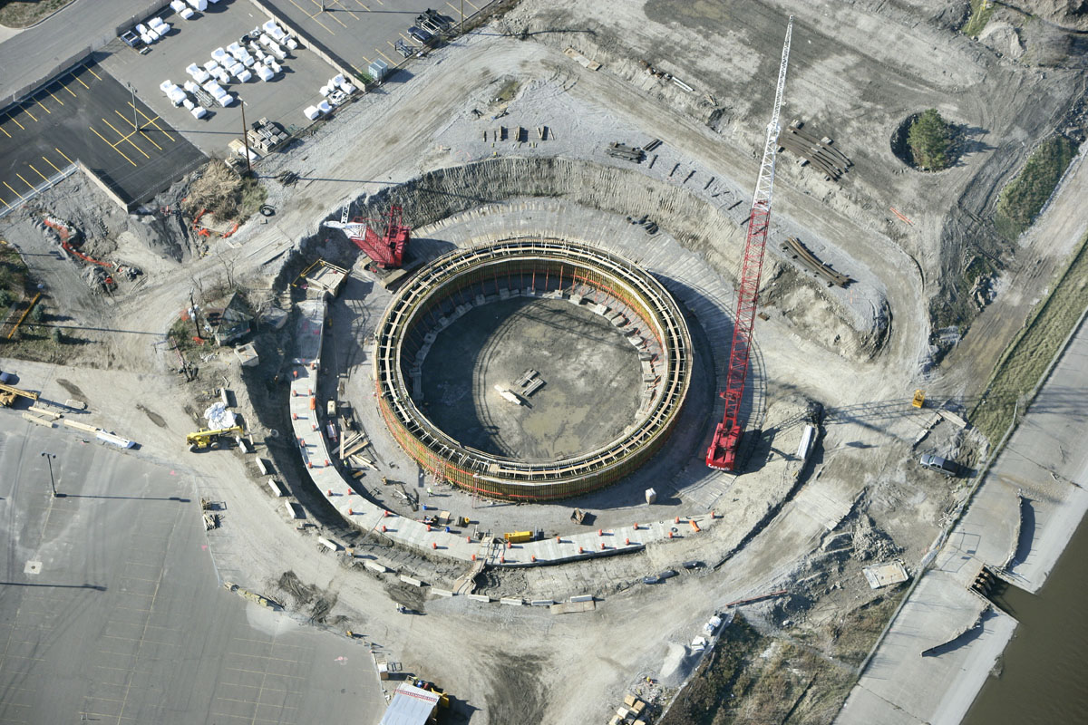

Slide 41
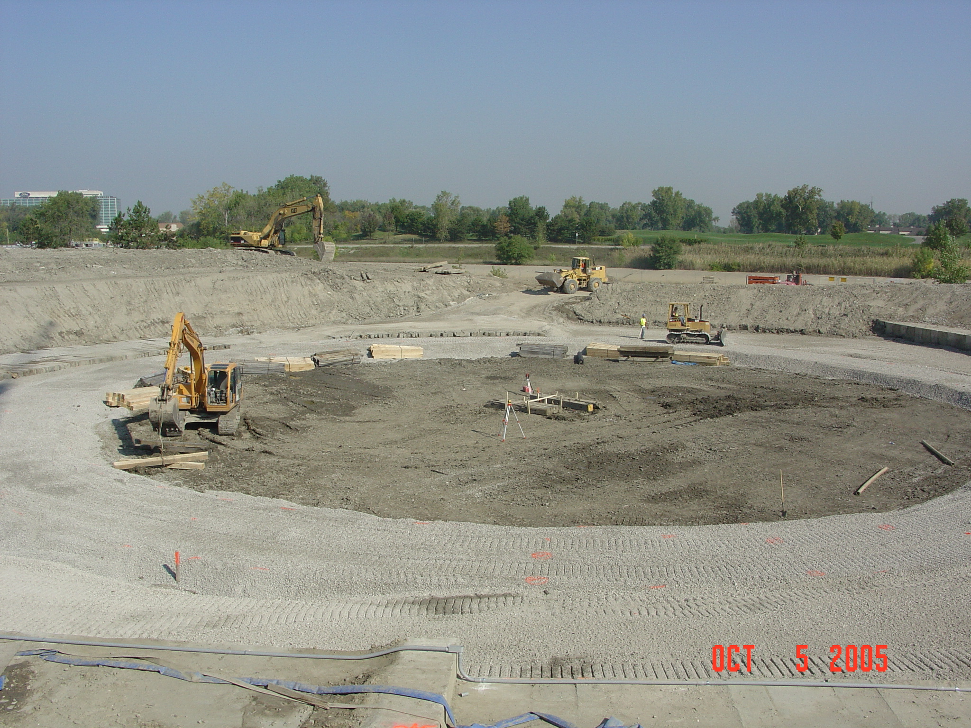

Slide 42
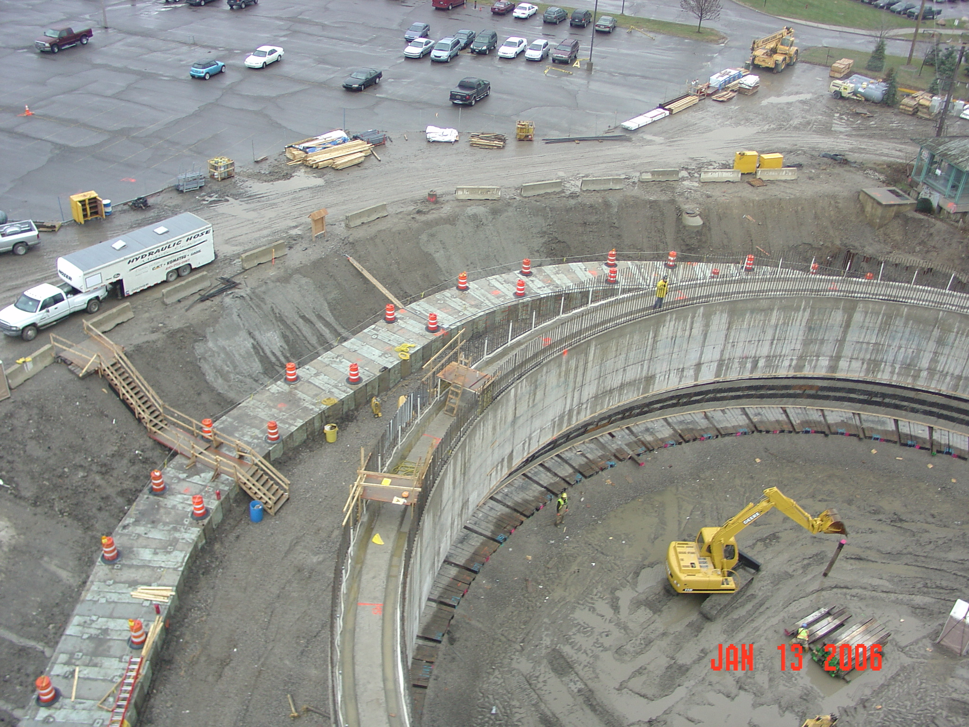

Slide 43
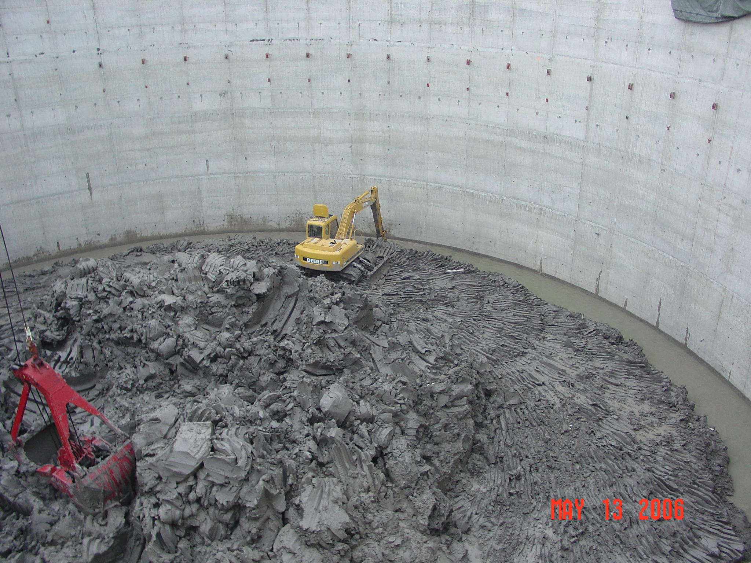

Slide 44
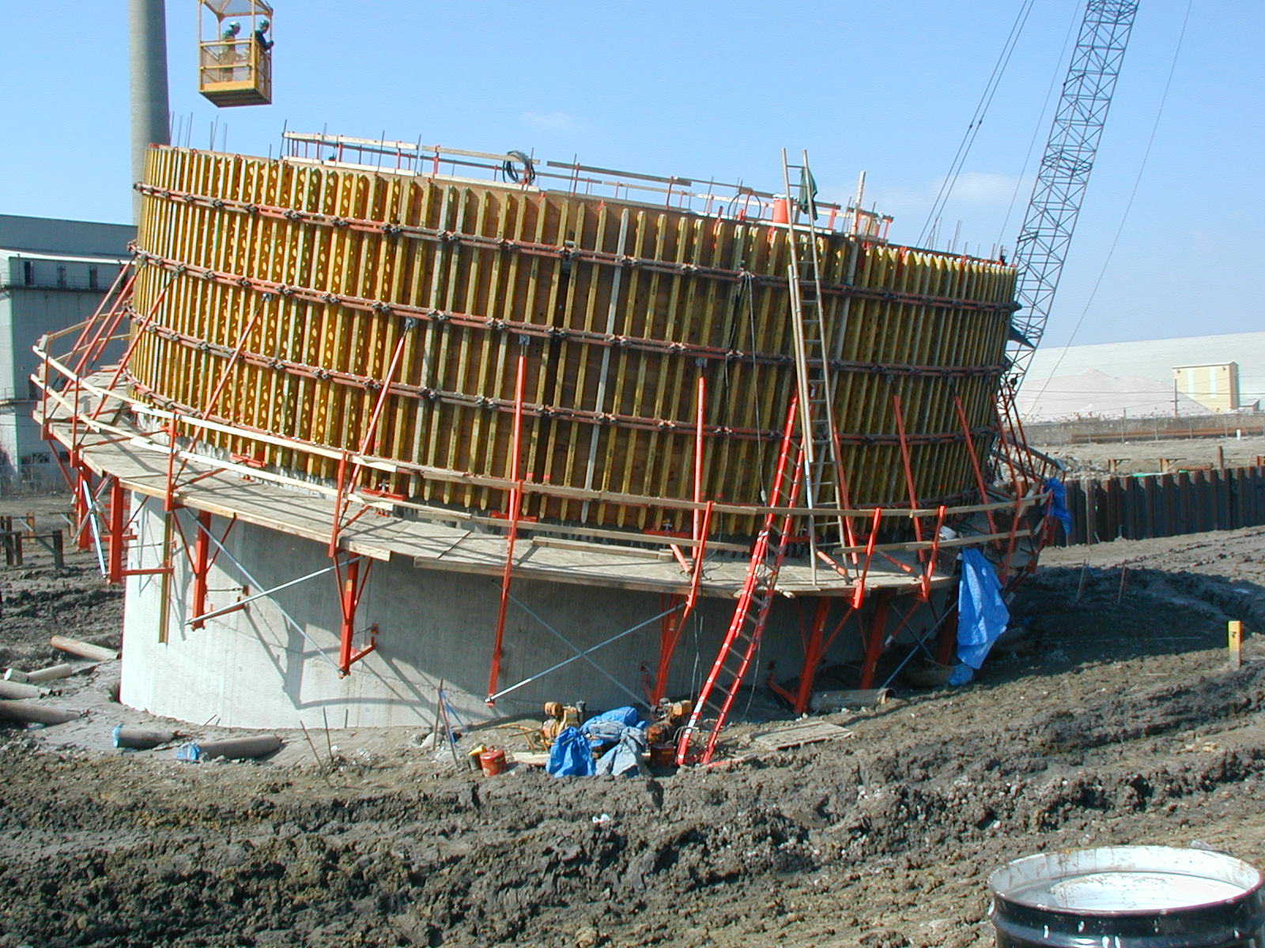

Slide 45
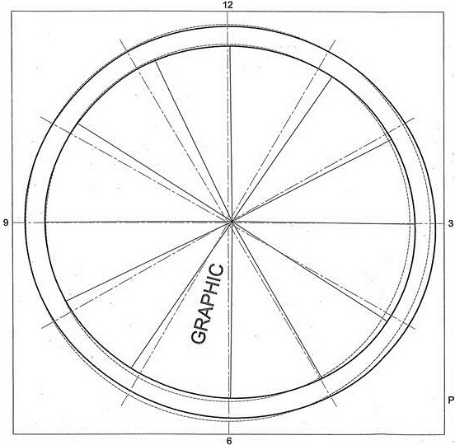

Slide 46
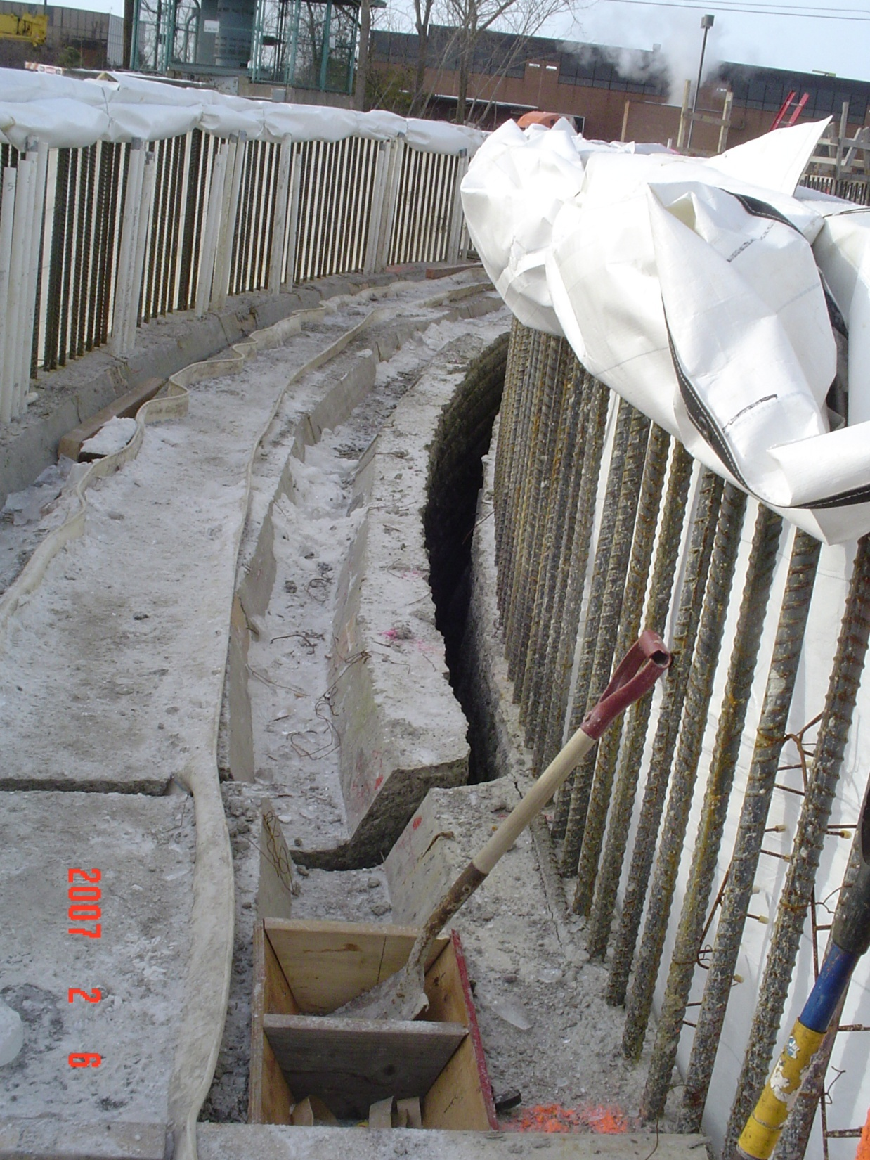

Slide 47
Same engineer Same contractor New design
The Proposed Fix

Slide 48
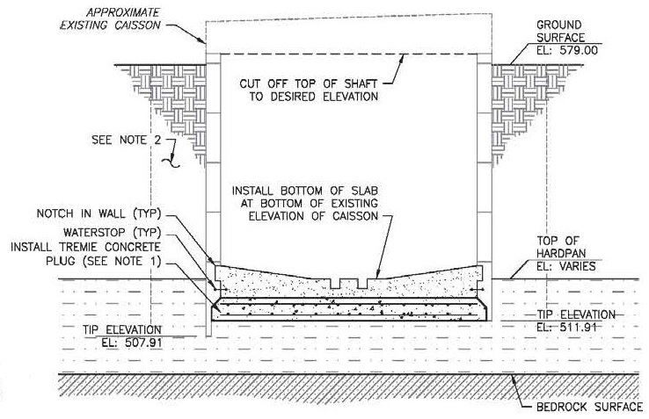

Slide 49
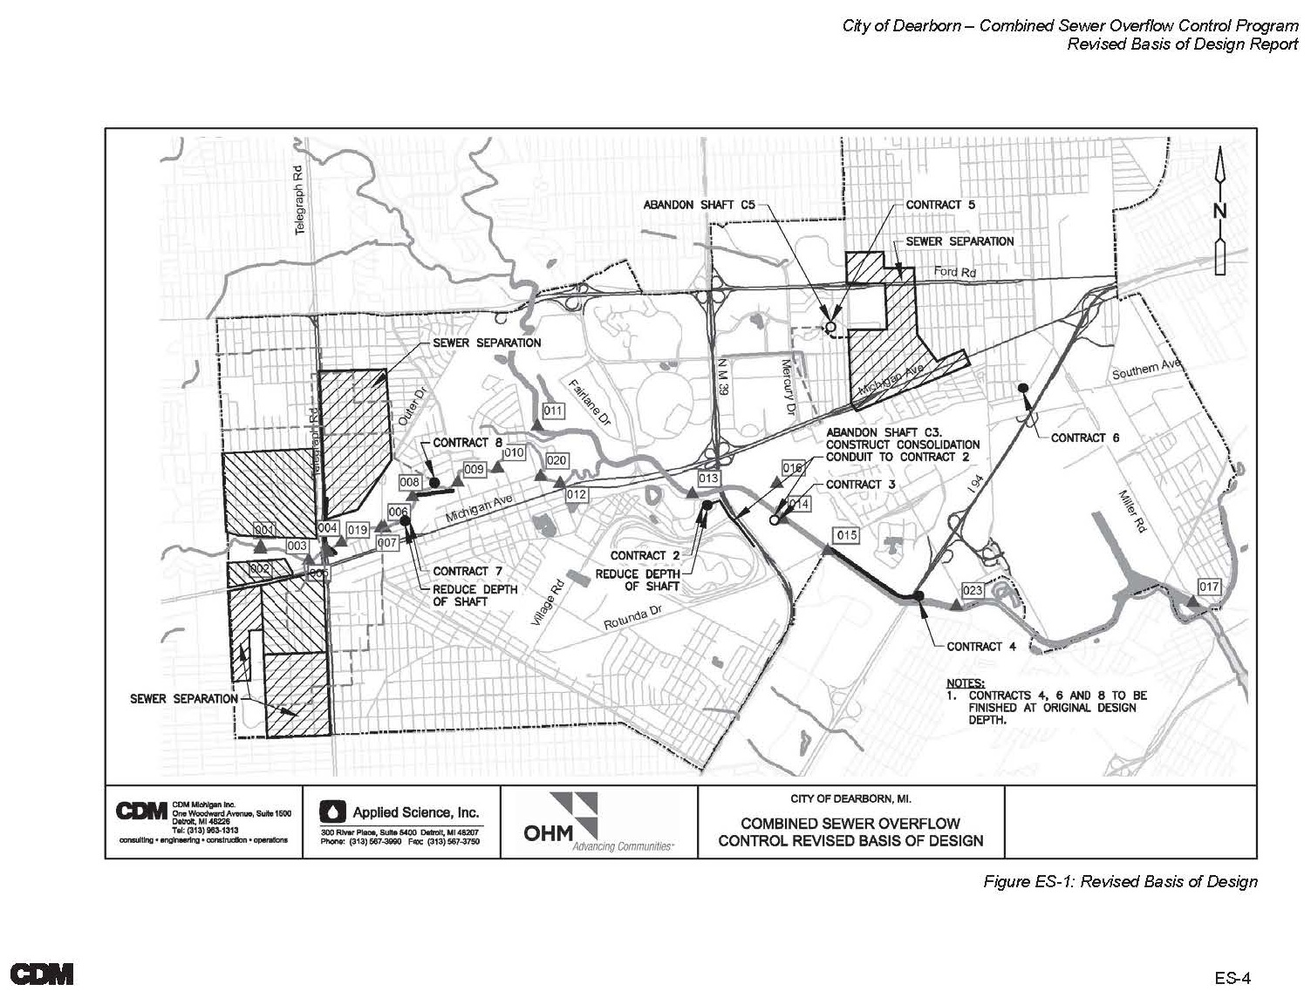

Slide 50
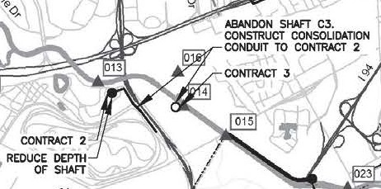

Slide 51
Pros: Eliminate $50 million Exposure Live to see another day
Pros and Cons of New Design

Slide 52

Cons of New Design from same Engineer

Slide 53
Scenario #4

Slide 54


Slide 55


Slide 56
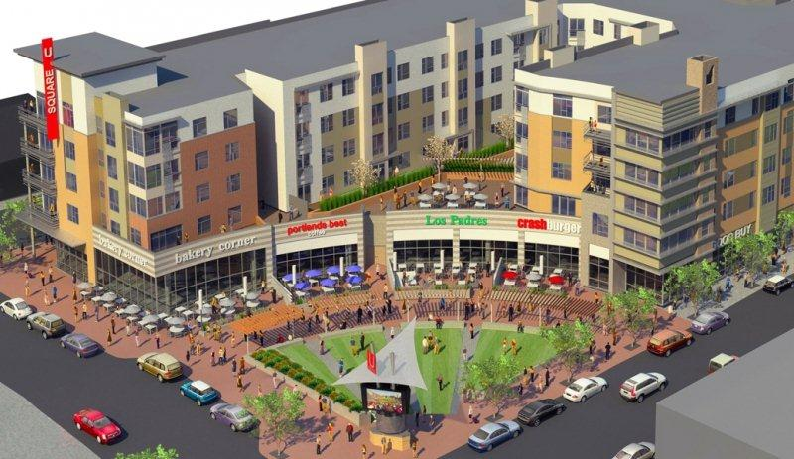

Slide 57


Slide 58


Slide 59


Slide 60
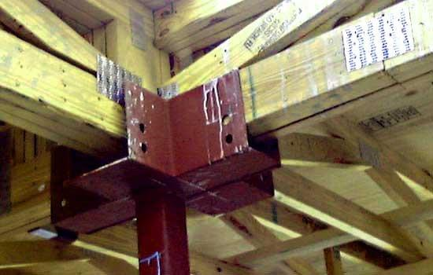

Slide 61
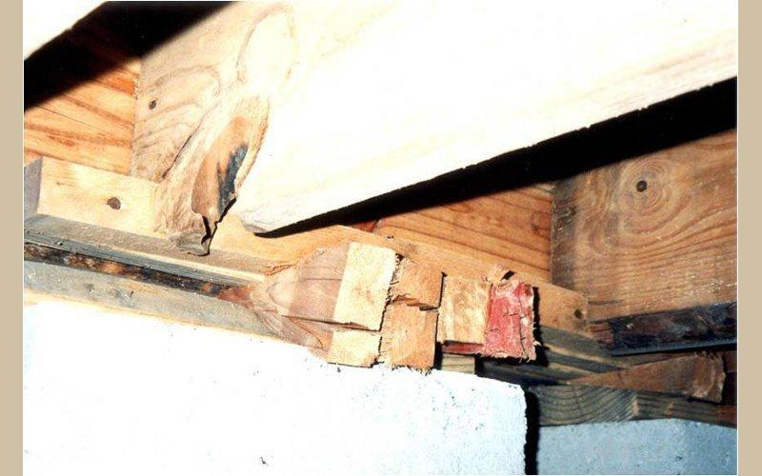

Slide 62
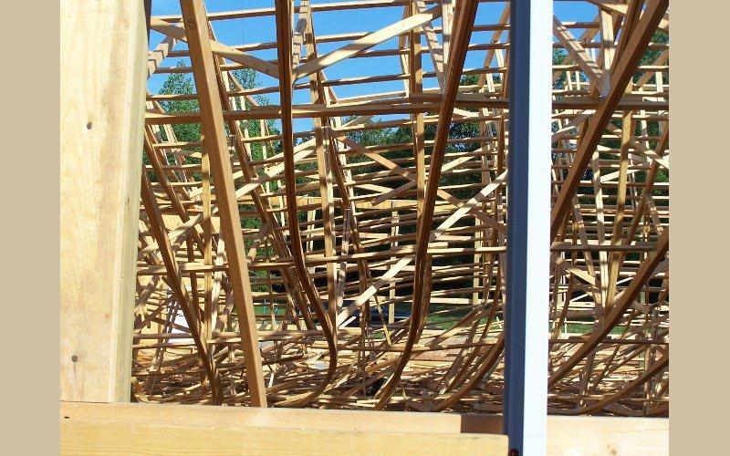

Slide 63
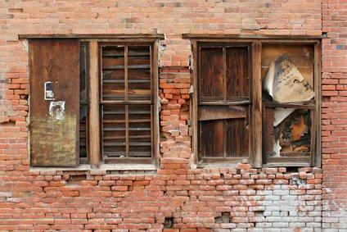

Slide 64
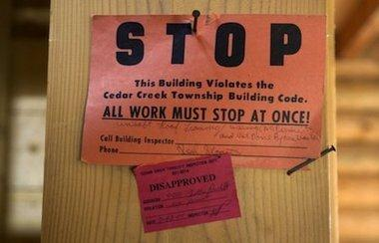

Slide 65
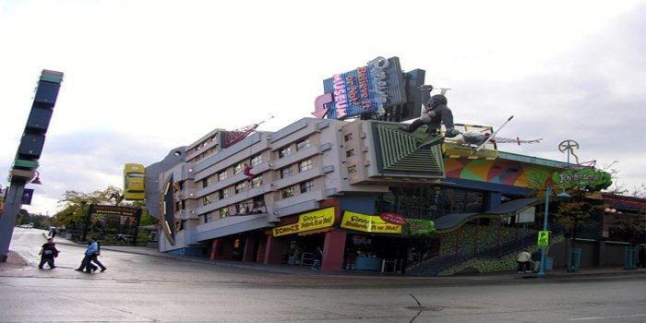

Slide 66
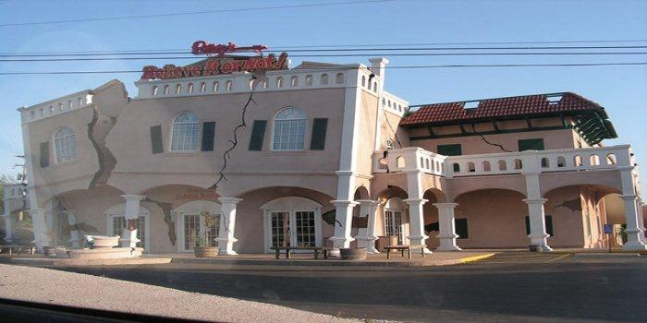

Slide 67
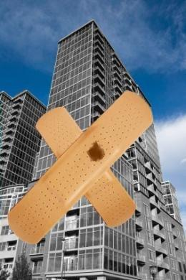

Slide 68


Slide 69
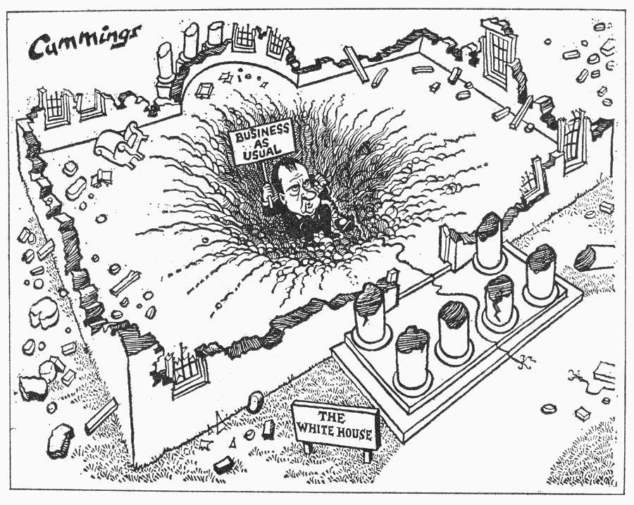

Slide 70
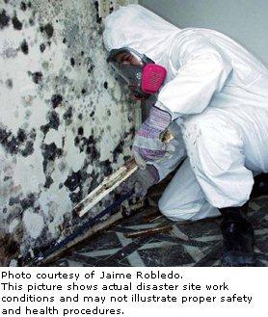

Slide 71


Slide 73
Break….

